Slide 1
International Health Care Management Part 1.3.1
Steffen Fleßa
Institute of Health Care Management
University of Greifswald

Slide 2
Structure
International Public Health
1.1 Background
1.2 Health and Development
1.3 Concepts
2 Demand for Health Services
3 Supply of Health Services
4 Health Systems and Reforms

Slide 3
1.3 Concepts
1 International Public Health
1.1 Background
1.2 Health and Development
1.3 Concepts
1.3.1 Prevention
1.3.2 Primary Health Care
1.3.3 Health Promotion
1.3.4 Recent Developments

Slide 4
1.3.1 Prevention
Content: Preventive measures
Types of prevention (prevention of diseases)
Primary prevention: Activities concerning the prevention of diseases before feasible (biological) damage occurs. Primary goal is the reduction of the incidence rate.
Secondary prevention: Measures to discover early, symptomless stages of disease (Measures of early detection, Health Check-up, Screening), incl. early treatment of detected cases. Primary goal is the reduction of clinical cases.
Tertiary prevention: Measures to prevent the recurrence of a disease after a condition has been treated curatively.

Slide 5
Key Components and Objectives
Key components of prevention
Behavioral prevention
Risk groups
Total population
Situational prevention
Objectives of prevention
Reduction of new cases
Increase in quality of life
Equity
…

Slide 6
Fields of Prevention
Collective prevention
Vaccination
Screening
Prevention for children
Health and safety
Nutrition and nutritional additives
Control of drinking water
Hygiene monitoring
Meat inspections
Constructional standards
Product safety
Workplace conditions
Road safety

Slide 7
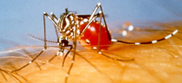
Example: Dengue Control
Dengue Fever(DF)
Agent: Dengue Virus
Flavivirus (as yellow fever, tick-borne encephalitis)
Four serotypes (DEN-1, DEN-2, DEN-3, DEN-4)
Vector: Mosquitoes [Aedes aegypti; Aedes albopictus (Asian tiger mosquito)]
Disease:
Incubation period: 7-10 days
Infection: 3-7 days with flu-like symptoms
Immunity: only against respective serotype

Slide 8
Example: Dengue Control
Dengue-hemorrhagic fever
Hemorrhagic fever: fever with bleeding tendency
Course of disease:
Flu-like accompanied by a bimodal fever
Second maximum fever usually accompanied by heavy bleeding
Shock syndrome, bleeding into all body cavities, death
Emergence:
controversial
Theory: Infection of somebody who is immune against one serotype with a different one

Slide 9
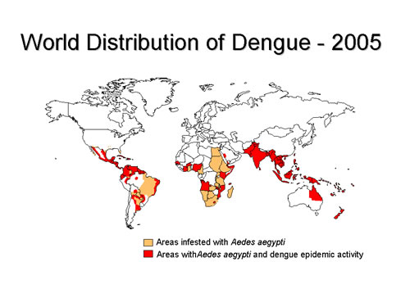
Spread
Endemic area: 2,5 billion people
Incidence: several 10 to 100 million
95 % of infected are children
Mortality:
2-5 %, primarily children and youth
Fatality in children < 1 year: 30 %

Slide 10
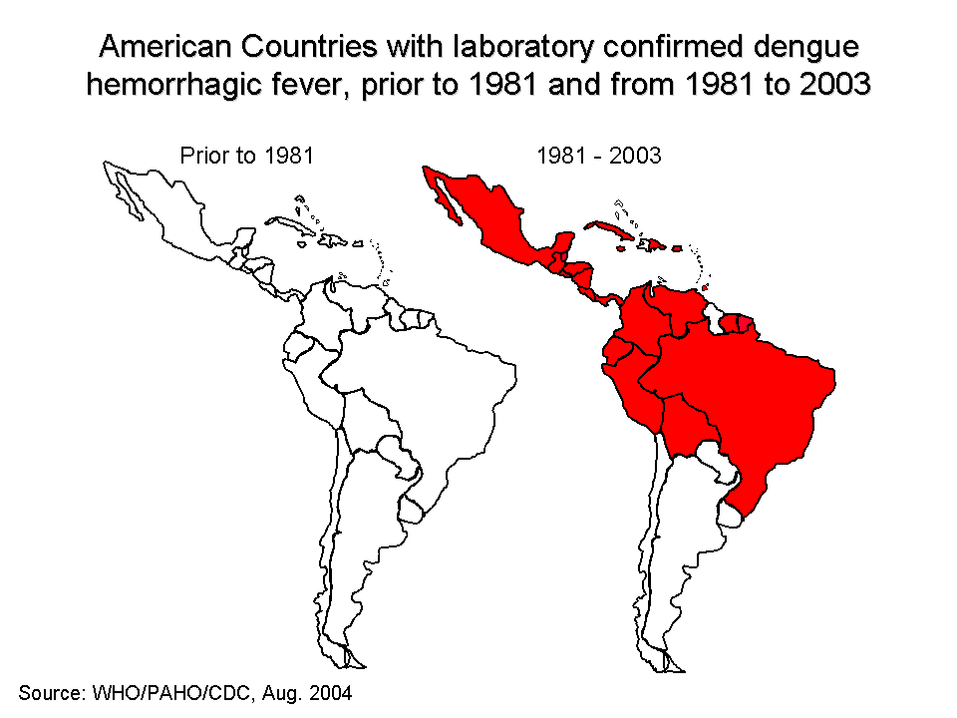
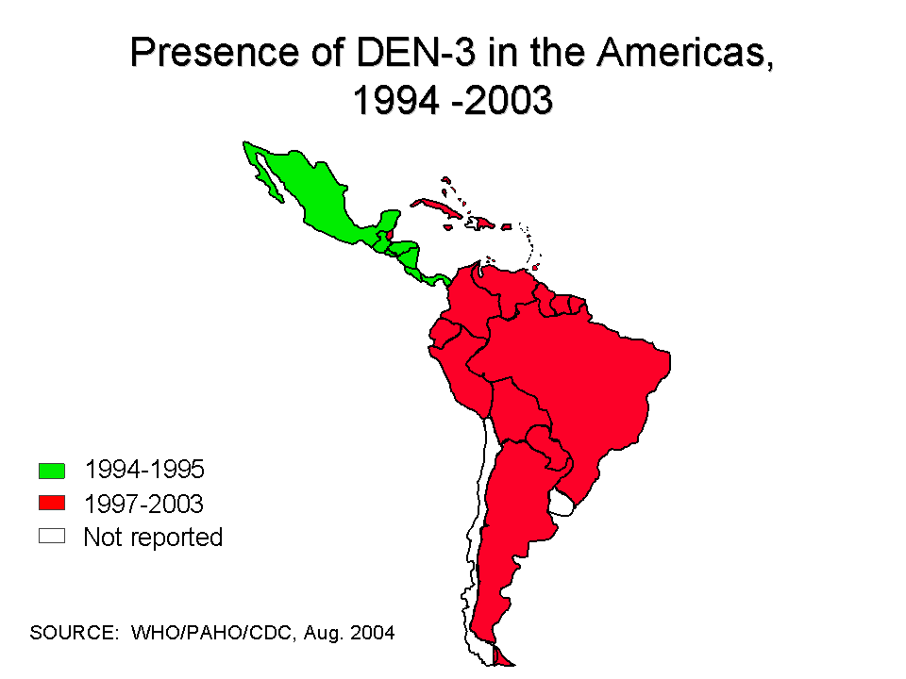
Trend

Slide 11
Disease Control
Control of adult mosquitoes
Vacuuming mosquitoes (use of attractants)
DDT spraying of interior walls (1950-1960)
problem: development of resistance
Control of larvae and pupae
„Abate“ for water disinfection
problem: damage to health
Bacteria to fight larvae
Chlorination
Reduction of hatcheries
Draining swamps
Reduction of water jars in settlements

Slide 12
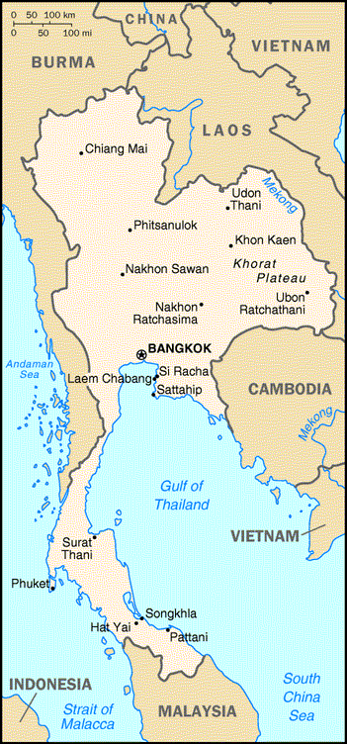
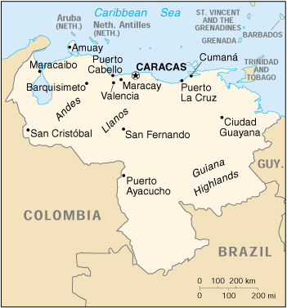
Example: Dengue Control in Venezuela and Thailand
Basic problem: water jars for water supply

Slide 13
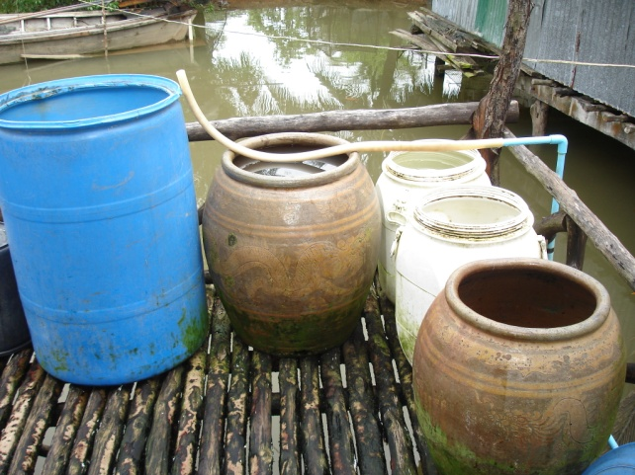
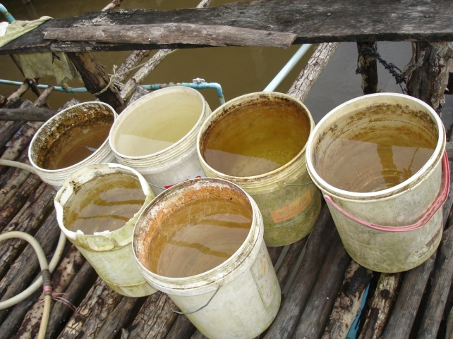
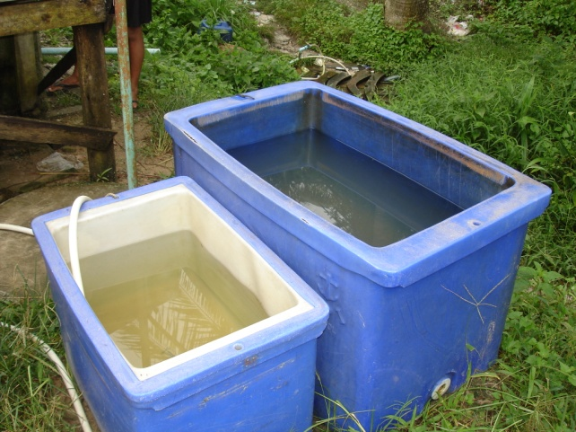
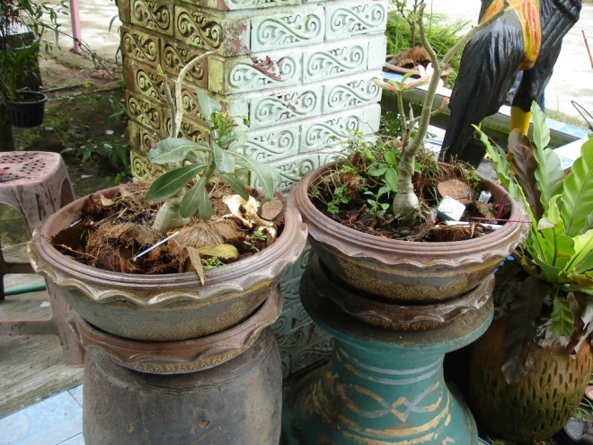
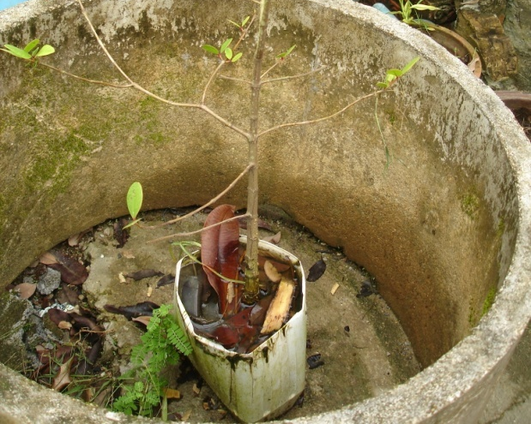
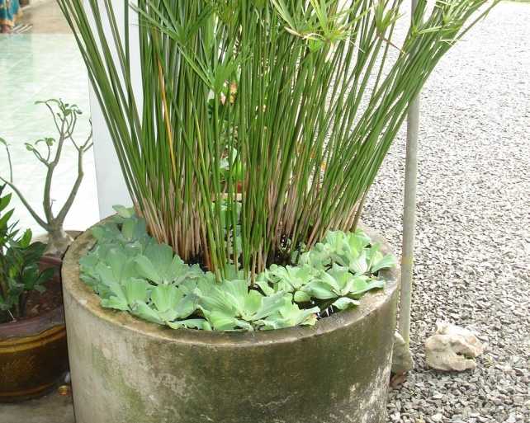
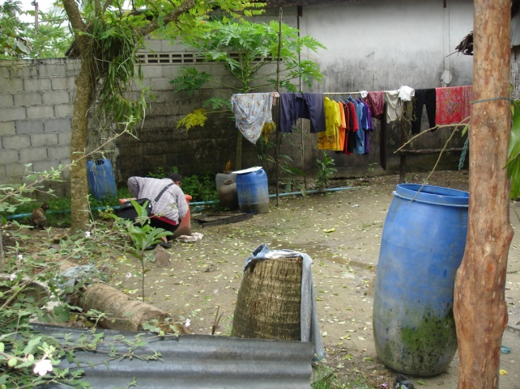
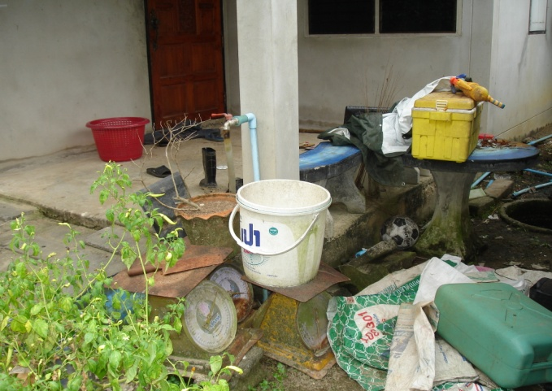
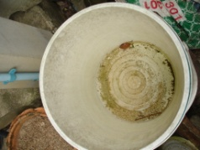

Slide 14
Solution
Impregnated curtains
Water jar covers

Slide 15
Distribution of Curtains

Slide 16
Installation

Slide 17
Collaboration with Village Health Workers

Slide 18
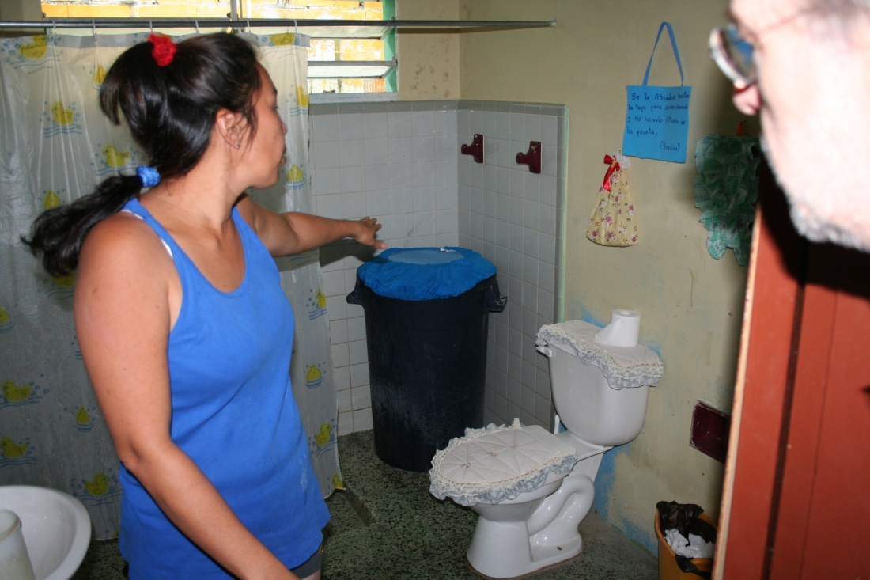
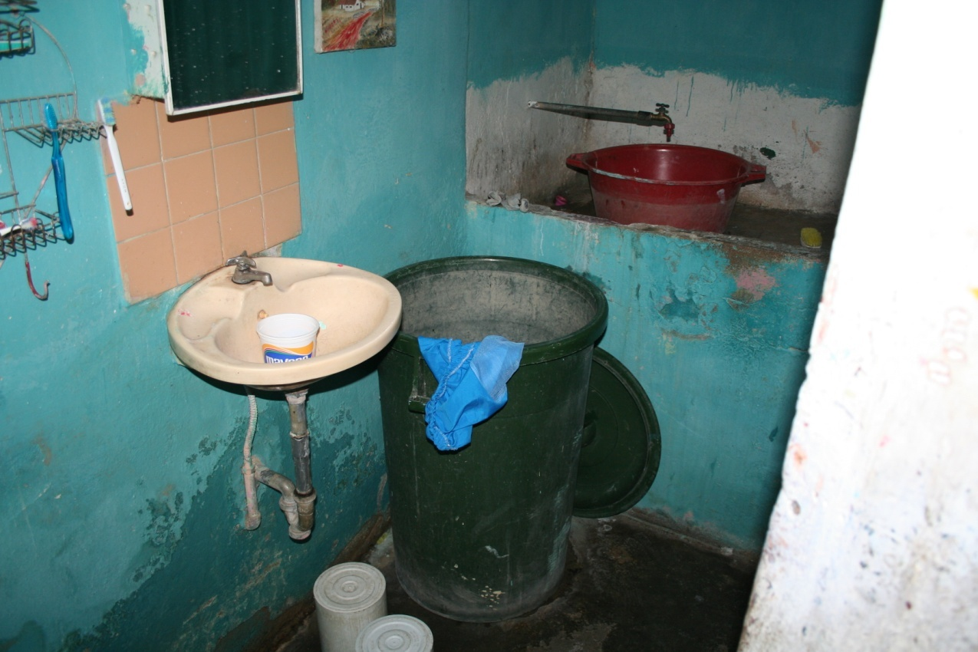
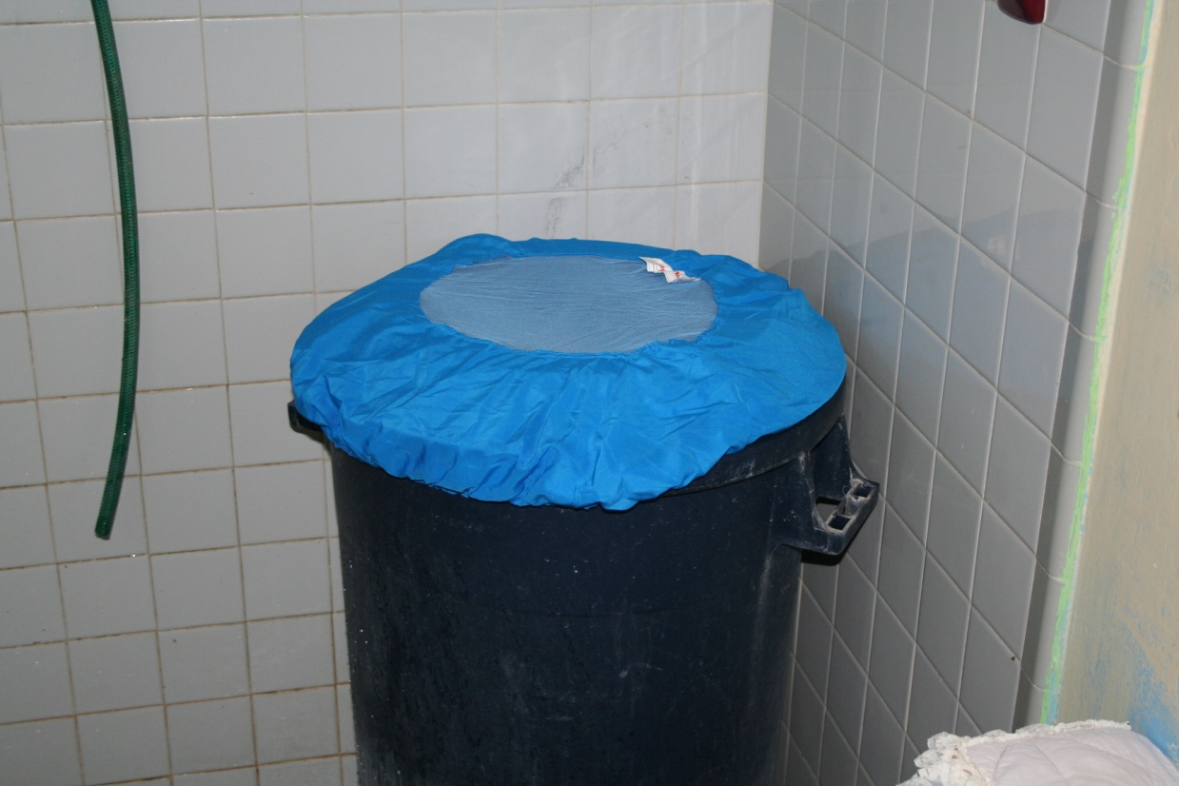

Slide 19
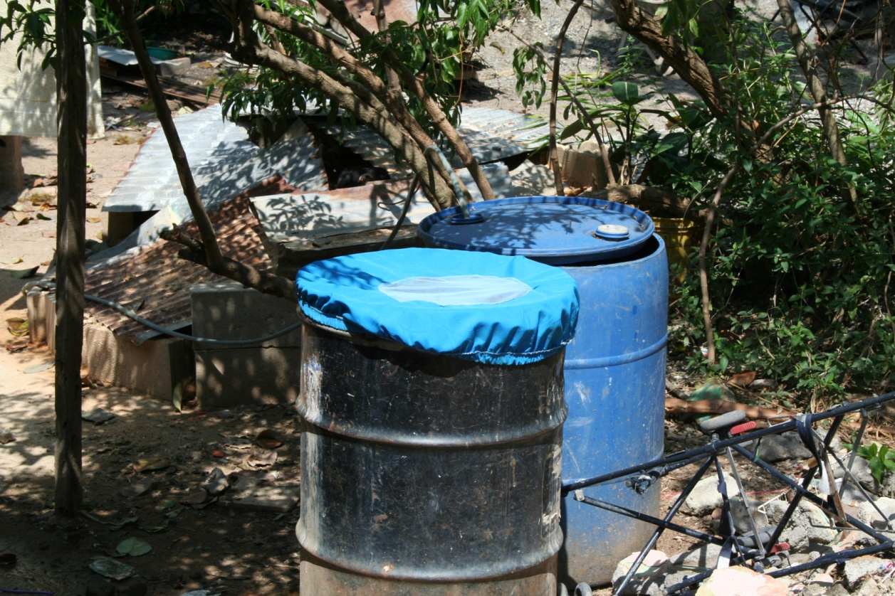
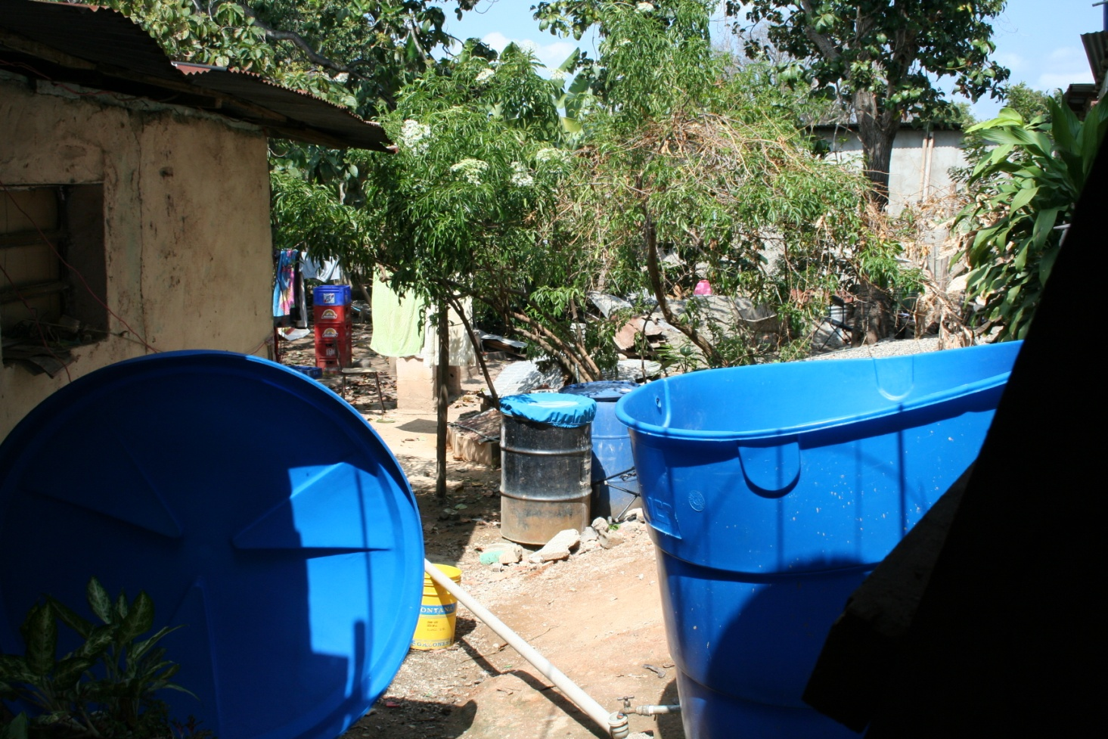

Slide 20
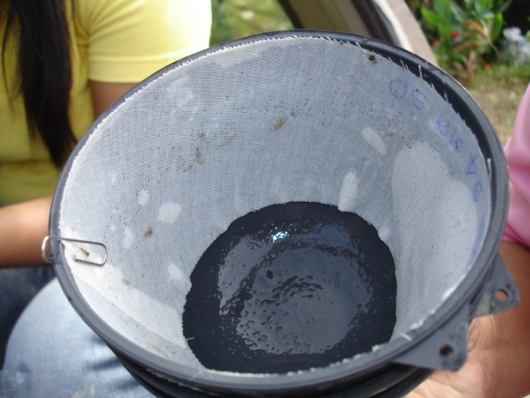
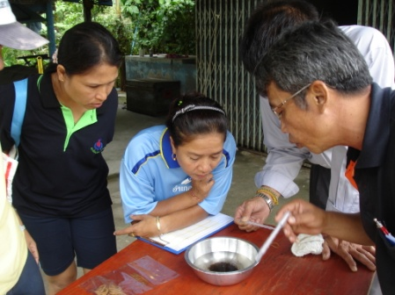
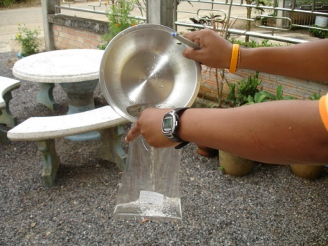
Research Methods
Ovitraps: eggs
Determining larvae

Slide 21
Results: Venezuela
Amount of water tanks containing Aedes Larvae per 100 households (Breteau index)
Study Arm | Baseline (July 2006) | 1-month (Sept. 2006) | 8-months (April 2007)
Curtains | 10.4 | 8.7 | 6.9
Jar covers | 12.7 | 7.7 | 8.2
Curtains + Jar covers | 23.3 | 9.2 | 0.4
Control | 6.2 | 8.5 | 11.6
External control | 15.1 | 11.8 | 14.1

Slide 22
Extent of Effectiveness and Relative Efficiency of ITC in Comparison to Standard Spraying

Slide 23
Consequences
Primarily Dengue is no medical issue
Primarily Dengue is an issue of stable supply with drinking water
Civil engineering is more important than other measures

Slide 24
1.3 Concepts
1 International Public Health
1.1 Background
1.2 Health and Development
1.3 Concepts
1.3.1 Prevention
1.3.2 Primary Health Care
1.3.3 Health Promotion
1.3.4 Recent Developments

