Slide 1
International Health Care Management I Part 1.1-1
Steffen Fleßa
Institute of Health Care Management
University of Greifswald

Slide 2
Epidemiology of Non-Infectious Diseases
Demand for Health Services
Epidemiology of Non-Infectious Diseases
Overview
Example: Diabetes Mellitus Type II
Example: Cervix Uteri Carcinoma
Example: Cataract
Risk Factors
Filter Between Need and Demand

Slide 3
1.1.1 Overview
Problem:
Multi-Cause-Multi-Effect Model
Not yet a general concept
Problems of Distinction:
Infectious diseases may become chronic
Infections have a certain role in chronic-degenerative diseases
i.e. Cervix Carcinoma, Gastric Cancer, Liver Cancer
i.e. Caries

Slide 4
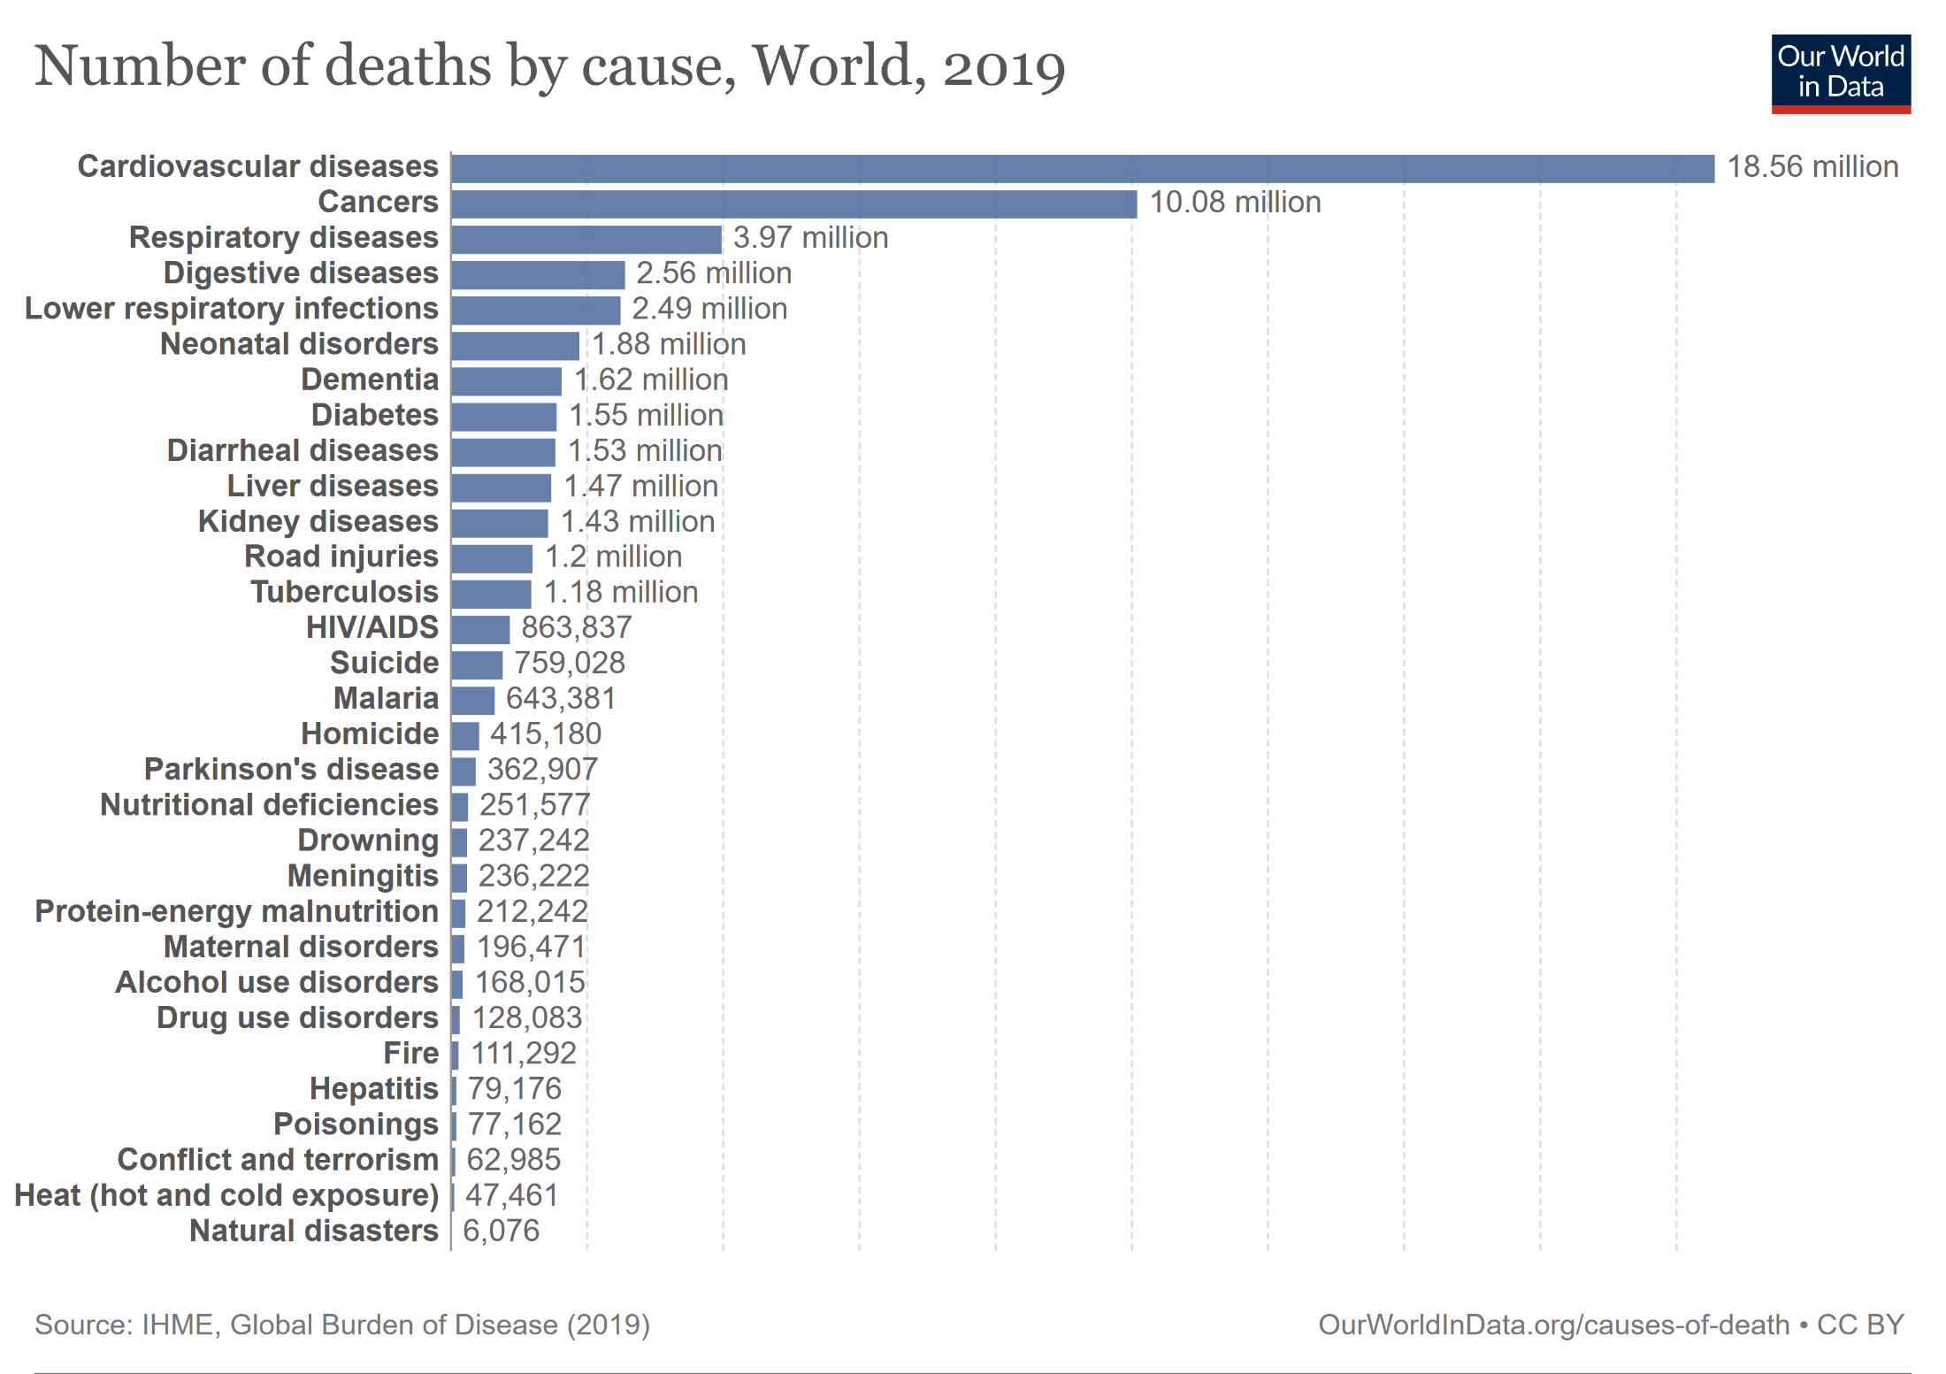
Relevance (WHO 2007)
https://ourworldindata.org/grapher/share-of-deaths-by-cause

Slide 5
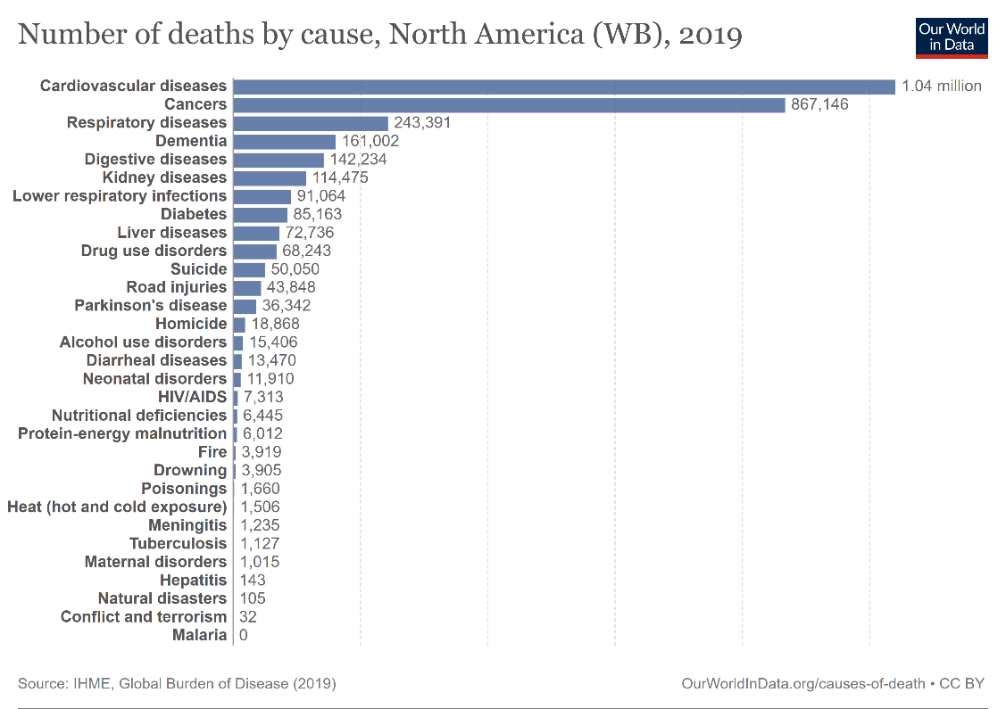
Causes of Death in Africa and North America

Slide 7
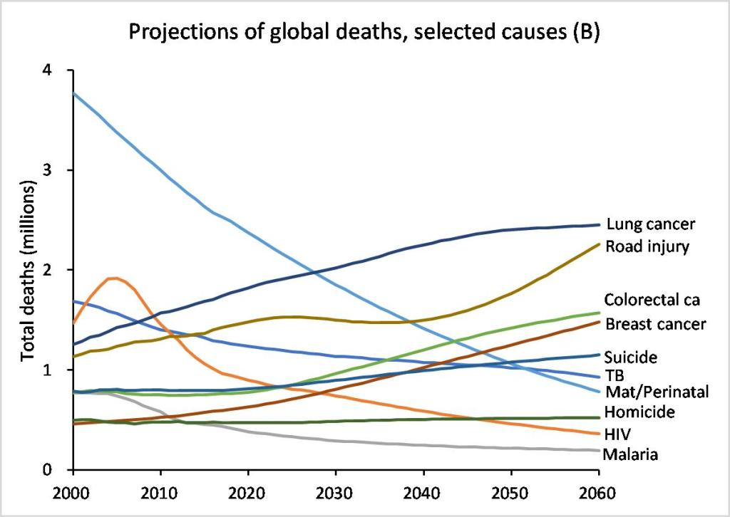
Projections of global deaths
https://colinmathers.com/2022/05/10/projections-of-global-deaths-from-2016-to-2060/

Slide 8
Mortality Risk: absolute
Mortality (per 100.000 pop., age adjusted)
WHO-Region | Cardio- Vascular Diseases | Cancer | Injuries
Africa | 404 | 144 | 133
Americas | 214 | 132 | 63
South-East Asia | 395 | 111 | 106
European | 354 | 144 | 80
Eastern Mediterranean | 455 | 100 | 95
Western Pacific | 245 | 142 | 72
Global | 315 | 132 | 87
Germany | 211 | 141 | 29
Notes:
2

Slide 9
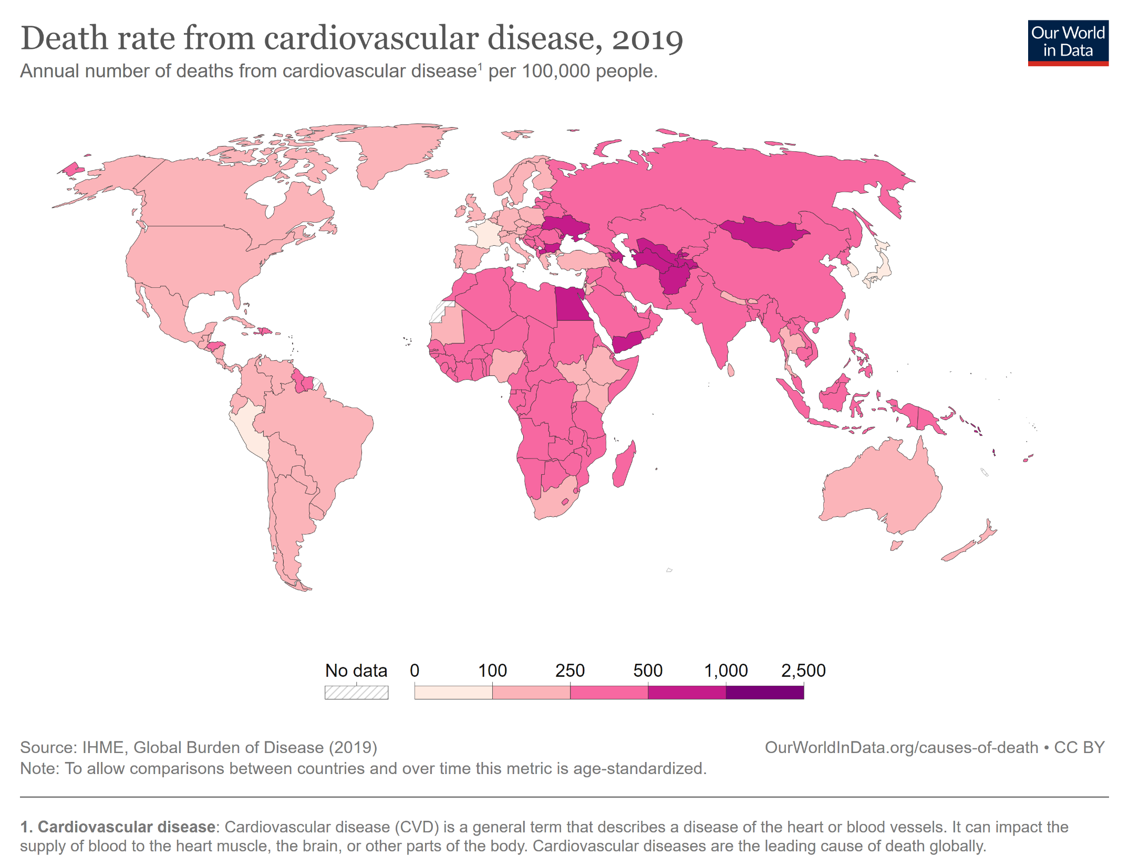

Slide 10
Mortality in Germany
https://www.destatis.de/EN/Themes/Society-Environment/Health/Causes-Death/_node.html
The absolute risk of dying from a chronic disease in developing countries is higher than it is in Germany
The relative risk (in comparison to other diseases) is lower in developing countries
Notes:
2

Slide 11
Development of Casualties
1845: 0.05 % of death cases due to cardio-vascular diseases
High increase in phase three and four of the epidemiologic transition
Decline since 1990
Less in women than in men
USA: less in Caucasian than in Afro-American population
Higher survival rate since 1990
Lower rates of second and third time infarcts since 1990

Slide 12
Congenital Heart Disease
Congenital: at birth
Genetic disorder
Strongly: Arabic countries
Reason?
http://www.ncbi.nlm.nih.gov/pmc/articles/PMC2765422/

Slide 13
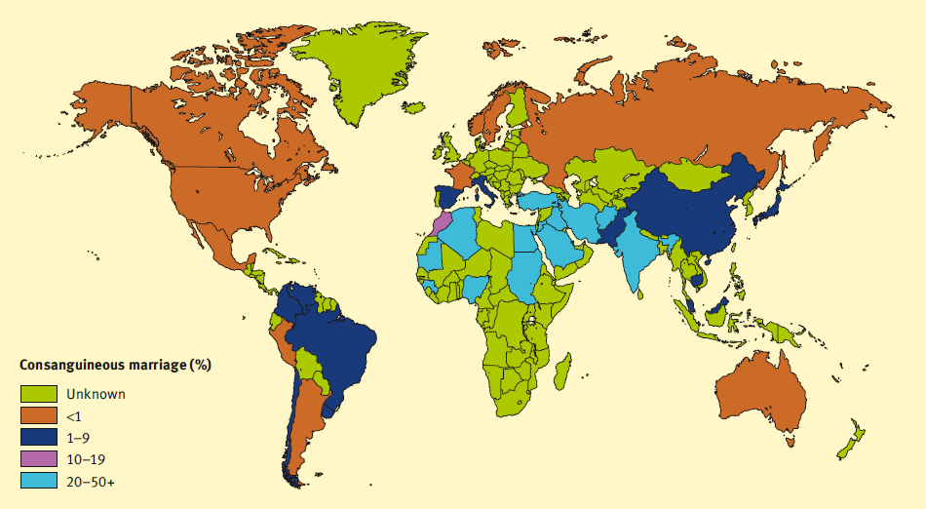
Genetic Disposition of Heart Diseases: Relationship in blood
http://nature-sucks.blogspot.de/2012_01_01_archive.html

Slide 14
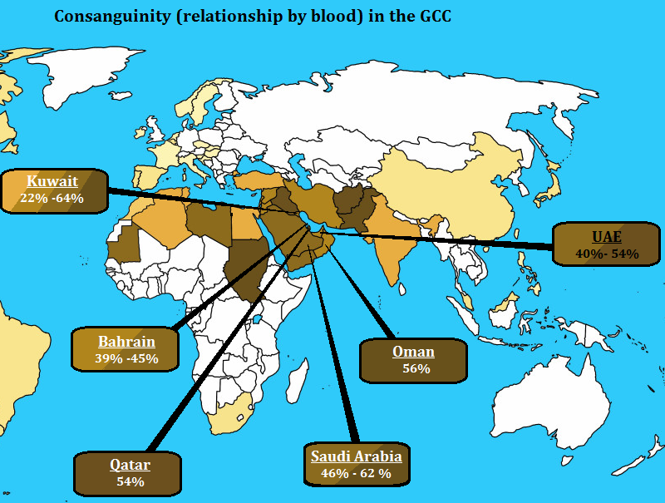
http://www.bqdoha.com/2013/09/gulf-explained-40-maps-part-2

Slide 15
Cancer
Collective name for more than 100 diseases that can occur in any part of the body.
Rapid development of abnormal cells that grow beyond their normal limits
Cancer cells destroy adjacent tissue and spread to other organs (metastases)
Metastases are the main cause of death in cancer

Slide 18
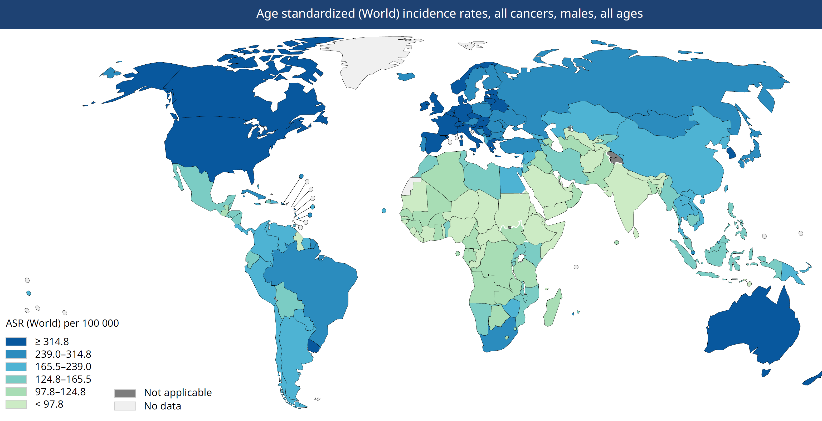
https://commons.wikimedia.org/wiki/File:Cancer_incidence,_OWID.svg

Slide 19
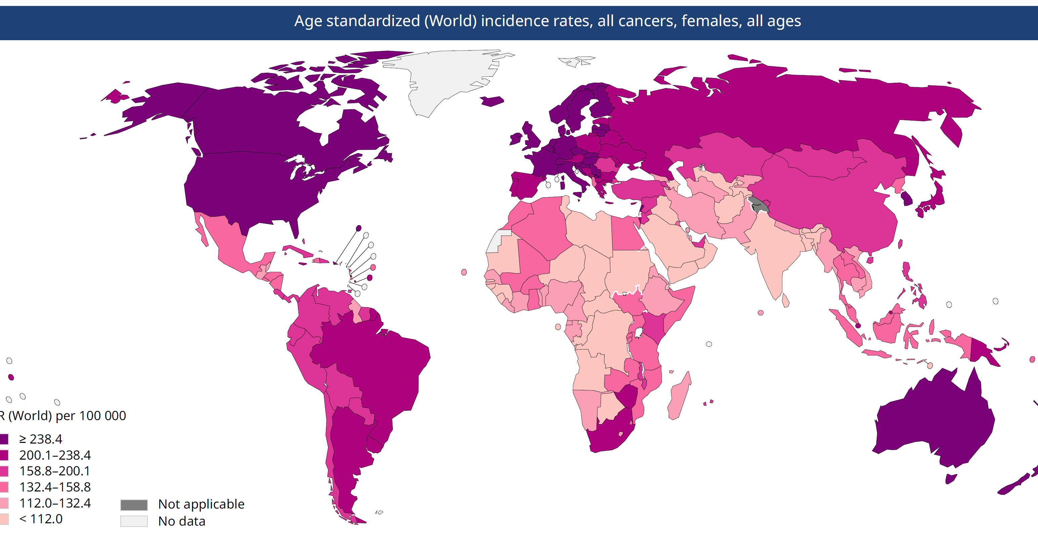
https://commons.wikimedia.org/wiki/File:Cancer_incidence,_OWID.svg

Slide 20
Epidemiology
Mortality:
Main cause of death worldwide
7.6 Million death cases annually worldwide (13 % of total fatalities),
Forms of cancer with high mortality:
Lung cancer (1.3 Mio.)
Gastric cancer (1 Mio.)
Liver cancer (662,000 )
Colon cancer (655,000)
Breast cancer (502,000)
Spread: 70 % of worldwide death cases due to cancer in developing countries
Estimations: 11.3 Mio. death cases due to cancer worldwide in 2030

Slide 21
Examples
Note: extremely varying spatial distribution
Genetic disposition
i.e. low risk of melanoma in Asians and Africans
Habitat / Exposition
i.e. skin cancer in Australia
Behavior
i.e. liver cancer → alcohol, mold
i.e. lung cancer → smoking

Slide 22
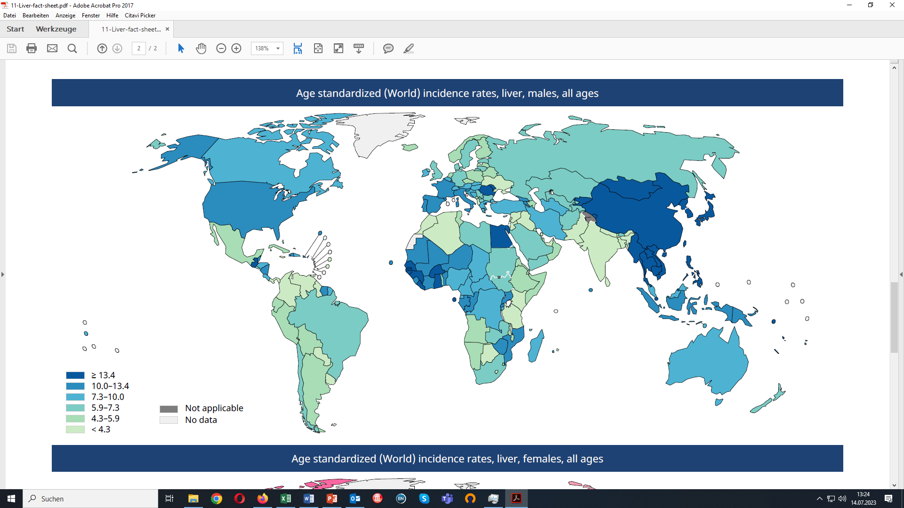
Globocan 2020

Slide 23
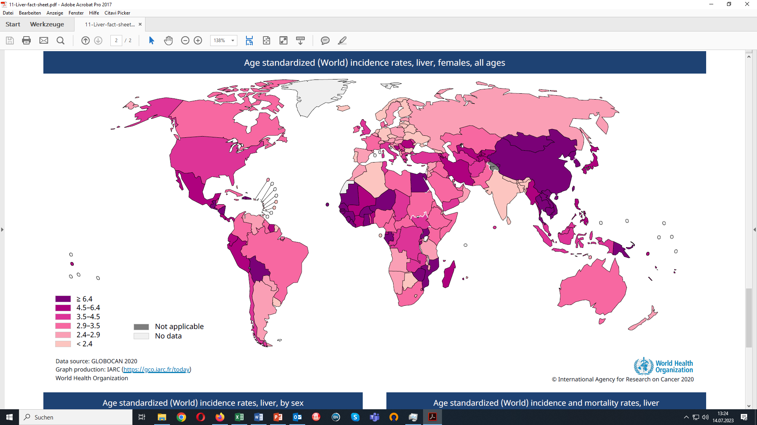
Globocan 2020

Slide 24
Globocan 2020

Slide 25
Globocan 2020
Globocan 2020

Slide 26
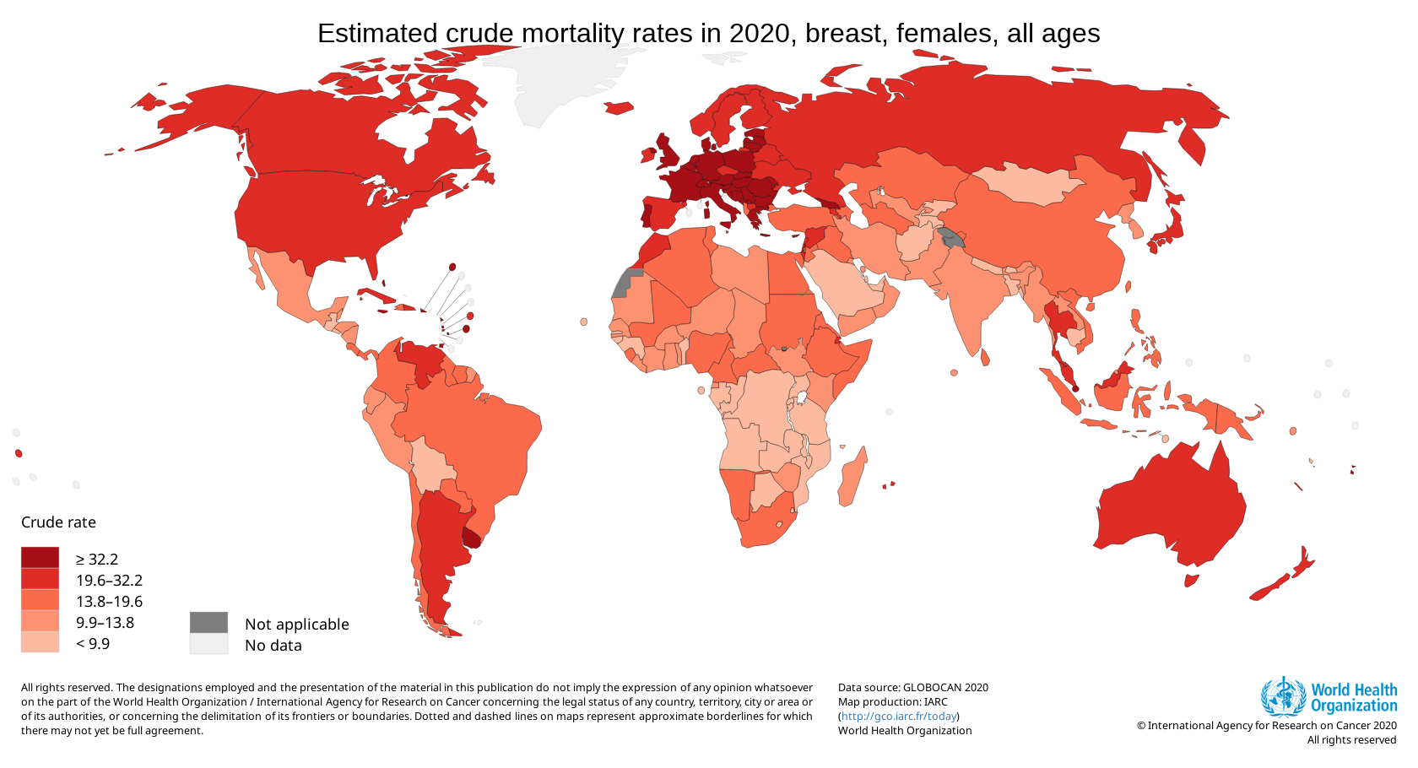
https://gco.iarc.fr/today/online-analysis-map?v=2020&mode=population&mode_population=continents&population=900&populations=900&key=crude_rate&sex=2&cancer=20&type=1&statistic=5&prevalence=0&population_group=0&ages_group%5B%5D=0&ages_group%5B%5D=17&nb_items=10&group_cancer=0&include_nmsc=0&include_nmsc_other=0&projection=natural-earth&color_palette=default&map_scale=quantile&map_nb_colors=5&continent=0&show_ranking=0&rotate=%255B10%252C0%255D

Slide 27
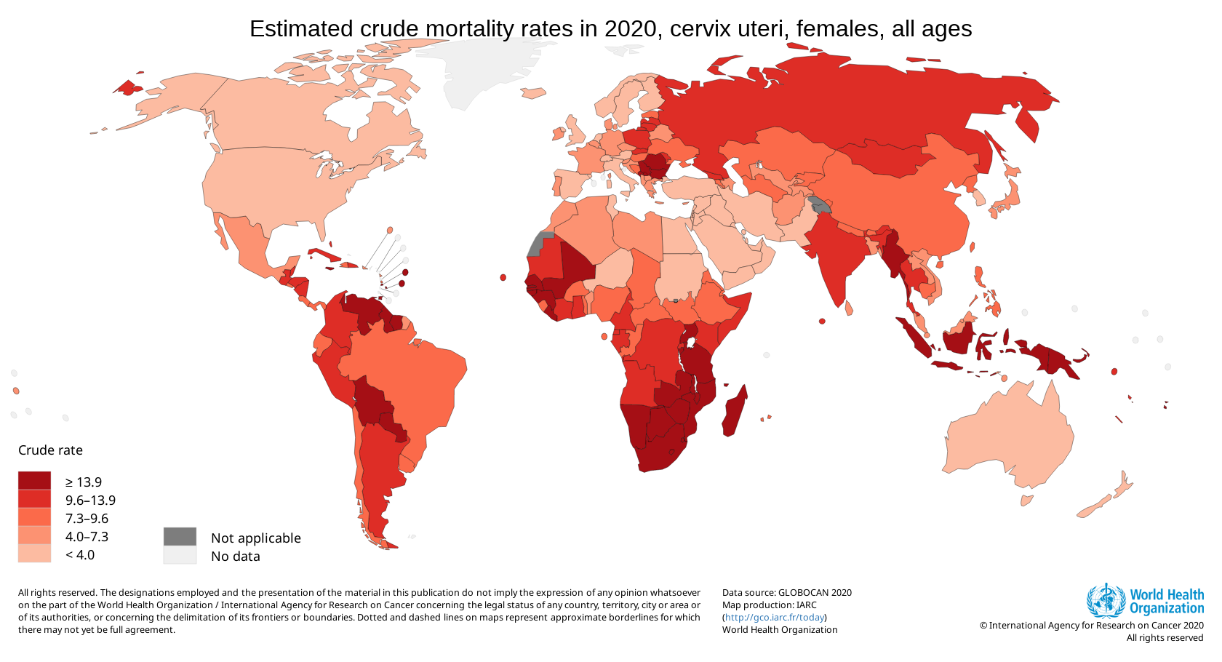
https://gco.iarc.fr/today/online-analysis-map?v=2020&mode=population&mode_population=continents&population=900&populations=900&key=asr&sex=0&cancer=39&type=1&statistic=5&prevalence=0&population_group=0&ages_group%5B%5D=0&ages_group%5B%5D=17&nb_items=10&group_cancer=1&include_nmsc=0&include_nmsc_other=0&projection=natural-earth&color_palette=default&map_scale=quantile&map_nb_colors=5&continent=0&show_ranking=0&rotate=%255B10%252C0%255D

Slide 28
Epidemiology of Non-Infectious Diseases
Demand for Health Services
Epidemiology of Non-Infectious Diseases
Overview
Example: Diabetes Mellitus Type II
Example: Cervix Uteri Carcinoma
Example: Cataract
Risk Factors
Filter Between Need and Demand

