Slide 1
International Health Care Management II Part 1.1-2
Steffen Fleßa
Institute of Health Care Management
University of Greifswald

Slide 2
Epidemiology of Non-Infectious Diseases
Demand for Health Services
Epidemiology of Non-Infectious Diseases
Overview
Example: Diabetes Mellitus Type II
Example: Cervix Uteri Carcinoma
Example: Cataract
Risk Factors
Filter Between Need and Demand

Slide 3
1.1.2 Example: Diabetes Mellitus Type II
World Diabetes Federation
2019:
463 million diabetics worldwide
4.2 million death cases p.a.
760 billion US$ health expenditure
90 % T2DM
80 % of diabetics live in middle or low income countries
2045
700 million cases

Slide 4
T2DM
Type-2-Diabetes
Chronic Degenerative Disease
Insulin resistance
Inadequate insulin secretion of β-cells, spectrum reaches from predominant insulin resistance accompanied by a relative lack of insulin to a predominant defect of insulin secretion accompanied by insulin resistance
Treatment
Diet
Oral therapy
Insulin replacement therapy

Slide 5
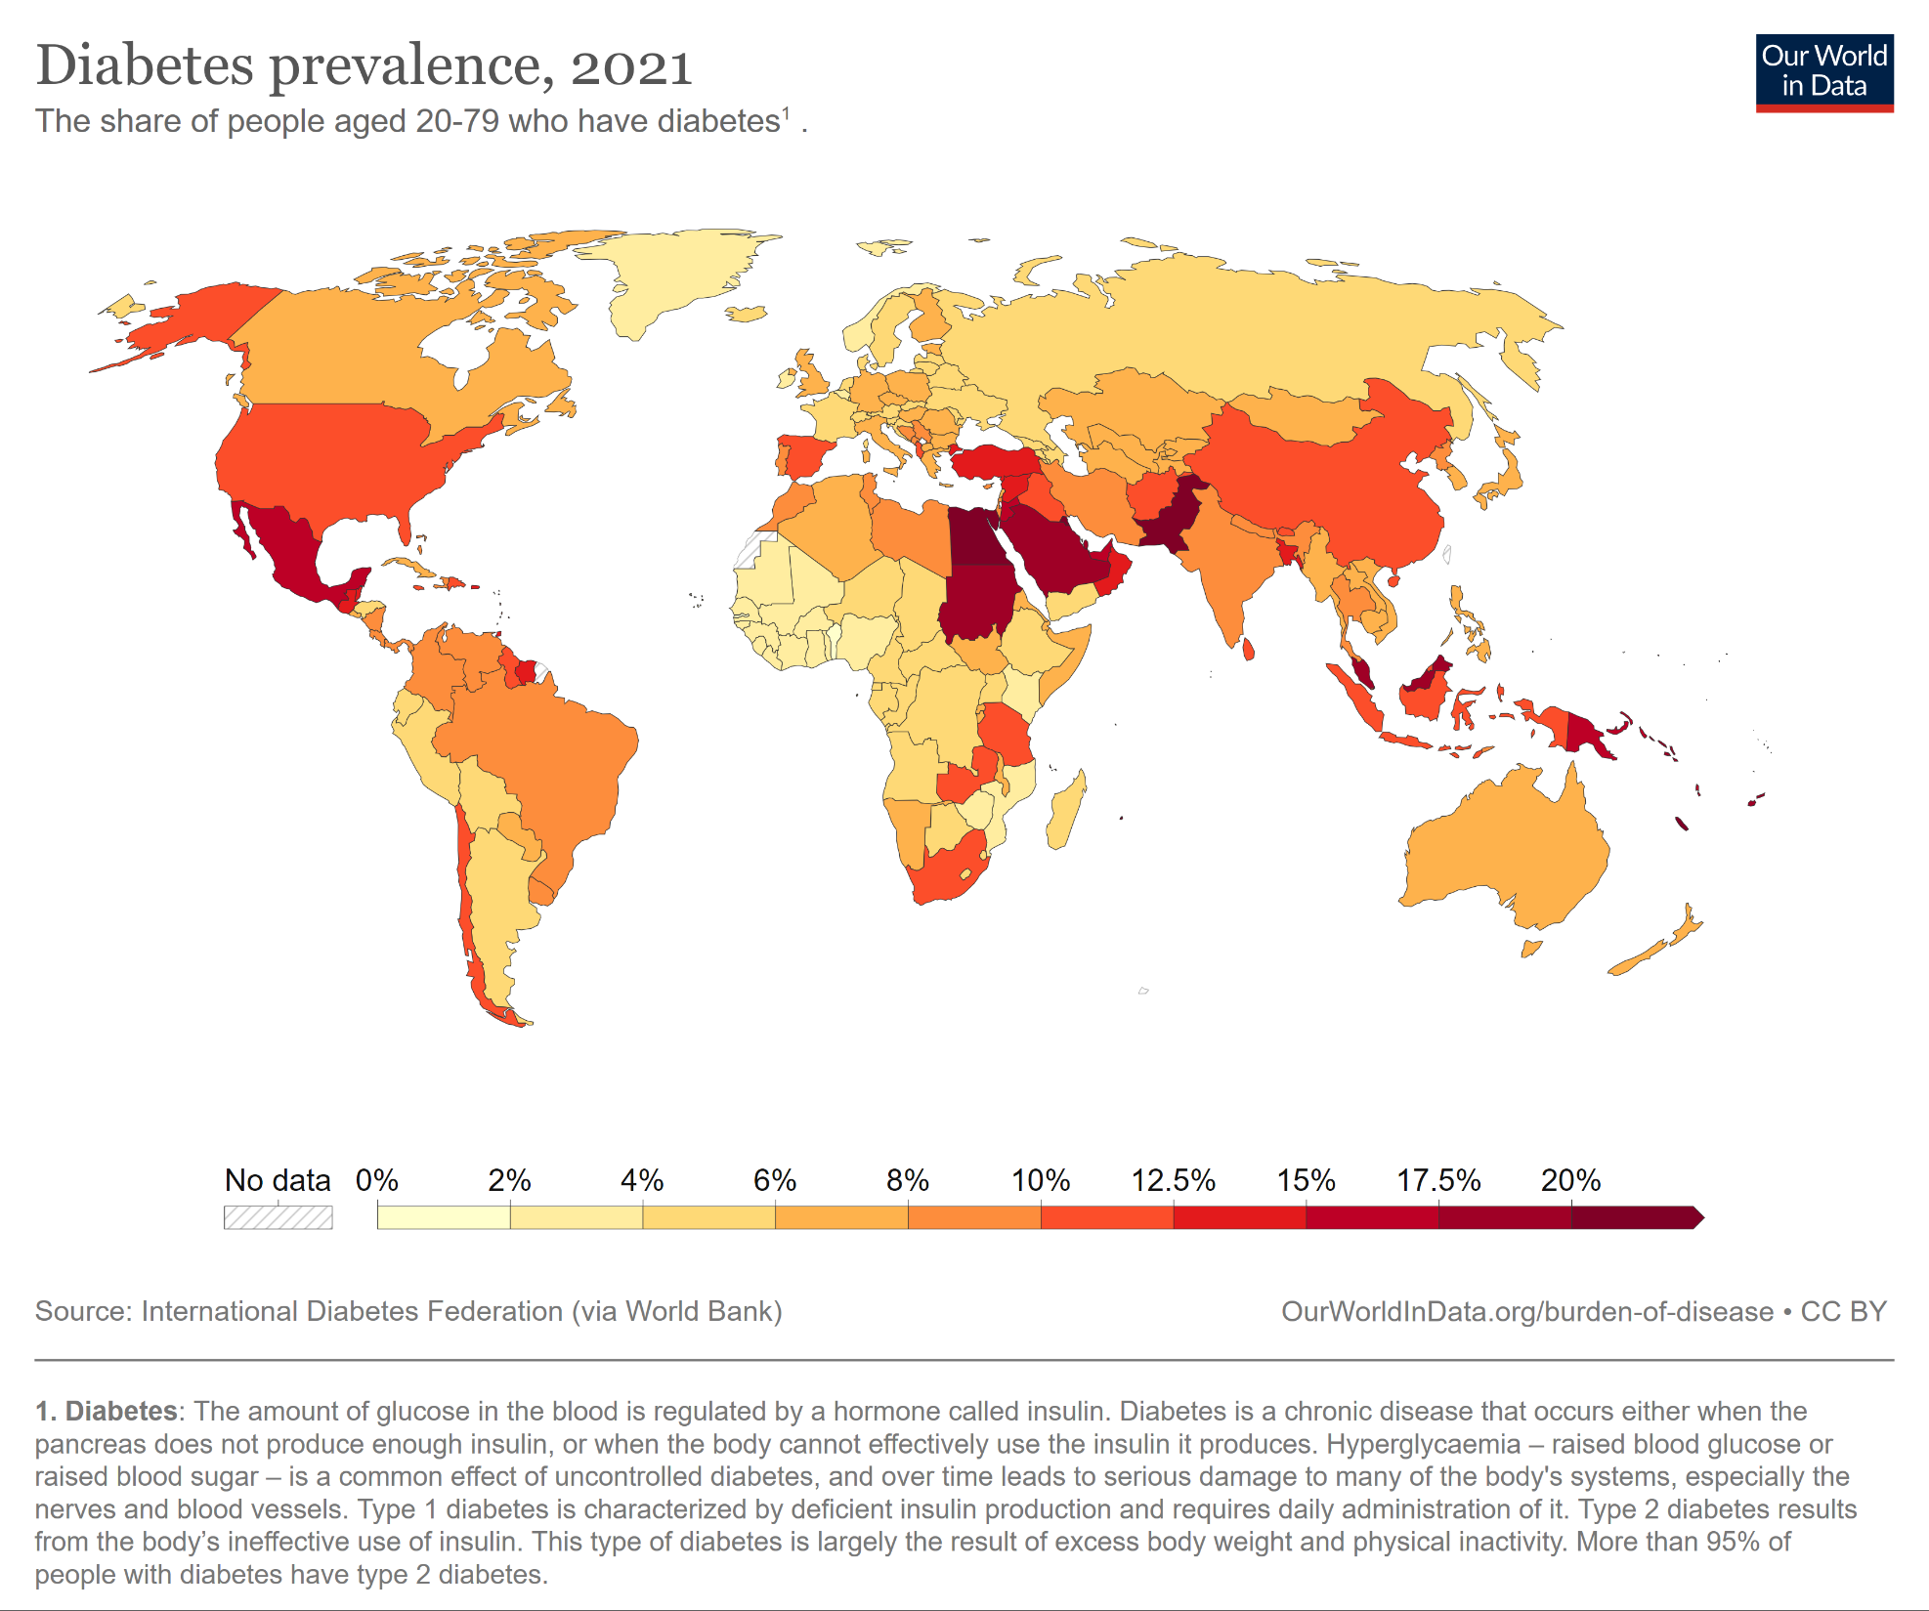
Distribution

Slide 6
Complications
Micro Vascular Complications
Retinopathy (retinal diseases)
Nephropathy (kidney disease, dialysis)
Macro Vascular Complications
Heart Attack
Stroke
Neuropathy (neurological diseases)
Diabetic Foot Ulcers (circulatory disorders of extremities)

Slide 7
Diabetes in Cambodia
WHO STEPS (2010): Population 25-64 years:
2.9 % countrywide
5.6% urban
2.4% rural
exposure to NCD risk factors: 80% had at least one risk factor
Source: WHO 2011
Cambodia epidemiologic survey
Siem Riep province: 4.8 %
Kampong Cham province: 11.4 %
Source: WHO 2011
World Development Indicators 2021: 7,3 % countrywide
https://ourworldindata.org/grapher/diabetes-prevalence?tab=table

Slide 8
Model

Slide 9
Model

Slide 10
Model

Slide 11
Model

Slide 12
Diagnosed and Undiagnosed Cases

Slide 13
Diagnosed Cases With and Without Complications

Slide 14
Therapy of Diagnosed Cases

Slide 15
Budget Impact

Slide 16
Impact of OAD Coverage (current = 12.5 %)
Incremental Cost per Life Saved: 800 US$
(r=5%)

Slide 17
Impact of Insulin Coverage (basic = 12.5 %)
Incremental Cost per Life Saved: 3392 US$
(r=5%)

Slide 18
Epidemiology of Non-Infectious Diseases
Demand for Health Services
Epidemiology of Non-Infectious Diseases
Overview
Example: Diabetes Mellitus Type II
Example: Cervix Uteri Carcinoma
Example: Cataract
Risk Factors
Filter Between Need and Demand

