Slide 1
International Health Care Management II Part 1.1-3
Steffen Fleßa
Institute of Health Care Management
University of Greifswald

Slide 2
Epidemiology of Non-Infectious Diseases
Demand for Health Services
Epidemiology of Non-Infectious Diseases
Overview
Example: Diabetes Mellitus Type II
Example: Cervix Uteri Carcinoma
Example: Cataract
Risk Factors
Filter Between Need and Demand

Slide 3
1.1.3 Example: Cervix Uteri Carcinoma
Agent: Humane Papilloma Virus (HPV)
Numerous subtypes, few of them carcinogenic
Incidence: 500,000 new cases and 270,000 fatalities worldwide p.a.
Transmission: primarily through sexual intercourse

Slide 4
CUC indicence 2020
https://www.thelancet.com/journals/langlo/article/PIIS2214-109X(22)00501-0/fulltext

Slide 5
CUC mortality 2020
https://www.thelancet.com/journals/langlo/article/PIIS2214-109X(22)00501-0/fulltext

Slide 6
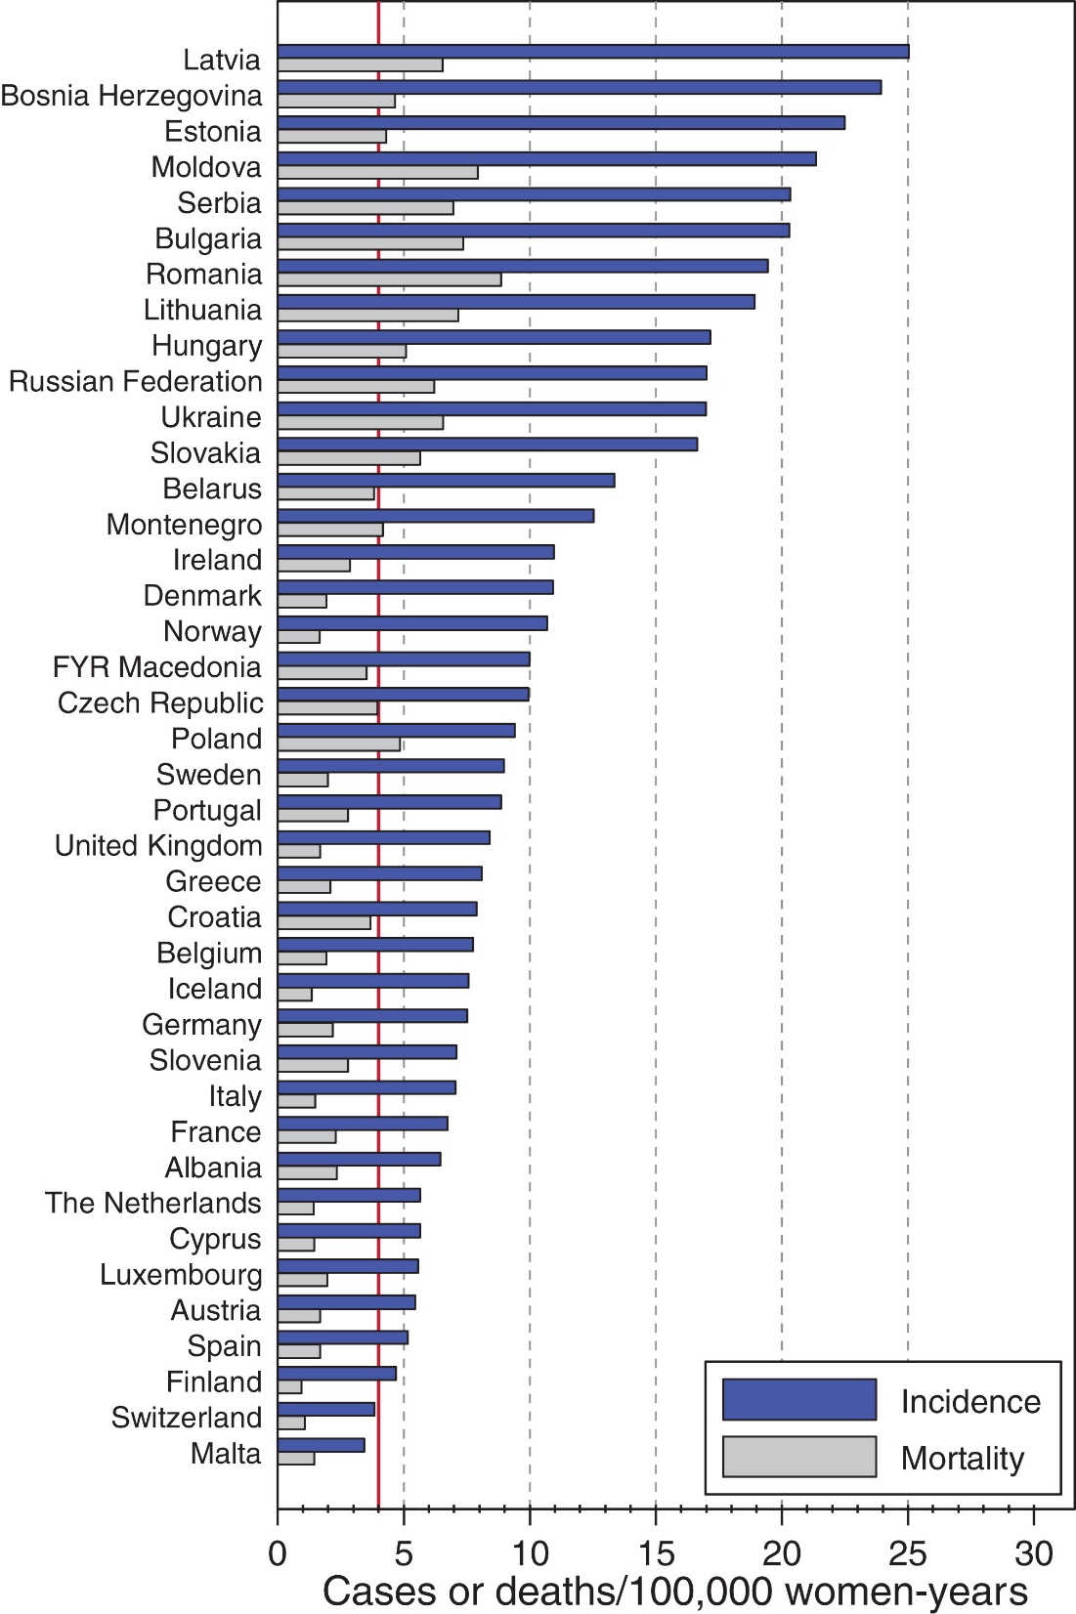
Europe
https://onlinelibrary.wiley.com/doi/full/10.1002/ijc.33189

Slide 7
Cervix Uteri Carcinoma
Prevention:
Vaccination (three vaccines prior to first sexual intercourse)
Screening
VIA: visual inspection with acetic acid
Pap smear
Genetic testing

Slide 8
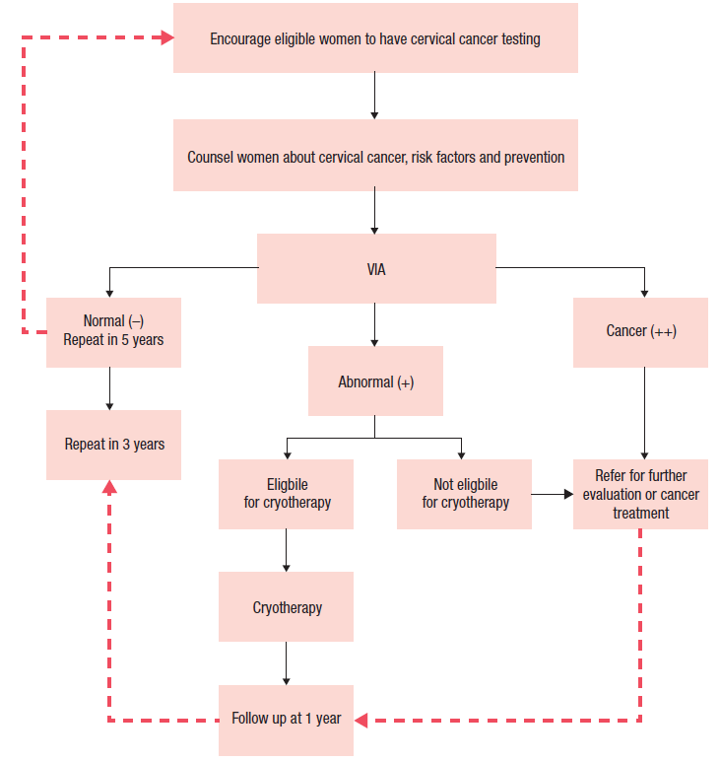
Screening, traditional
WHO 2014

Slide 9
Screening
Source: WHO 2006
loop ex-cision of the transforma-tion zone (LLETZ)
Cervical intraepithelial neoplasia (CIN); CIN 3: Refers to abnormal cells affecting more than two-thirds of the epithelium.
https://screening.iarc.fr/atlasviadetail.php?Index=4&e=

Slide 10
Cervix Uteri Carcinoma
Treatment:
pre-invasive: cryotherapy, “cold coagulation”
invasive: surgery, radiotherapy

Slide 11
Model

Slide 12
Parameter
System | Parameter | Value
Transition | “Healthy, infected” to “lesion” | 16 yrs.
 | “Lesion” to “cancer” | 8 yrs.
 | “Cancer” to “death” | 2 yrs.
Medical | Infectiosity | 50 %
Intervention parameters | Effectiveness vaccine | 90 %
 | Compliance vaccine | 75 %
 | Age VIA screening | 30-49
 | Compliance VIA | 50 %
 | Compliance Cryotherapy | 75 %
 | Screening interval | 3 yrs.
 | Treatment effectiveness | 25 %
Cost parameters | VIA | 2.5 US$
 | Cryotherapy | 7.5 US$
 | Treatment National Hospital | 800 US$
 | Vaccination | 22.5 US$
Sexual activity | Median age at first intercourse (women/men) | 20.8/22.1 yrs.
 | Median age at marriage (women/men) | 20.3/22.6 yrs.

Slide 13
Case Development Cambodia

Slide 14
Incremental Cost Effectiveness Ratio (ICER) of Treatment

Slide 15
Cost of Treatment

Slide 16
Screening (w/o Treatment)

Slide 17
Vaccination (w/o Treatment)

Slide 18
Combined Intervention

Slide 19
Combined Intervention

Slide 20
Epidemiology of Non-Infectious Diseases
Demand for Health Services
Epidemiology of Non-Infectious Diseases
Overview
Example: Diabetes Mellitus Type II
Example: Cervix Uteri Carcinoma
Example: Cataract
Risk Factors
Filter Between Need and Demand

