Slide 1
International Health Care Management II Part 1.1-4
Steffen Fleßa
Institute of Health Care Management
University of Greifswald

Slide 2
Epidemiology of Non-Infectious Diseases
Demand for Health Services
Epidemiology of Non-Infectious Diseases
Overview
Example: Diabetes Mellitus Type II
Example: Cervix Uteri Carcinoma
Example: Cataract
Risk Factors
Filter Between Need and Demand

Slide 3
1.1.4. Example: Cataract
1.1 billion people live with vision loss.
90% of vision loss is preventable or treatable.
Number of people affected by vision loss, 2020
https://www.iapb.org/learn/vision-atlas/

Slide 4
3. Results
Global annual
productivity loss 2018: $410 billion US$ (0.3% of GDP)

Slide 5
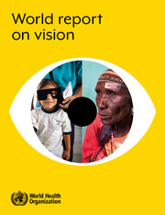
Estimated costs of addressing the coverage gap of services to prevent or address MSVI* and blindness
*moderate and severe vision impairment (MSVI ...
Condition | USD2018
MSVI or blindness causes that are treatable or addressable
Cataract | 8,768,759,000
Unaddressed Refractive Error (Distance) | 6,988,223,000
Unaddressed Refractive Error (Near) | 9,035,476,000
Total | 24,792,458,000
MSVI or blindness causes that are preventable
Diabetic Retinopathy | 19,858,251,000
Trachoma | 494,077,000
Glaucoma | 11,744,642,000
Total | 32,096,970,000
Only 7.8 % of global annual
productivity loss 2018

Slide 6
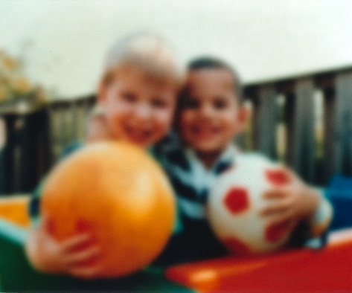
Cataract
Def.: cloudy area in the lens of the eye that leads to a decrease in vision
Main causes: Age (trauma, radiation, smoking,…)
Prevalence worldwide:
50 % of blindness worldwide
33 % of visual impairment worldwide

Slide 7
Age-standardised DALY rates (per 100 000) by location, both sexes, 2019
https://www.healthdata.org/results/gbd_summaries/2019/cataract-level-4-cause

Slide 8
Cataract Surgery
https://twitter.com/HelpMeSee/status/964246739975892992/photo/1

Slide 9
Example: Cataract in Africa
Onset | 60
Life expectancy | 70
Pension age | 60
Age:
Interest: 5 %
Productivity loss:
Cost:
Quality of Life:
 | Patient | Care giver
Mild impairment | 5% | 0%
Severe impairment | 30% | 5%
Blindness | 60% | 25%
GNI p.a. p.c. | $1.100,00
Cost treatment p.a. | $20,00
surgery (2 eyes) | $300,00
 | operated | mild impair. | severe impair. | blind | healthy
Quality of Life | 0,75 | 0,7 | 0,6 | 0,5 | 0,9

Slide 10
Cost-Effectiveness of Cataract Surgery
Total net value cost
without surgery: 162.16 US$
with surgery: 300 US$
Additional cost of surgery: 137.84 US$
Net value of quality of life
without surgery: 5.68 QALYs
with surgery: 7.5 QALYS
Cost per additional QALY: 75,55 US$

Slide 11
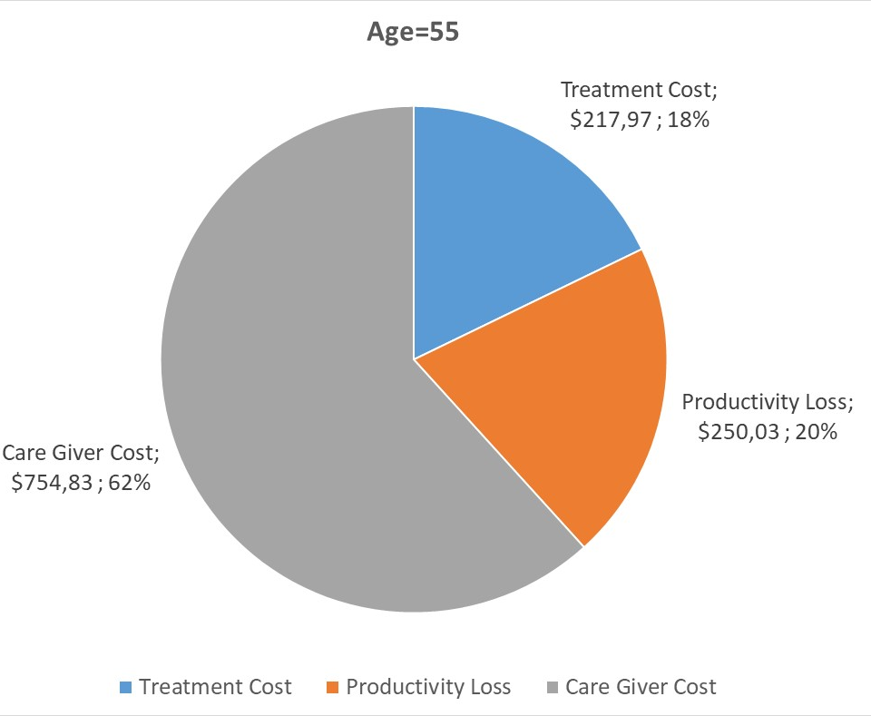
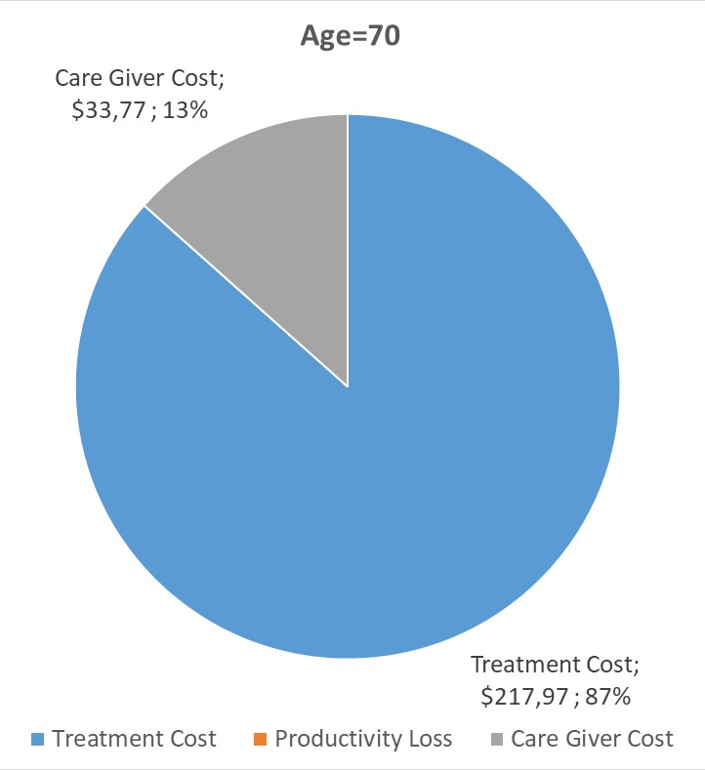
Cost components

Slide 12
ΔEffect
Lower cost and higher effects
Higher cost and higher effects
70-years: 137.84 US$, 2.34 QALYs,
58,97 US$ / DALY
58-years: -437.22 US$, 5.68 QALYs
ΔCost
ΔCost
Lower cost and lower effects
Higher cost and lower effects

Slide 13
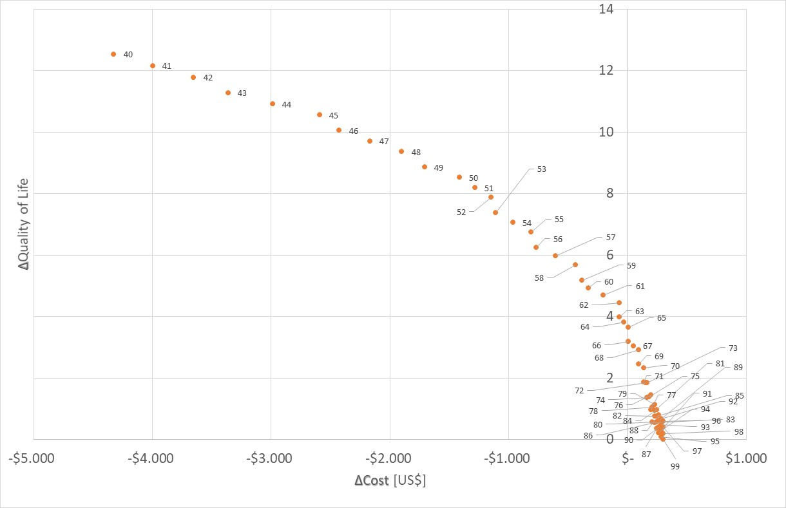
Cost-Benefit-Matrix
Rather good deal!
A good deal!

Slide 14
Cost-Effectiveness-Threshold
Cost-Effectiveness-Ratio
3000
2000
Moderate cost-effective
1000
Highly cost-effective
500
40
60
80
100
Age [years]
-500

Slide 15
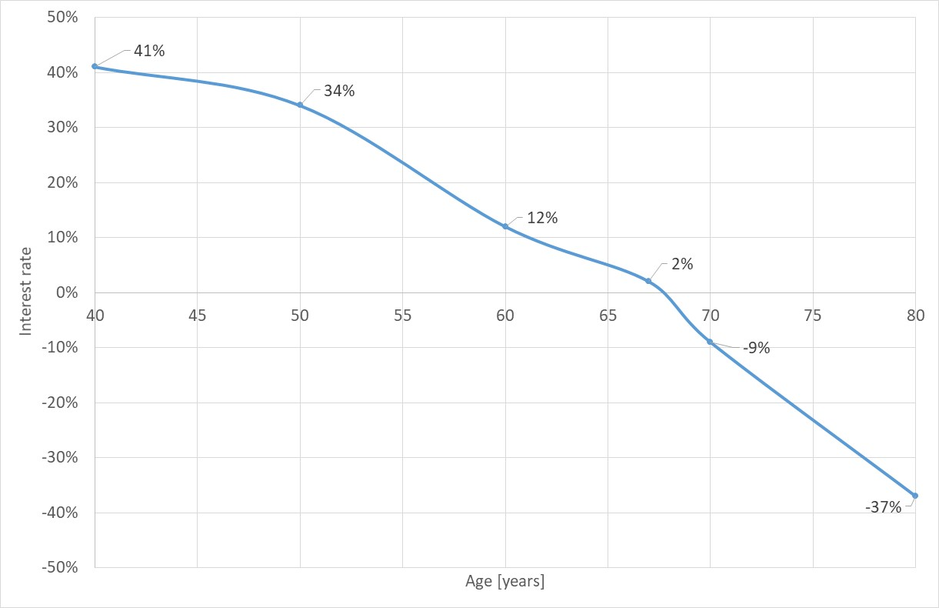
Return-on-Investment
Surgery: Investment
Cost Savings: in future
Question: for which interest rate is this investment profitable? (Return-on-investment)

Slide 16
Epidemiology of Non-Infectious Diseases
Demand for Health Services
Epidemiology of Non-Infectious Diseases
Overview
Example: Diabetes Mellitus Type II
Example: Cervix Uteri Carcinoma
Example: Cataract
Risk Factors
Filter Between Need and Demand

