Slide 1
International Health Care Management II Part 1.2-1
Steffen Fleßa
Institute of Health Care Management
University of Greifswald

Slide 2
Risk Factors
Demand for Health Services
Epidemiology of Non-Infectious Diseases
Risk Factors
Nutrition
Water and Hygiene
Smoking, Alcohol and Environmental Influences
Pregnancy and Delivery
Health in unstable Populations
Health and Health Care in Megacities
Filter Between Need and Demand

Slide 3
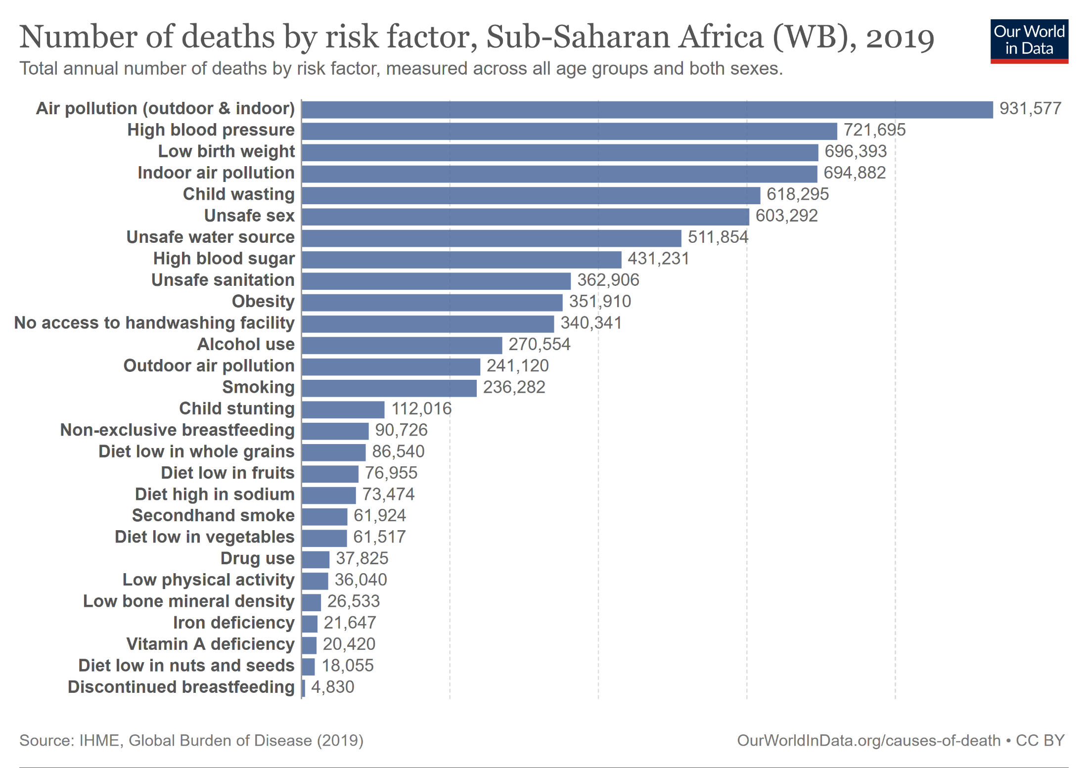

Slide 6
1.2.1 Nutrition
Traditional Notion:
Hunger, Malnutrition
Reality:
Wrong Nutrition
Obesity
„Diseases of Civilization“
→ high complexity of worldwide nutritional situation!
Various “worlds of nutrition” within one country

Slide 7
Undernourisment
Assumption until 2018: no more problem
Today?
https://news.un.org/en/story/2022/07/1122032

Slide 8
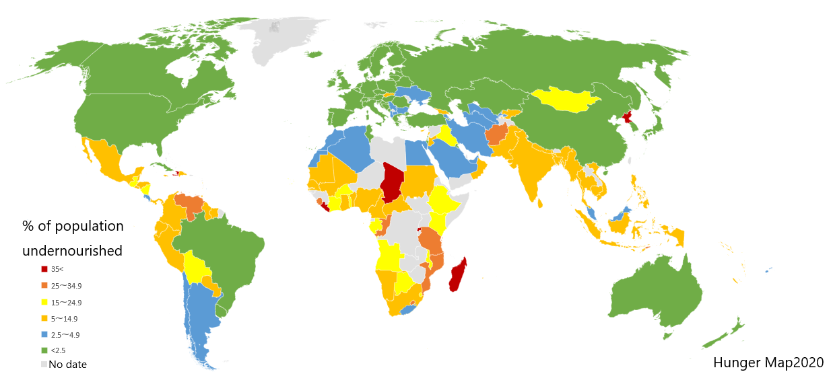
Hunger 2020
(http://upload.wikimedia.org/wikipedia/commons/7/78/Percentage_population_undernourished_world_map.PNG)

Slide 9
Definitions for Children
stunting (chronic malnutrition)- height-for-age <-2 SD of the WHO Child growth standards median;
Wasting (acute malnutrition) - weight-for-height <-2 SD of the WHO Child growth standards median; and
underweight - weight-for-age <-2 standard deviations (SD) of the WHO Child growth standards median;
overweight - weight-for-height >+2 SD of the WHO Child growth standards median
https://www.who.int/data/nutrition/nlis/info/malnutrition-in-children

Slide 10
Children Stunted
“The impaired growth and development that children experience from poor nutrition […]. Children are defined as stunted if their height-for-age is more than two standard deviations below the WHO Child Growth Standards median”.
https://www.who.int/news/item/19-11-2015-stunting-in-a-nutshell
https://ourworldindata.org/hunger-and-undernourishment

Slide 11
Supply and Demand
for Food

Slide 13
Supply

Slide 14
Food Security
Food Security
Nahrungs-aufnahme
Ingestion
State of Health
Quantity and Quality of Available Resources:
human
natural
economic
social and political context
Food Security
Capacity for Care
Health Care
Access to food as the result of food market (price, quality, quantity, distance, …)
Knowledge, Education,
Welfare
(i.e. maternity protection)
Access to clean drinking water, sanitation and health care facilities

Slide 15
Food Price Index
https://cepr.org/voxeu/columns/global-weather-disruptions-food-commodity-prices-and-economic-activity-global-warning

Slide 16
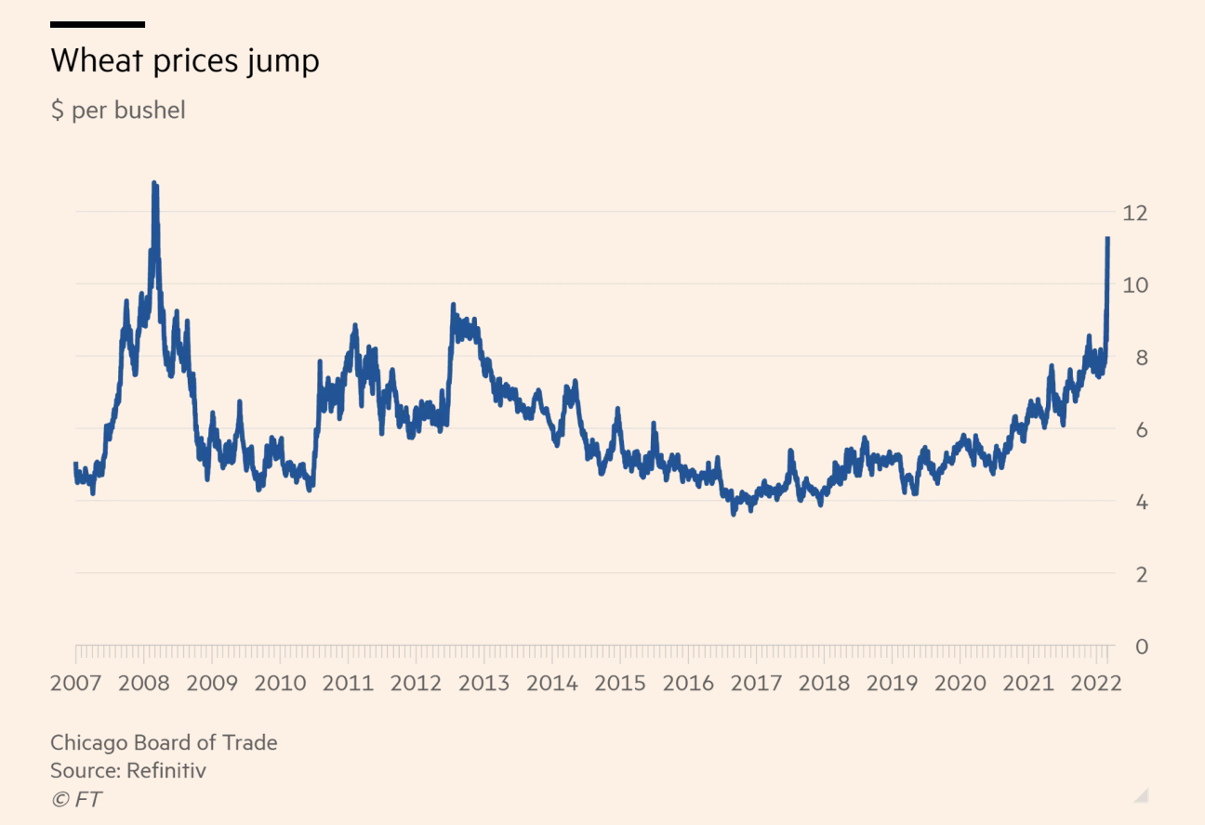
Wheat Prices [U.S. Dollar per bushel (35 kg)]
https://farmpolicynews.illinois.edu/2022/03/wheat-soars-to-14-year-high-surge-to-14-possible-citigroup-says/

Slide 17
World Hunger Index (WHI)
Calculation:
the proportion of the undernourished as a percentage of the population;
the proportion of children under the age of five suffering from wasting (“acute malnutrition);
the proportion of children under the age of five suffering from stunting (“chronic malnutrition”); and
the mortality rate of children under the age of five.
Concern Worldwide (NGO), Welthungerhilfe

Slide 18
https://www.welthungerhilfe.org/hunger/global-hunger-index/

Slide 19
https://www.welthungerhilfe.org/hunger/global-hunger-index/

Slide 20
Wheat Price and Ukraine War
https://www.statista.com/chart/27225/russian-and-ukrainian-share-of-global-crop-exports/
https://tradingeconomics.com/commodity/wheat

Slide 21
Nutrition and Diseases
Regulatory Circuit:
Wrong and malnutrition increase susceptibility to disease
Disease results in malnutrition
Reason:
Increased need in sickness
Calories: up to 100 % additionally
Vitamins: up to couple 100% additionally
Diseases specific to the digestive system, i.e. hookworm → Anemia

Slide 22
Malnutrition
https://www.redcross.ca/blog/2017/3/the-transformation-of-baby-munir-with-help-from-malnutrition-clinic-in-syria
Krawinkel 2008
22

Slide 23
Developmental origins of health and disease
Barker‘s hypothesis
Children with low birthweight have a higher chance to develop ischemic heart disease, stroke and diabetes as adults
undernutrition during gestation is one origin of adult cardiac and metabolic disorders
fetal programming permanently shapes the body’s structure, function, and metabolism and contributes to adult disease
Example: Cambodia: should have very high risk of Diabetes

Slide 24
Malnutrition and Wrong Nutrition
Hunger → Global Malnutrition
formerly: Protein-Energy-Malnutrition
‚Hidden Hunger‘ → Deficit of Micronutrients
Individual nutrients (i.e. vitamin A, iron, iodine)
24

Slide 25
Anemia (= Iron Deficiency)
in Women in Reproductive Age (WRA)
Menshawey, Rahma, et al. "Low iron mitigates viral survival: insights from evolution, genetics, and pandemics—a review of current hypothesis." Egyptian Journal of Medical Human Genetics 21 (2020): 1-14.

Slide 26
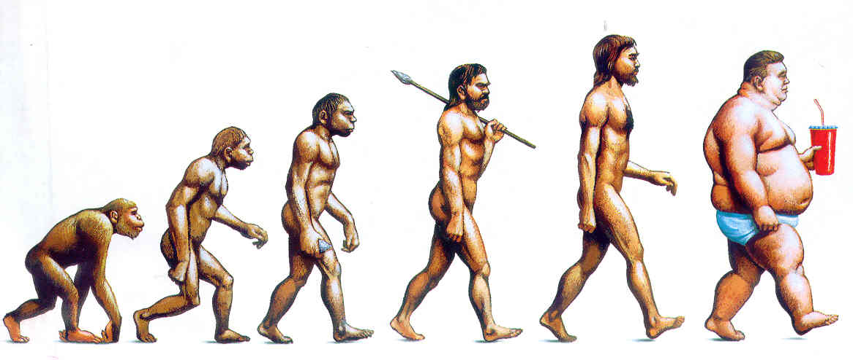
Obesity
26

Slide 27
Nairobi 2012

Slide 28
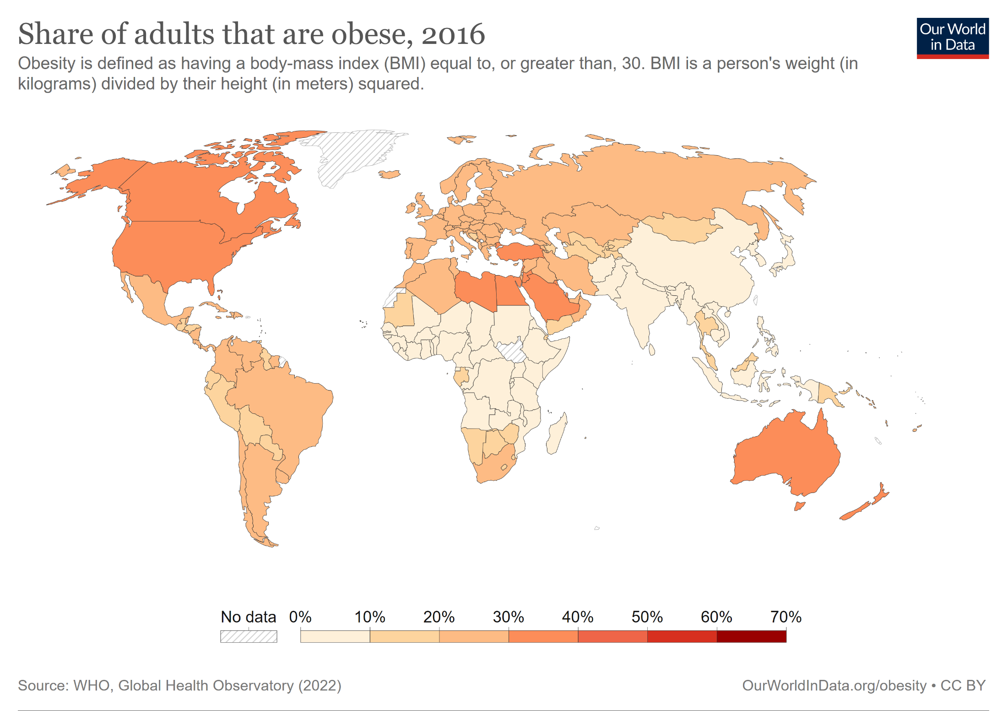

Slide 29
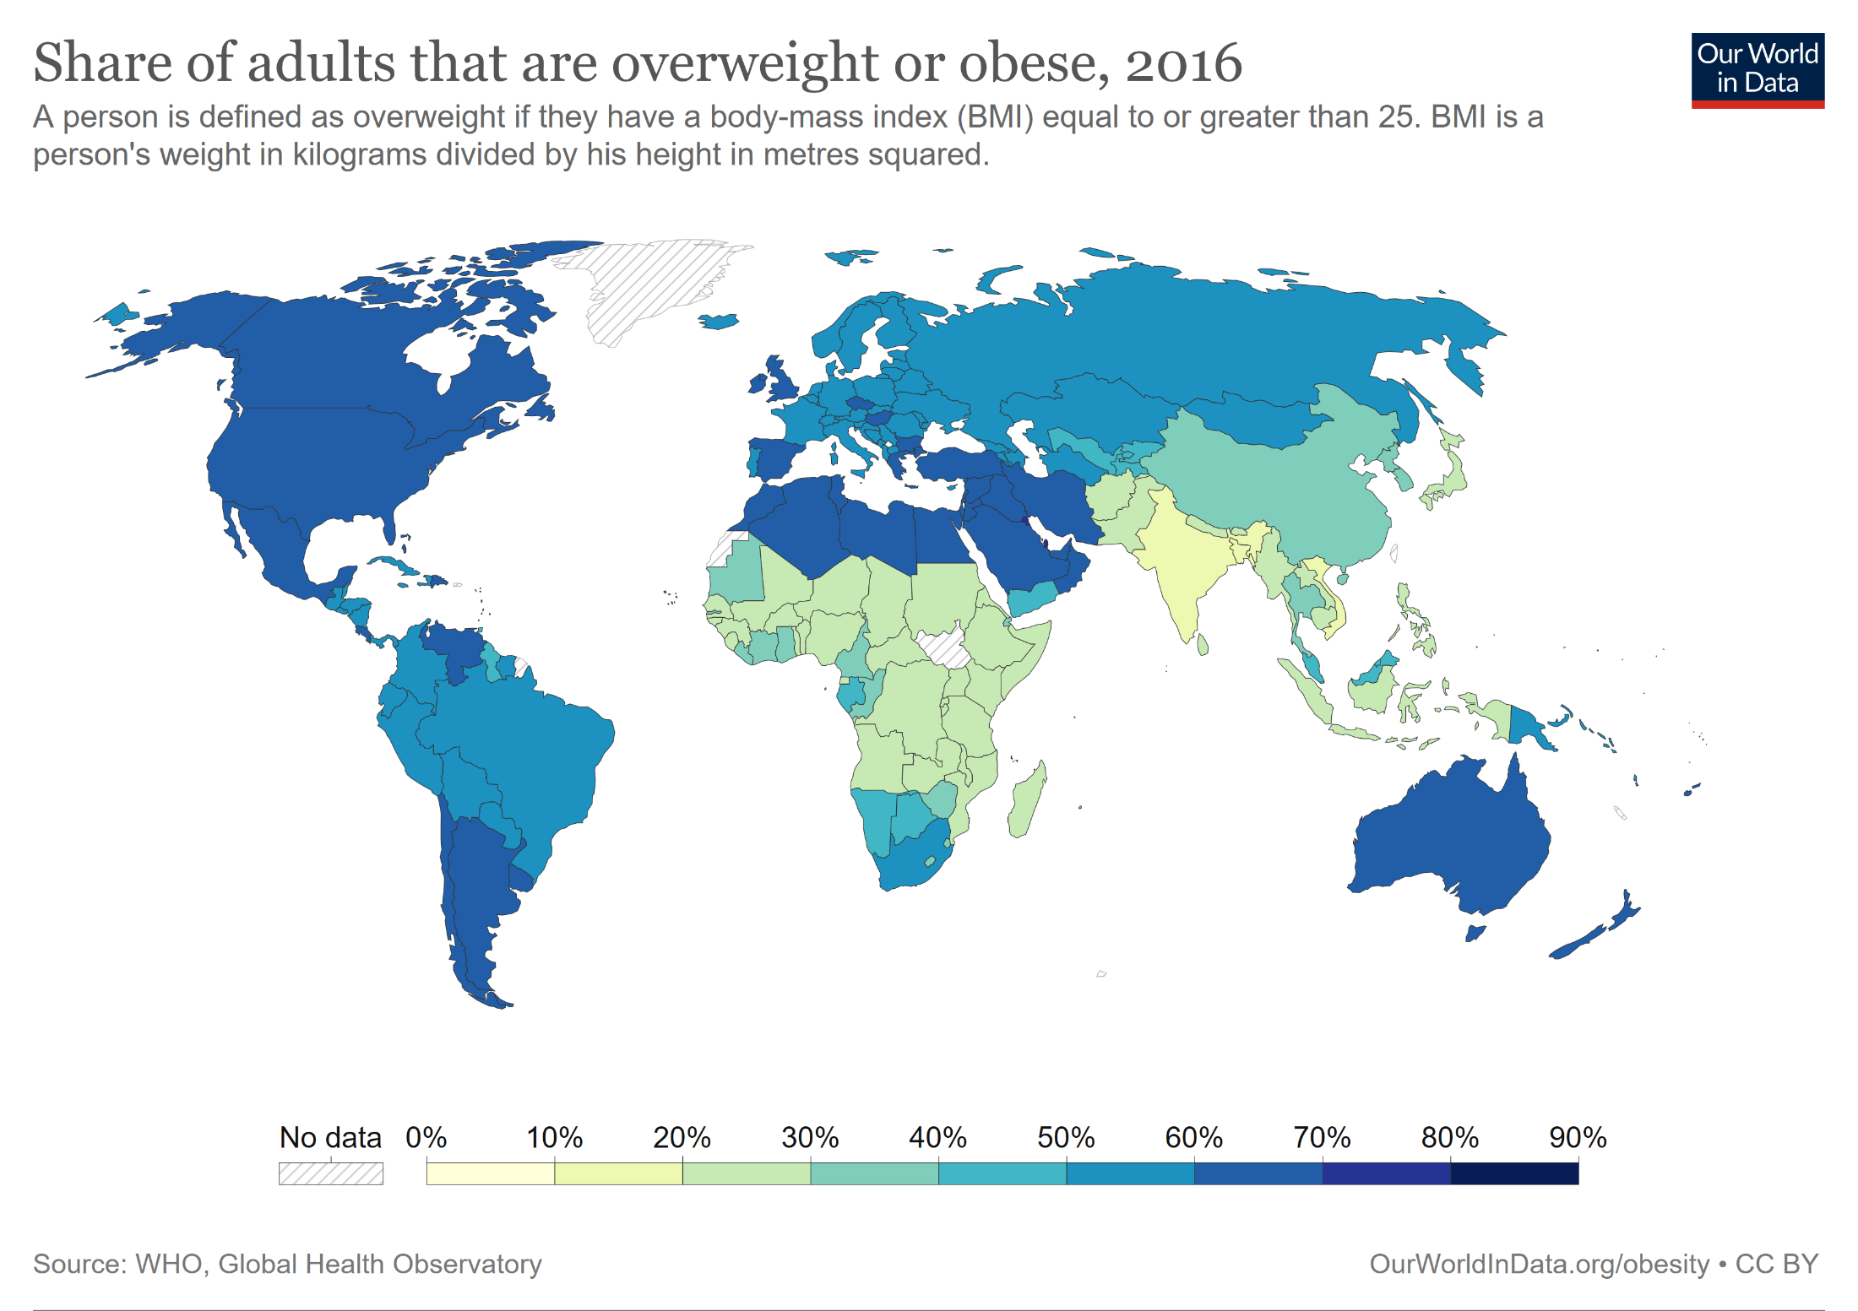

Slide 30
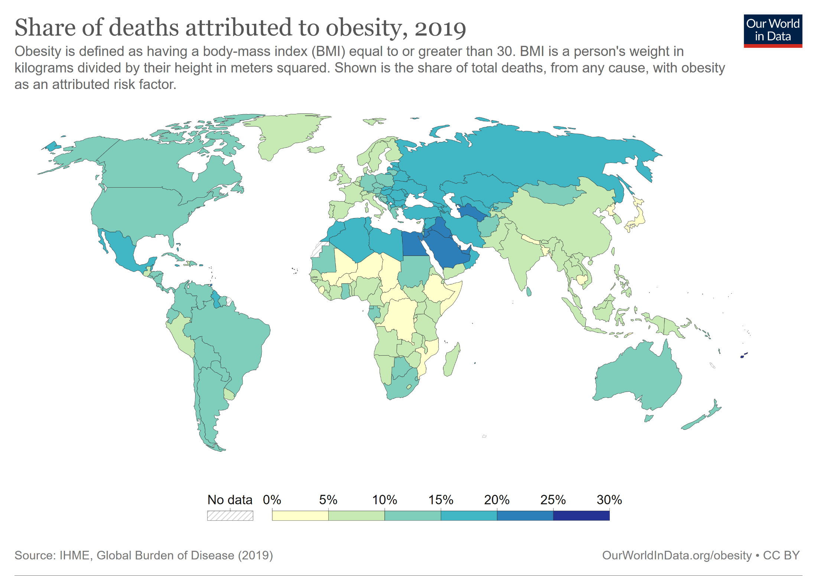

Slide 31
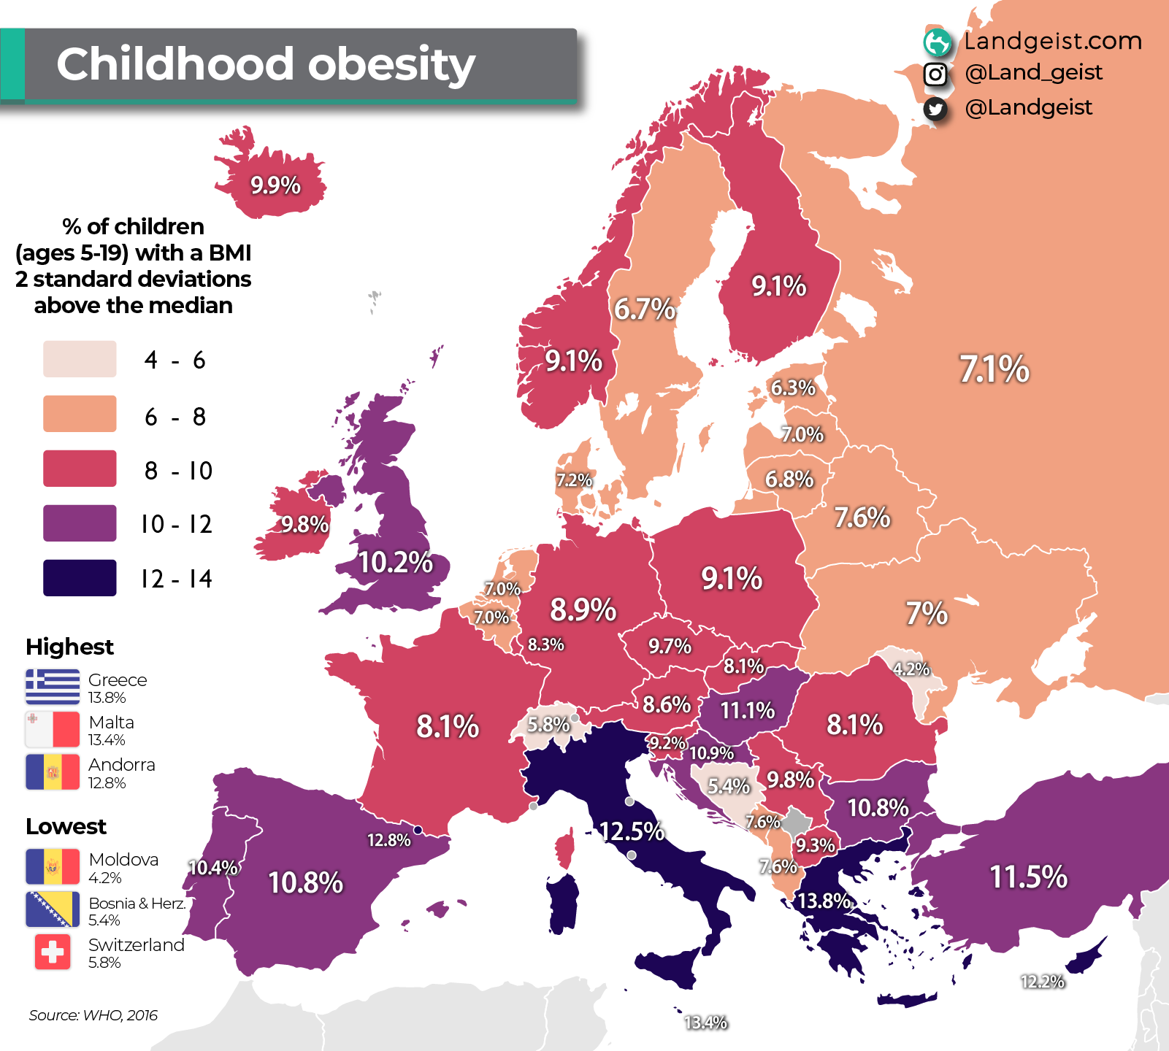
https://landgeistdotcom.files.wordpress.com/2022/11/europe-obesity-among-children.png

Slide 32
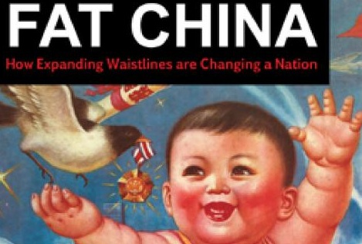
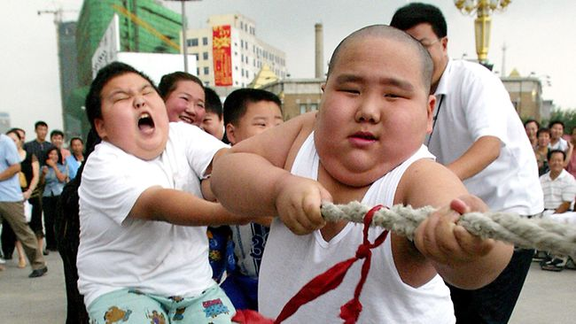
http://resources2.news.com.au/images/2010/
12/30/1225978/530638-aus-bus-pix-china-obesity.jpg
http://www.jingdaily.com/wp-conten
t/uploads/2010/09/fatchina.jpg
https://ourworldindata.org/obesity#childhood-obesity
http://magazine.jhsph.edu/sebin/f/v/global_obesity.jpg

Slide 33
Obesity - Prognosis

Slide 34
Risk Factors
Demand for Health Services
Epidemiology of Non-Infectious Diseases
Risk Factors
Nutrition
Water and Hygiene
Smoking, Alcohol and Environmental Influences
Pregnancy and Delivery
Health in unstable Populations
Health and Health Care in Megacities
Filter Between Need and Demand

