Slide 1
International Health Care Management II Part 1.2-2
Steffen Fleßa
Institute of Health Care Management
University of Greifswald

Slide 2
Risk Factors
Demand for Health Services
Epidemiology of Non-Infectious Diseases
Risk Factors
Nutrition
Water and Hygiene
Smoking, Alcohol and Environmental Influences
Pregnancy and Delivery
Health in unstable Populations
Health and Health Care in Megacities
Filter Between Need and Demand

Slide 3
1.2.1 Water and Hygiene
Causality
Water as essential element of life
Overconsumption leads to thirst and poor hygiene
Water as a cause of diseases, e.g. Cholera
Water as a means against disease, e.g. Handwashing

Slide 4
Terminology
Hygiene
“Hygiene refers to conditions and practices that help to maintain health and prevent the spread of diseases. Medical hygiene therefore includes a specific set of practices associated with this preservation of health, for example environmental cleaning, sterilization of equipment, hand hygiene, water and sanitation and safe disposal of medical waste.” (https://www.afro.who.int/health-topics/hygiene)
Sanitation
“Sanitation generally refers to the provision of facilities and services for the safe disposal of human urine and faeces. Inadequate sanitation is a major cause of disease world-wide and improving sanitation is known to have a significant beneficial impact on health both in households and across communities. The word 'sanitation' also refers to the maintenance of hygienic conditions, through services such as garbage collection and wastewater disposal.” (https://www.afro.who.int/health-topics/sanitation)

Slide 5
Risk Faktors for Death

Slide 7
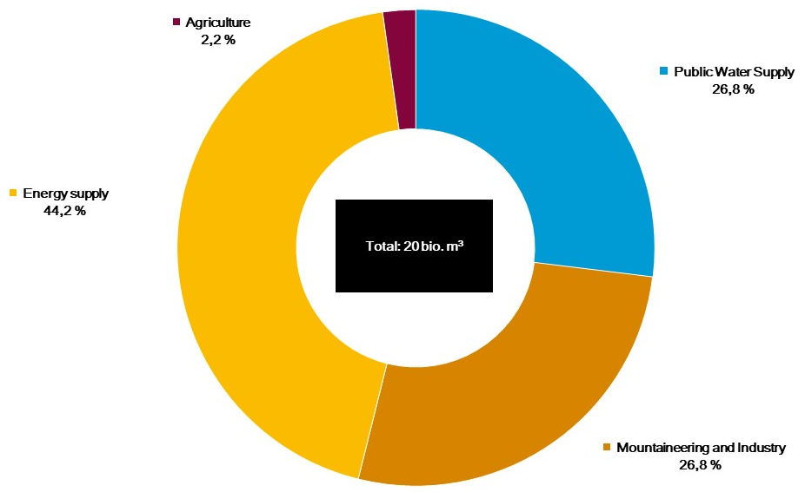
Water Consumption Germany
Water consumption p.c. p.d. Germany
https://www.co2online.de/energie-sparen/wasser-sparen/wasserverbrauch/durchschnittlicher-wasserverbrauch/
https://www.umweltbundesamt.de/daten/wasser/wasserressourcen-ihre-nutzung#wassernachfrage

Slide 8
Water Consumption India
HICs: mainly industrial use
L+MICs: Predominantly agricultural
Consumption p.a. p.c.
Germany: 44,000 l
India: 98,000 l
Thakur, Ankaj, et al. "Water footprint a tool for sustainable development of Indian dairy industry." International Journal of Livestock Research 8.10 (2018): 1-18.

Slide 11
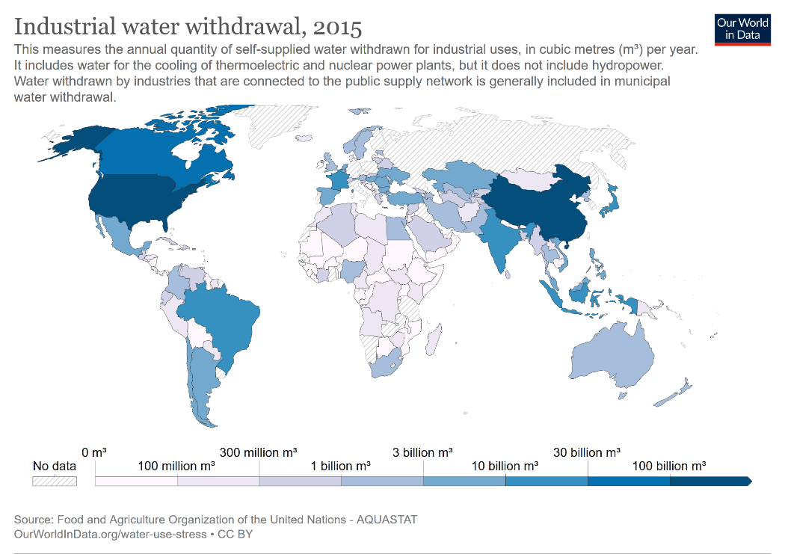

Slide 12
Hippocrates of Cos (460 BC -370 BC)
„Air, Water and Places"
Whoever wishes to investigate medicine properly, should proceed thus: in the first place to consider the seasons of the year, and what effects each of them produces for they are not at all alike, but differ much from themselves. Then the winds, the hot and the cold, especially such as are common to all countries, and then such as are peculiar to each locality. We must also consider the qualities of the waters, for as they differ from one another in taste and weight, so also do they differ much in their qualities.
These things one ought to consider most attentively, and concerning the waters which the inhabitants use, whether they be marshy and soft, or hard, and running from elevated and rocky situations, and then if saltish and unfit for cooking; and the ground, whether it be naked and deficient in water, or wooded and well watered, and whether it lies in a hollow, confined situation, or is elevated and cold; and the mode in which the inhabitants live, and what are their pursuits, whether they are fond of drinking and eating to excess, and given to indolence, or are fond of exercise and labor, and not given to excess in eating and drinking.
http://www.paganrod.com/2010/02/hippocrates-on-airs-waters-and-places.html

Slide 13
Declaration of Alma Ata (1978)
Primary health care … includes at least:
education concerning prevailing health problems and the methods of preventing and controlling them;
promotion of food supply and proper nutrition;
an adequate supply of safe water and basic sanitation;
maternal and child health care, including family planning;
immunization against the major infectious diseases;
prevention and control of locally endemic diseases;
appropriate treatment of common diseases and injuries;
and provision of essential drugs;

Slide 14
Millennium Development Goals
Eradicate extreme poverty and hunger until 2015
Water is the basis for nutrition
Achieve universal primary education
Promote gender equality and empower women
Reduce child mortality
Water and hygiene are basis for child health
Improve maternal health
Water and hygiene are basis for maternal health
Combat HIV/Aids, Malaria and other diseases
Malaria is a water-related disease
Ensure environmental sustainability
Water cycle
Global partnership for development

Slide 15
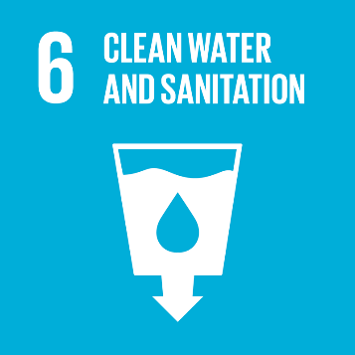
Social Development Goals
SDG 6: „Ensure availability and sustainable management of water and sanitation for all”
Target 6.1: Safe and affordable drinking water
Target 6.2: End open defecation and provide access to sanitation and hygiene
Target 6.3: Improve water quality, wastewater treatment, and safe reuse
Target 6.4: Increase water-use efficiency and ensure freshwater supplies
Target 6.5: Implement “integrated water resources management”
Target 6.6: Protect and restore water-related ecosystems

Slide 16
Water-Related Diseases
(Drinking)Water-Transmitted Diseases
Water is medium of transmission
i.e. Cholera, Hepatitis A, Diphtheria, Salmonellae, Polio
Water-Washable Diseases
Water is medium of prevention
i.e. Colds and Flues, Worms, Diarrhea, Pox
Water-Persistent Diseases
Water is reservoir
i.e. Bilharzias, Malaria, Dengue, River Blindness

Slide 17
Water and Health (2020,2017)
1.2 million people died prematurely in 2017 as a result of unsafe water, 2.2 % of global death
In low-income countries unsafe water sources account for 6% of deaths
The risk of dying from unsafe water in Chad is more than 1000-fold the risk in Europe
46% of the global population did not use a safely managed sanitation service
> 1.7 billion people still do not have basic sanitation services, such as private toilets or latrines.
https://ourworldindata.org/water-access
https://www.who.int/news-room/fact-sheets/detail/sanitation

Slide 18
Example: Rotavirus
Most Common Severe Diarrhea Worldwide
111 million cases annually
25 million in health care system
35-50% clinical diarrhea
2 million hospital admissions <5 years
850,000 fatalities annually (predominantly children)
Main cause of death: dehydration
Transmission: fecal-oral

Slide 19
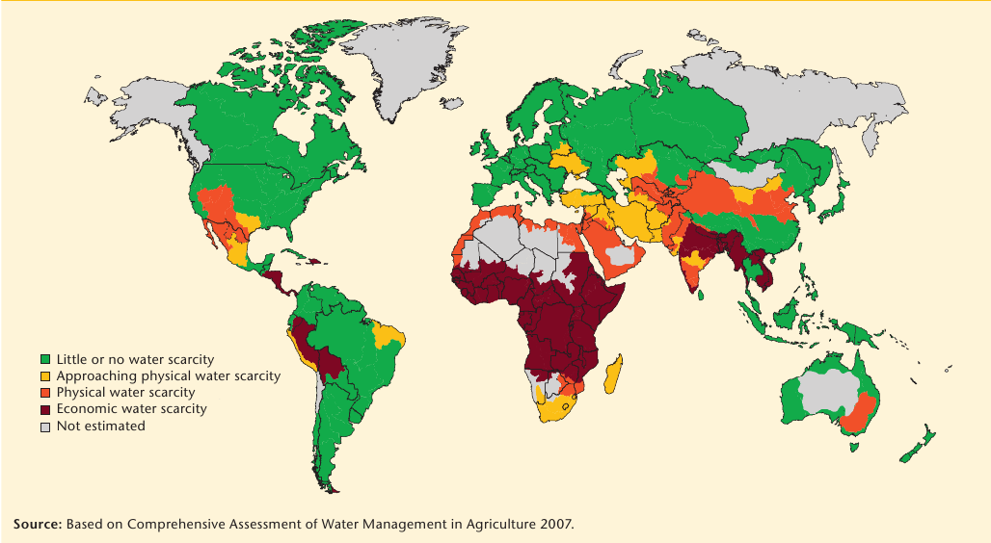
Water Scarcity http://www.savemynature.com/message/13525

Slide 20
The Fight for Water

Slide 21
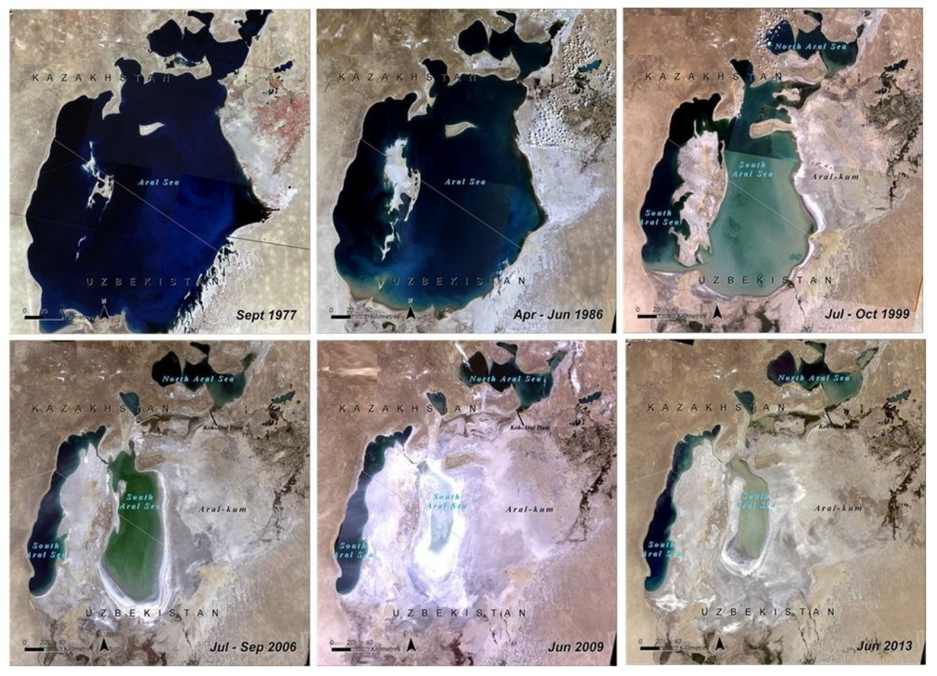
Aral Lake Catastrophe
Anchita, et al. "Health impact of drying aral sea: One health and socio-economical approach." Water 13.22 (2021): 3196.

Slide 22
Aral Lake Catastrophe
https://www.deutschlandfunk.de/aralsee-in-kasachstan-frueher-ein-gewaltiges-meer-100.html
Anchita, et al. "Health impact of drying aral sea: One health and socio-economical approach." Water 13.22 (2021): 3196.

Slide 23
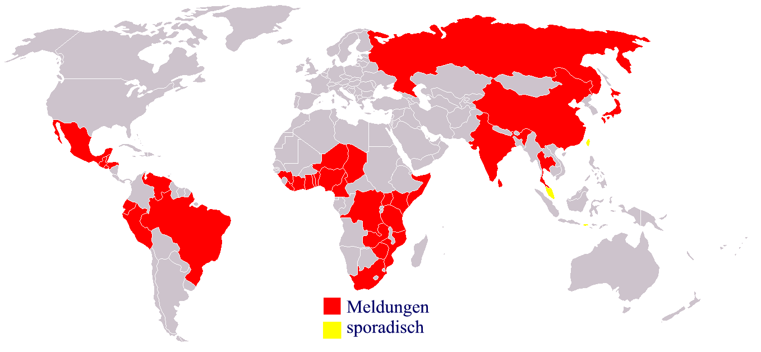
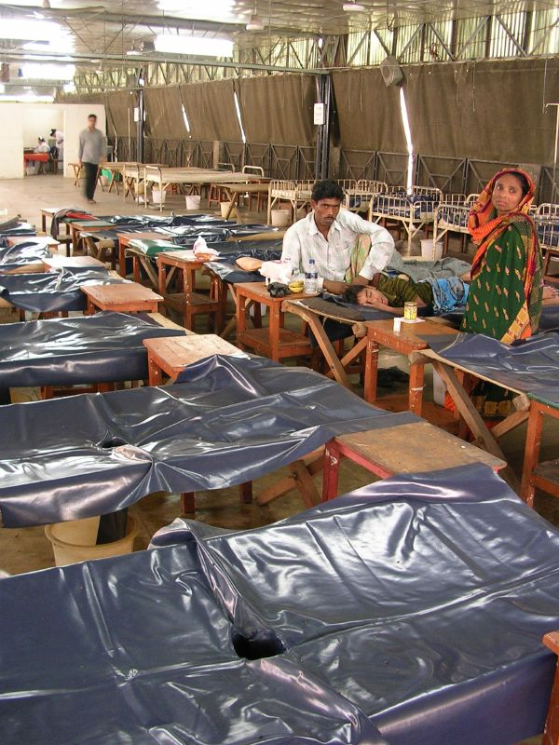
Diarrheal Diseases
http://upload.wikimedia.org/wikipedia/commons/e/ef/Choleraverbreitung_%28deutsch%29.PNG
Cases of Cholera worldwide
Reported
Sporadically

Slide 24
Diesfeld et al. (1997): S. 94

Slide 25
Toilet Systems: Primary Prevention
No Toilet
Roadside, bushes, water channels, rice fields…
Dry Latrines
Pit with cover, danger of formation of gases, breeding place for flies
Ventilated Dry Latrine
Pit is ventilated, fly trap
Flush Toilet with Odor Trap
Low water consumption, primarily serves odor/smell reduction via siphon
Water Closet
Thorough removal of excrements by use of water pressure and amount

Slide 26
Water and Hygiene in Health Care Facilities (2016)
In Least Developed Countries, only 55% of health care facilities had basic water services.
Regional coverage of basic water services ranged from 51% in sub-Saharan Africa to 87% in Eastern and South-Eastern Asia.
4% of hospitals and 11% of other health care facilities had no water service.
12% of government health care facilities and 6% of non-government health care facilities had no water service.
5% of health care facilities in urban areas and 15% in rural areas had no water service.
896 million people had no water service at their health care facility.
WASH: water, sanitation and hygiene concept by WHO & UNICEF
https://apps.who.int/iris/bitstream/handle/10665/311620/9789241515504-eng.pdf
WHO 2019

Slide 27
Risk Factors
Demand for Health Services
Epidemiology of Non-Infectious Diseases
Risk Factors
Nutrition
Water and Hygiene
Smoking, Alcohol and Environmental Influences
Pregnancy and Delivery
Health in unstable Populations
Health and Health Care in Megacities
Filter Between Need and Demand

