Slide 1
International Health Care Management II Part 1.2-3
Steffen Fleßa
Institute of Health Care Management
University of Greifswald

Slide 2
Risk Factors
Demand for Health Services
Epidemiology of Non-Infectious Diseases
Risk Factors
Nutrition
Water and Hygiene
Smoking, Alcohol and Environmental Influences
Pregnancy and Delivery
Health in unstable Populations
Health and Health Care in Megacities
Filter Between Need and Demand

Slide 4
1.2.3 Smoking, Alcohol and Environmental Change
http://www.sanger.ac.uk/news/view/smoking-pack-day-year-causes-150-mutations-lung-cells
Alexandrov, Ludmil B., et al. "Mutational signatures associated with tobacco smoking in human cancer." bioRxiv (2016): 051417.

Slide 5
Germany
smoking rate: 27 % (2019)
Men: 30 %
Women: 23 %
Smokers: 17.5 million (2019) with 200
Average consumption: 16.6 cigarettes per smoker per day
Illicit (= illegal) cigaretts:
second largest market for illicit tobacco trade in EU
200 million cigarettes consumed p.a.
https://www.smokefreeworld.org/health-science-research-2/health-science-technology-agenda/data-analytics/global-state-of-smoking-landscape/state-smoking-germany/

Slide 6
Tobacco associated fatalities in Germany (incl. passive smoking)

Slide 7
MB: Figures differ (smoking < tobacco abuse)!
U. Mons 2010:
Cancer: 60,000
Cardio-Vascular Diseases: 52,000
Respiratory Diseases: 28,000
Total: > 140,000 (16 % of total fatalities)
Almost every 6th resident of Germany dies due to consuming tobacco
86 % of smokers die due to tobacco as estimated by the Centre for Disease Control
“Tabakatlas Deutschland 2020“ (figures 2018)
127,000 death cases due to smoking (13.3 % of all death cases)
≈ 40 % cancer, 34 % cardio-vascular, 25 % respiratory dis.
DKFZ: Tabakatatas Deutschland 2020. Heidelberg
MONS, U. Tobacco-attributable mortality in Germany and in the German Federal States-calculations with data from a microcensus and mortality statistics. Gesundheitswesen (Bundesverband der Arzte des Offentlichen Gesundheitsdienstes (Germany)), 2010, 73. Jg., Nr. 4, S. 238-246

Slide 8
Prevalence of current smokers [%}
https://www.google.com/url?sa=t&rct=j&q=&esrc=s&source=web&cd=&ved=2ahUKEwjwrrePp_z_AhVfSPEDHZWzDUwQFnoECCEQAQ&url=https%3A%2F%2Fwww.rki.de%2FEN%2FContent%2FHealth_Monitoring%2FHealth_Reporting%2FGBEDownloadsJ%2FFactSheets_en%2FJoHM_2017_02_Smoking_adults.pdf%3F__blob%3DpublicationFile&usg=AOvVaw0jtgMEtQSZ_VF-ad7gHsD4&opi=89978449

Slide 9
Prevalence of Smoking in Germany
Frauen
Source: Destatis 2016

Slide 10
Cost of Smoking in Germany (2018)
Direct Cost: 30.32 billion
Treatment Active Smoking: 27.3 billion €
Treatment Passive Smoking: 1.1 billion €
Long-term care: 0.7 billion €
Rehabilitation: 0.5 billion €
Accidents: 0.3 billion €
Indirect Cost: 97.2 billion €
Prematue death: 22.9 billion €
Long-term unemployment: 16.6 billion €
Disability: 9.7 billion €
Short-term unemployement: 9.6 billion €
Other: 8.0 billion €
DKFZ: Tabakatalas Deutschland 2020. Heidelberg

Slide 15
Prevalence of Daily Smoking (≥18 Years, 2003-2004)
World Health Survey 2007
http://www.ceche.org/publications/infocus/GlobalDisease.html

Slide 16
Cost of Smoking in LMICs
https://www.google.com/url?sa=t&rct=j&q=&esrc=s&source=web&cd=&ved=2ahUKEwi2y_uVsvz_AhWTXvEDHXG_BfoQFnoECA4QAQ&url=https%3A%2F%2Ftobacconomics.org%2Ffiles%2Fresearch%2F523%2FUIC_Economic-Costs-of-Tobacco-Use-Policy-Brief_v1.3.pdf&usg=AOvVaw15X9V2QTt3QcwC-7bE68if&opi=89978449

Slide 17
Cost of Smoking in HICs
https://www.google.com/url?sa=t&rct=j&q=&esrc=s&source=web&cd=&ved=2ahUKEwi2y_uVsvz_AhWTXvEDHXG_BfoQFnoECA4QAQ&url=https%3A%2F%2Ftobacconomics.org%2Ffiles%2Fresearch%2F523%2FUIC_Economic-Costs-of-Tobacco-Use-Policy-Brief_v1.3.pdf&usg=AOvVaw15X9V2QTt3QcwC-7bE68if&opi=89978449

Slide 18
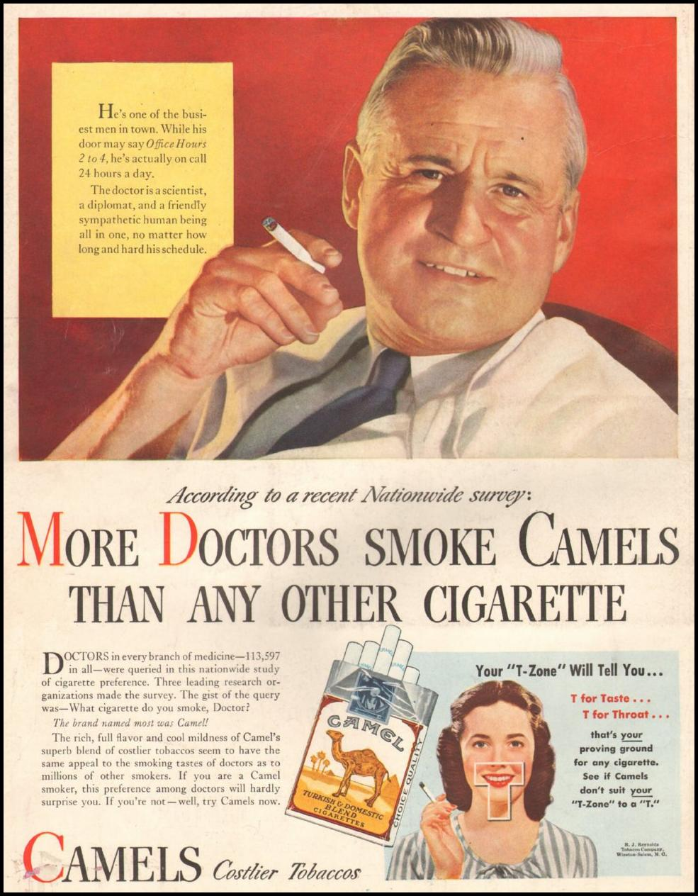
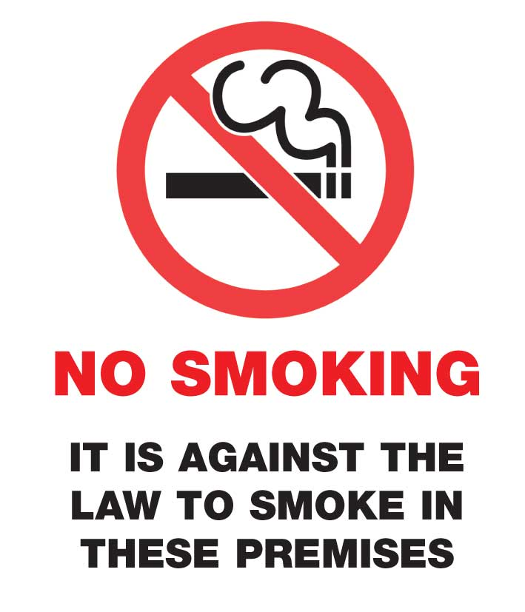
Smoking: from social acceptance to marginalisation

Slide 19
Indonesia
Jordan
Moldova

Slide 21
Model of Smoking

Slide 22
(own, Vietnam 2016)

Slide 23
https://www.facebook.com/world.pharmacy/photos/harmful-use-of-alcohol-kills-more-than-3-million-people-each-year-most-of-them-m/10158011027952501/

Slide 24
http://gamapserver.who.int/mapLibrary/Files/Maps/Global_adult_percapita_consumption_2005.png

Slide 33
https://www.cdc.gov/alcohol/onlinemedia/infographics/cost-excessive-alcohol-use.html

Slide 34
Environment
https://www.who.int/news/item/04-04-2022-billions-of-people-still-breathe-unhealthy-air-new-who-data

Slide 35
Environmental Change and Health

Slide 36
https://injuryfacts.nsc.org/home-and-community/safety-topics/weather-related-deaths-and-injuries/

Slide 37
https://injuryfacts.nsc.org/home-and-community/safety-topics/weather-related-deaths-and-injuries/

Slide 38
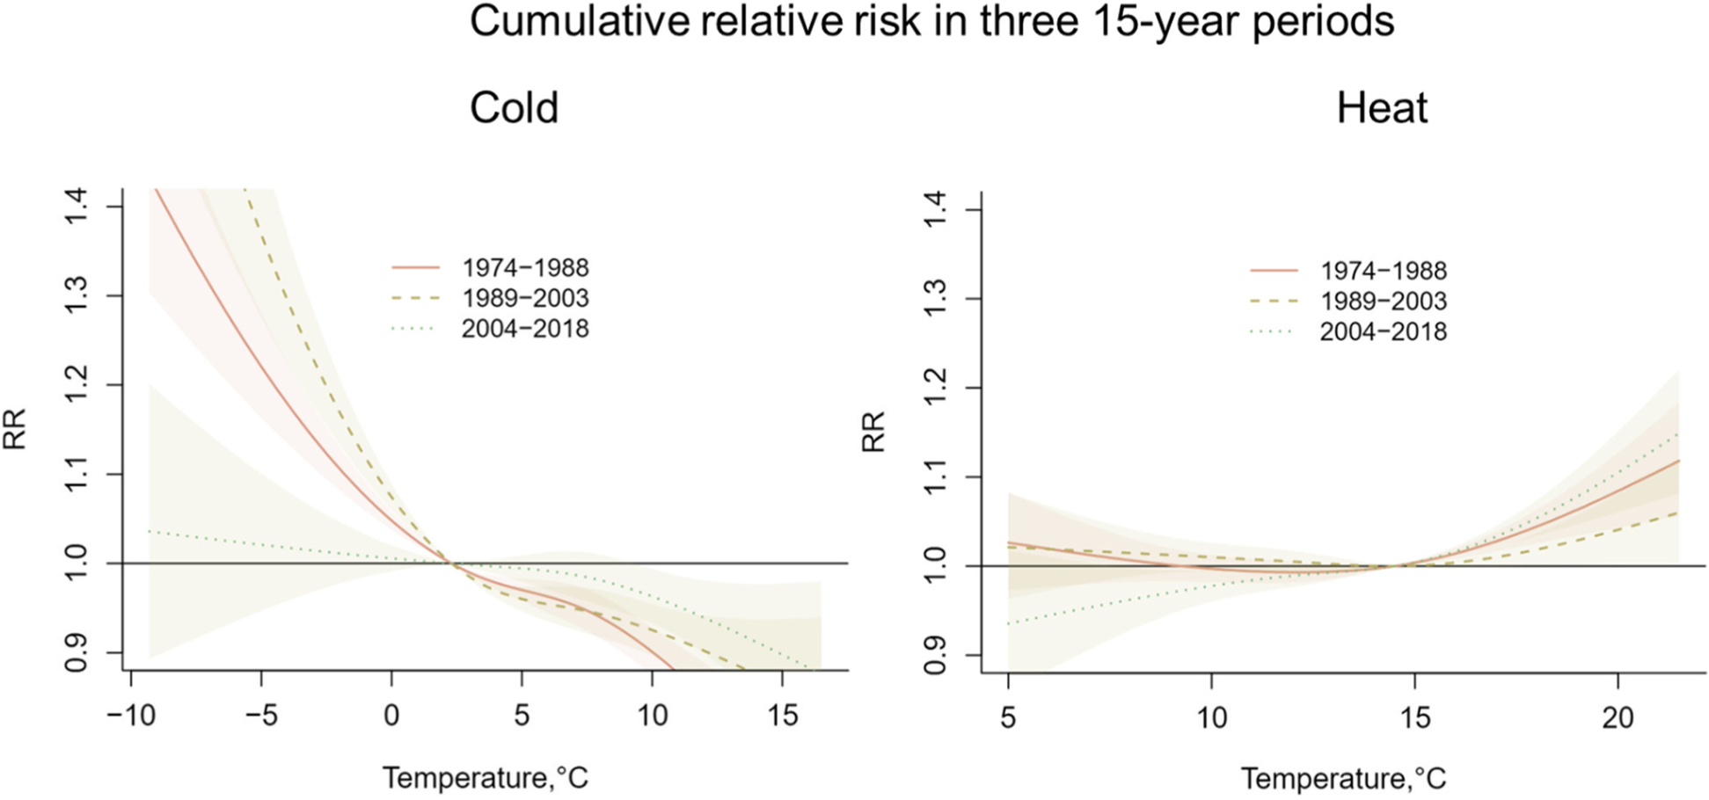
Relative mortality in winter (left) and summer
https://ehjournal.biomedcentral.com/articles/10.1186/s12940-022-00912-5

Slide 39
Climate Change and Health

Slide 40
Environ-mental Influences

Slide 41
Smallest contribution – highest damage
https://phys.org/news/2019-11-climate-impacts-world-trillion.html

Slide 42
Expected sea level rise
https://www.coastalwiki.org/w/images/d/de/SLRscenariosIPCC2019.jpg

Slide 43
Permanently flooded areas if high tide line rises 1 meter
https://coastal.climatecentral.org/

Slide 44
Permanently flooded areas if high tide line rises 2.5 meters
https://coastal.climatecentral.org/

Slide 45
Storm Tide
STORM TIDE
STORM SURGE
MEAN SEA LEVEL
https://oceanservice.noaa.gov/facts/stormsurge-stormtide.html

Slide 46
Storm Tide
OLD STORM
SURGE
Old
Storm Surge
Sea
Level Rise
MEAN
SEA
LEVEL
MEAN
SEA
LEVEL
https://oceanservice.noaa.gov/facts/stormsurge-stormtide.html

Slide 47
Main problem: storm tide = f∙mean sea level, f>1
Additional
Storm Surge
ADD. STORM SURGE
OLD STORM
SURGE
Old
Storm Surge
Sea
Level Rise
MEAN
SEA
LEVEL
MEAN
SEA
LEVEL
https://oceanservice.noaa.gov/facts/stormsurge-stormtide.html

Slide 48
Risk Factors
Demand for Health Services
Epidemiology of Non-Infectious Diseases
Risk Factors
Nutrition
Water and Hygiene
Smoking, Alcohol and Environmental Influences
Pregnancy and Delivery
Health in unstable Populations
Health and Health Care in Megacities
Filter Between Need and Demand

