Slide 1
International Health Care Management II Part 1.2-4
Steffen Fleßa
Institute of Health Care Management
University of Greifswald

Slide 2
Risk Factors
Demand for Health Services
Epidemiology of Non-Infectious Diseases
Risk Factors
Nutrition
Water and Hygiene
Smoking, Alcohol and Environmental Influences
Pregnancy and Delivery
Health in unstable Populations
Health and Health Care in Megacities
Filter Between Need and Demand

Slide 3
1.2.4 Pregnancy and Delivery
Starting Point: Millennium Development Goals, Goals 3-5
Promotion of gender equality and empower women
Reduce child mortality
Reduce mortality rate of children younger than 5 by 2/3 until 2015 (basis 1990)
Improve maternal health
Reduce maternal mortality rates by 3/4 until 2015 (basis 1990)

Slide 4
Infant and Child Mortality Rates
https://databank.worldbank.org/source/world-development-indicators#

Slide 5
Maternal Mortality in Germany 1900-1999
Maternal Mortality Rate = MMR
Live Birth = LB
http://www.who.int/gho/maternal_health/countries/deu.pdf?ua=1

Slide 6
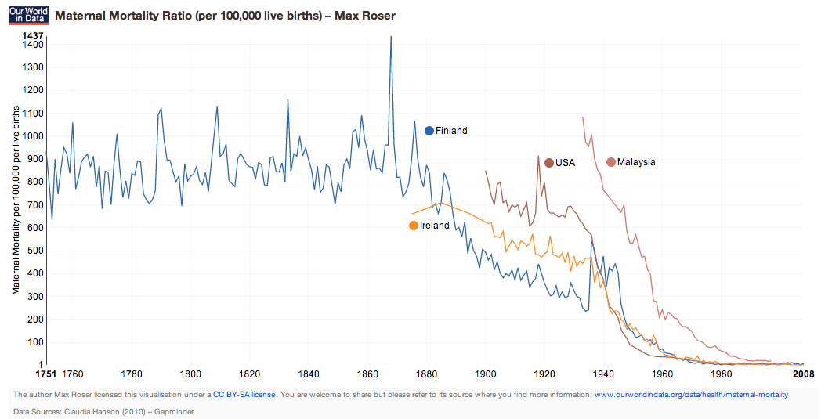
Maternal mortality development
LLDC Average 2000

Slide 7
Maternal mortality development
USA
England
Sweden
Notes:
Second phase: different patterns between 1870 and the late 1930s
After this first phase of reduction the speed and timing of MM-reduction varied considerably from one country to the next. One can distinguish three patterns: stagnation without significant gains; early reduction with a major drop as early as the 19th century; and an intermediate pattern.
The prototypes are the United States, Sweden and England & Wales. Around 1850 maternal mortality ratios in all three countries were below 700 per 100,000, and similar to the median of poor countries today. Swedish ratios show a clear downward trend from as early as 1870, stabilising at 250-300 per 100,000 between 1900 and 1940. England and Wales show a slow downward trend, and stabilise around 400-450 up to the late thirties. MM Ratios in the United States, on the other hand, remain in the 600-800 bracket up to the mid-thirties.
Clearly, Sweden has the success story, with an early reduction of the problem, all the more impressive since this was achieved before modern hospital technology, transfusions, caesarean sections, or antibiotics became available. It is interesting to look at what made this possible, and conversely, at what caused E&W and even more so, the USA to lag behind. This may help to understand why many poor countries lag behind, even if the technology to avoid maternal deaths is well known.

Slide 8
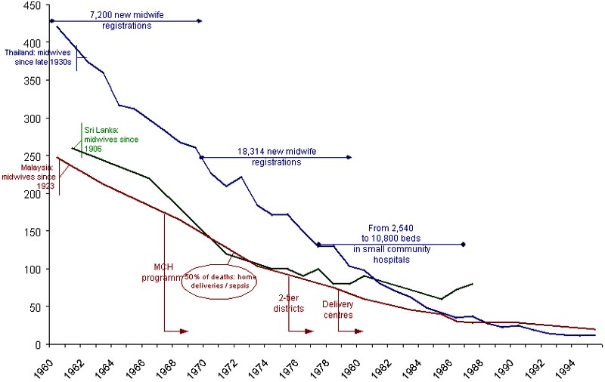
Maternal mortality since the 1960s in Malaysia, Sri Lanka and Thailand

Slide 9
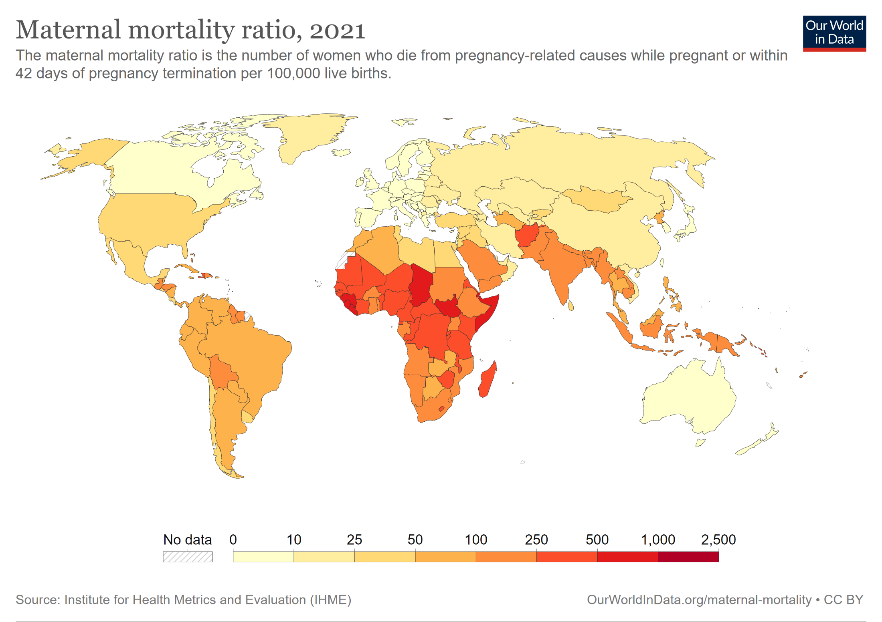
99% maternal fatalities occur
in developing countries!

Slide 10
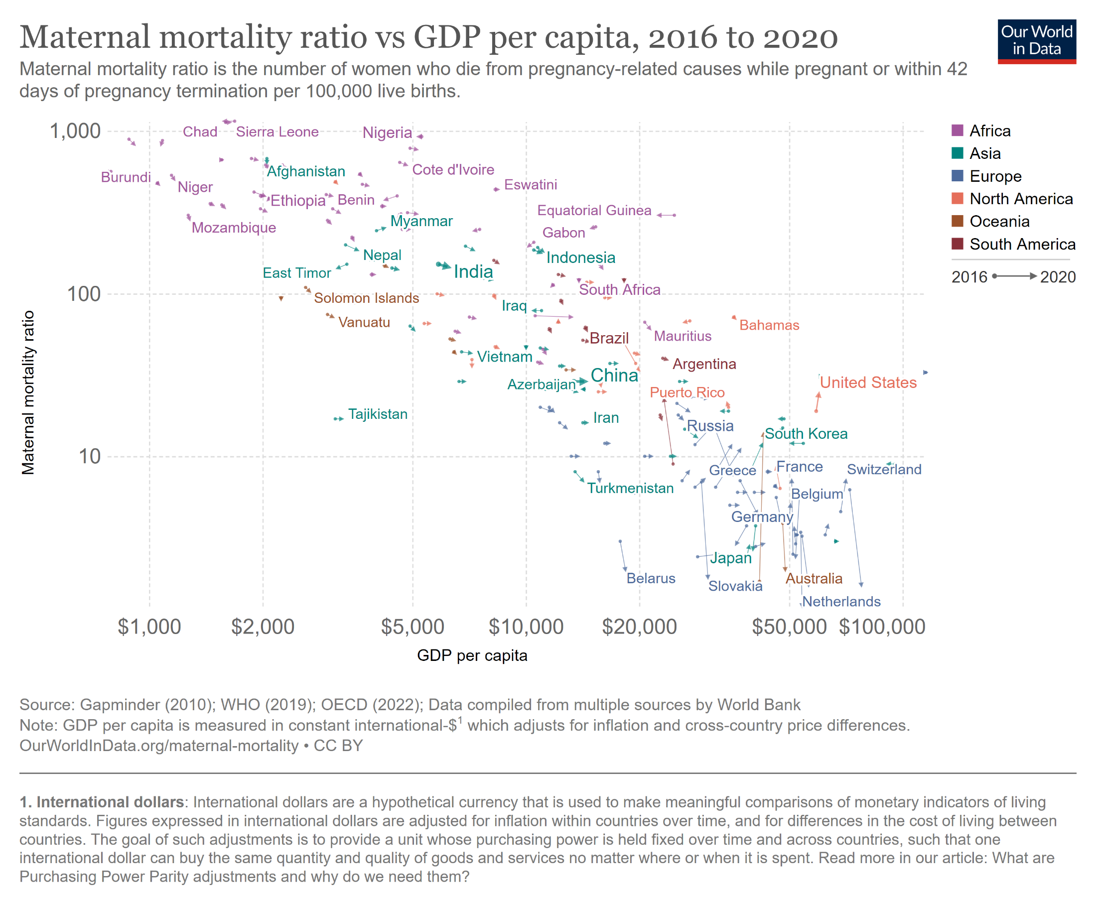

Slide 11
Maternal Mortality: a Main Problem of Health?
Maternal mortality has a significant share of total mortality in women of reproductive age (10-30%)
Maternal mortality has a significant share of pregnancy related mortality: 7% of total pregnancy related fatalities involve mothers
Proportion of burden of disease (in DALYs) in Africa:
Maternal conditions: 3.2 %
Perinatal: 6.5 %

Slide 12
Mother-Child-Programs (MCH)
1948: Mother-Child-Health (MCH) is one of four priorities in founding the WHO
1978: MCH is an element of PHC
Prenatal care and obstetrics
training MCH health professionals
Focus on survival of children
1985: more emphasis on maternal health: “Where is the “M” in MCH?”
1987: Safe Motherhood Initiative:
Concept of risk in prenatal care
Training of traditional midwifes
Obstetrics in in reference hospital
(concept of districts)

Slide 13
International Conference on Population and Development
Abbreviation:
ICPD
Cairo 1994
Resolutions:
Prevention and referral
Obstetrics assisted by trained midwives
Preventing over-intervention
Abortion care
Increase quality and effectiveness
Informed decision

Slide 14
Safe Motherhood Actions 1999
Content: Revision of Safe Motherhood Strategy
Goals:
1. Advance Safe Motherhood Through Human Rights
2. Empower Women: Ensure Choices
3. Safe Motherhood is a Vital Economic and Social Investment
4. Delay Marriage and First Birth
5. Every Pregnancy Faces Risks (Emergency Care)
6. Ensure Skilled Attendance at Delivery
7. Improve Access to Quality Reproductive Health Services
8. Prevent Unwanted Pregnancy and Address Unsafe Abortion
9. Measure Progress
10.The Power of Partnership

Slide 15
Loss of Effectiveness in Prenatal Care
Jahn (2002): Screening – the Trojan horse in preventive medicine?
Notes:
Zusammenfassend ergibt sich; dass das Screening wenig effektiv ist:
Diagramm auslesen (8%)

Slide 16
Medically Defined Risk Groups versus Self Assessment of Mothers (Example Mtwara, Tanzania)
Hospital Births: 21%
Risk Pregnancies according to catalogue: 29%
Risk Pregnancy in Hospital: 6%
Jahn (2002): Screening – the Trojan horse in preventive medicine?

Slide 17
Current Debate
Can maternal health be improved without an improvement of overall health care?
Is an emphasis on emergency care justified?
What role has prenatal care?
Maternal versus child health?
Improving the legal and social status of women.

Slide 18
Abortion
Number of induced abortions p.a.:about 73 million worldwide
61% of all unintended pregnancies and 29% of all pregnancies end in induced abortion
https://www.who.int/news-room/fact-sheets/detail/abortion
In majority of countries abortion is illegal under most conditions: 39 % of world population

Slide 19
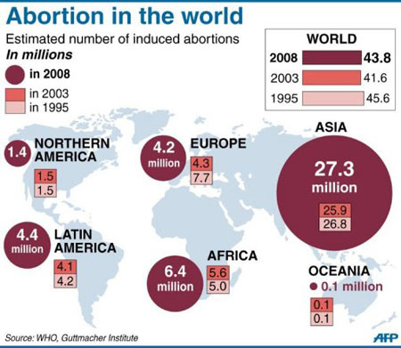

Slide 20
Countries where Abortion is Illegal
https://wisevoter.com/country-rankings/countries-where-abortion-is-illegal/

Slide 21
Example Kenya
Abortion is illegal (except for conflict of life of mother and after rape)
Estimated number of (illegal) abortions:
300-400,000 p.a.
Predominantly girls < 15 years
Post coital contraception: unknown number
High mortality due to illegal abortions
Estimate: 40 % of maternal mortality

Slide 22
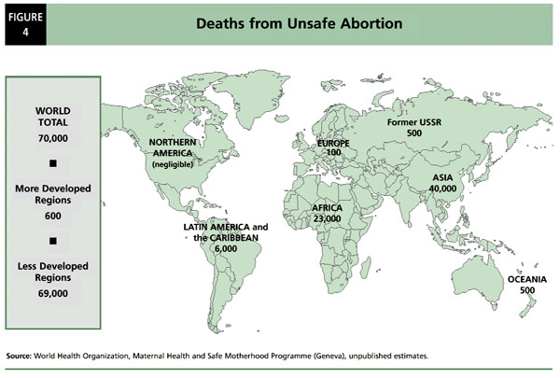

Slide 23
Conclusion
All previous “magic bullet” concepts failed
Actual progress in reducing maternal mortality demands for an overall improvement of health care in addition to specific measures (i.e. training midwives)

Slide 24
Risk Factors
Demand for Health Services
Epidemiology of Non-Infectious Diseases
Risk Factors
Nutrition
Water and Hygiene
Smoking, Alcohol and Environmental Influences
Pregnancy and Delivery
Health in unstable Populations
Health and Health Care in Megacities
Filter Between Need and Demand

