Slide 1
International Health Care Management II Part 1.2-5
Steffen Fleßa
Institute of Health Care Management
University of Greifswald

Slide 2
Risk Factors
Demand for Health Services
Epidemiology of Non-Infectious Diseases
Risk Factors
Nutrition
Water and Hygiene
Smoking, Alcohol and Environmental Influences
Pregnancy and Delivery
Health in unstable Populations
Health and Health Care in Megacities
Filter Between Need and Demand

Slide 3
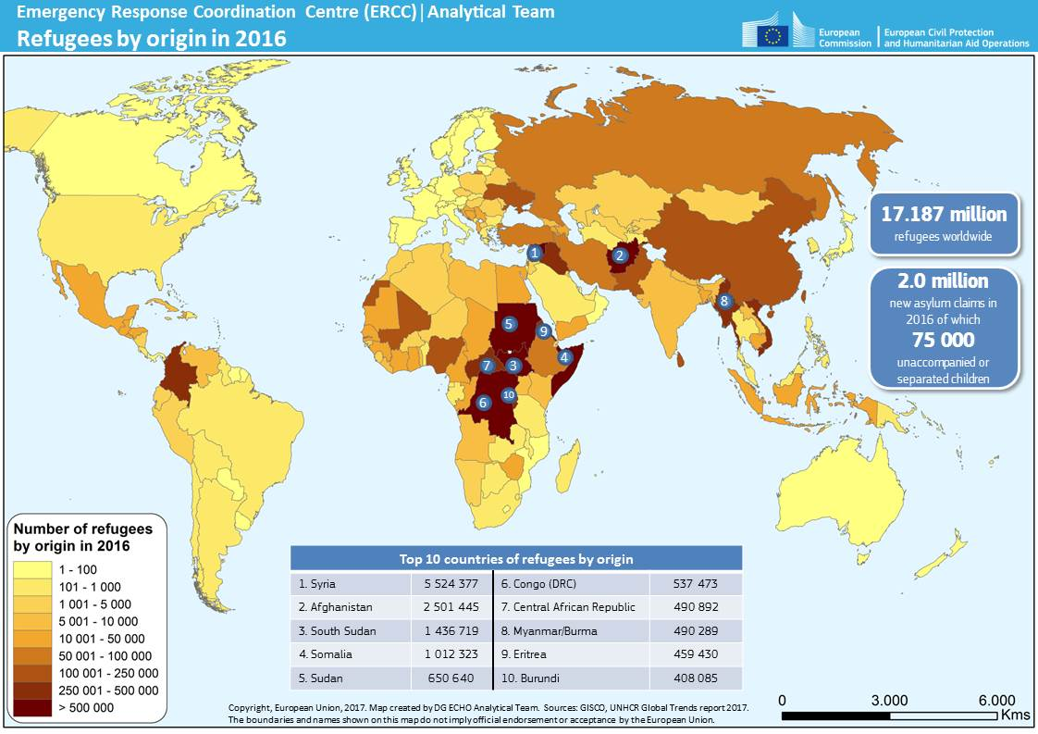
1.2.5. Health in Unstable Populations
https://ec.europa.eu/echo/what-we-do/humanitarian-aid/
efugees-and-internally-displaced-persons_en

Slide 4
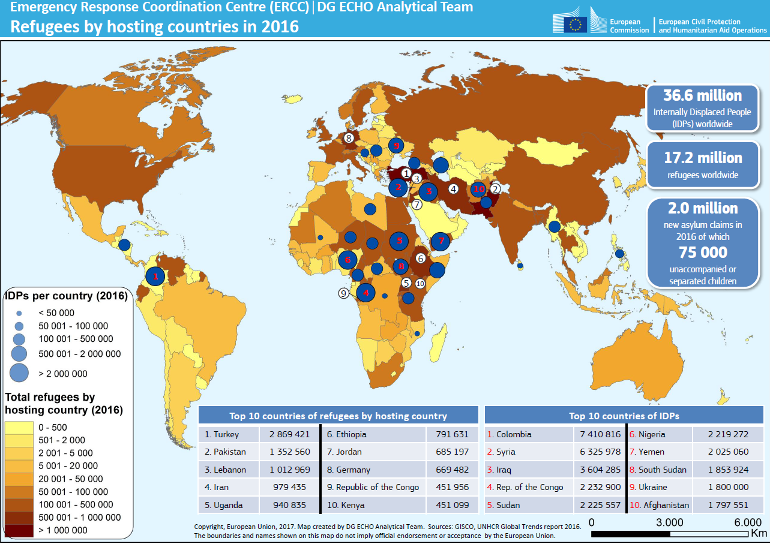
Refugees: hosting countries
https://reliefweb.int/map/world/world-refugee-day-refugees-hosting-countries-2017-emergency-response-coordination-centre

Slide 5
Internal displacement
https://reliefweb.int/report/world/global-report-internal-displacement-2023-grid-2023-internal-displacement-and-food-security

Slide 6
Groups
Refugees
Flee their own country
Special protection of “United Nations High Commissioner for Refugees” (UNHCR)
Internally displaced persons
leave their homes and livelihoods behind
Remain in own country
Residents affected by complex emergencies
non-displaced populations
Heudtlass, Speybroeck &Guha-Sapir (2016)

Slide 7
Health problems
Violence
War
genocide
Non-violence (more fatality than violence)
Poor public health support,
E.g. vaccination coverage
Shelter and sanitation
Nutrition, lack of access to food and water
E.g. anemia
Availability of medication
E.g. anti-diabetic drugs
Stress and mental diseases
Birth-giving and contraceptives
Cardiovascular diseases
Communicable Diseases
E.g. TB, STDs, parasitic infections, worm infections
NB: The majority of refugees does not live in camps but (illegally) in cities

Slide 8
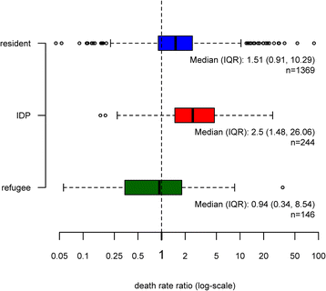
Excess mortality in humanitarian emergencies
EMR=emergency death rates / baseline death rates
residents: significant additional mortality
IDP: highly significant additional mortality
Refugees: no significant additional mortality
emergency death rates / baseline death rates

Slide 9
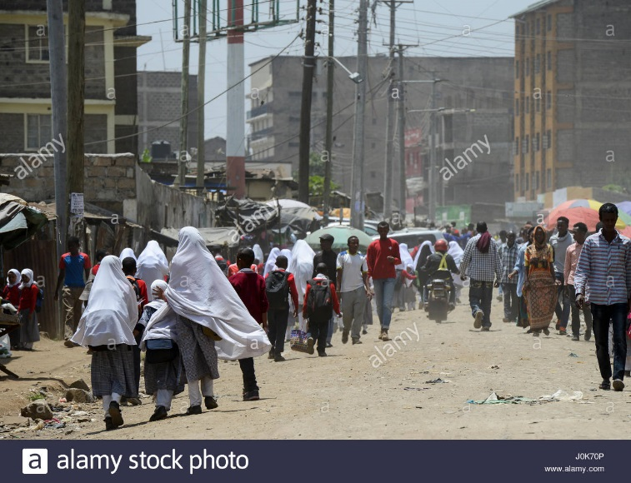
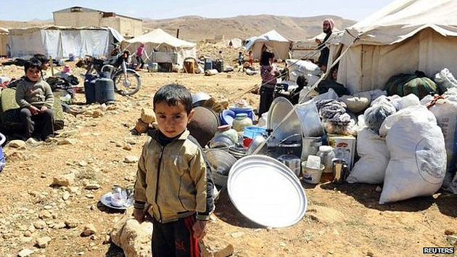
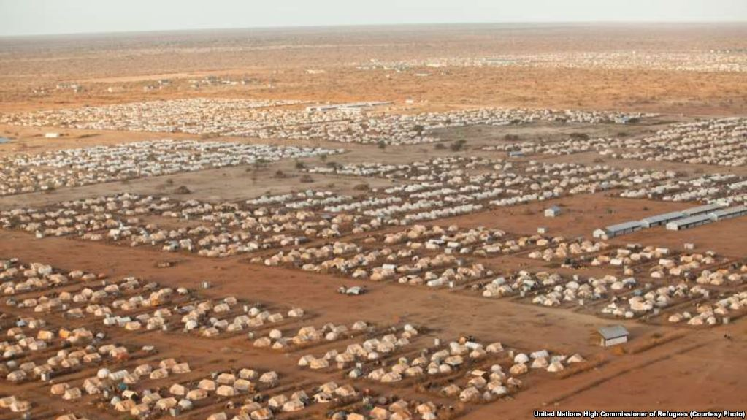
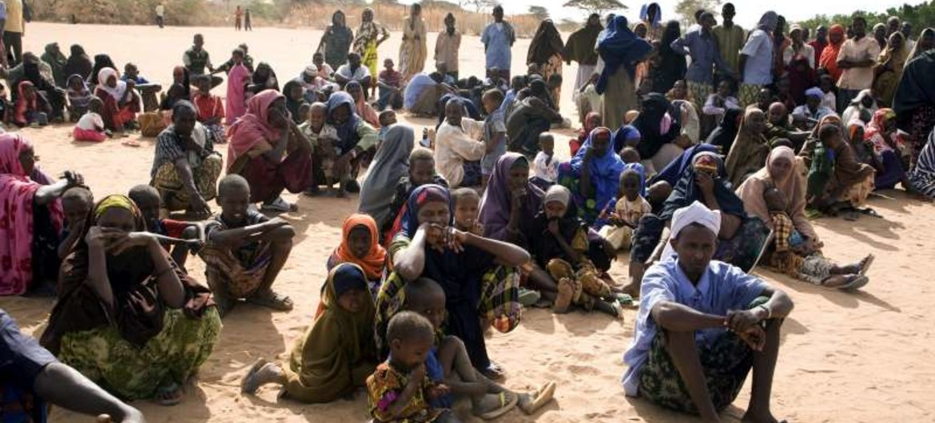
Refugees in camps are in the focus of international aid – but not worst problem
Internally displaced persons and in particular population residing in emergency situations are the main problems – unaddressed.

Slide 10
1.2.6 Health and Health Care in Megacities
Mega City: Definition: ≥ 10 million inhabitants
Reason:
High urbanization in developing countries
Strong attention to rural problems

Slide 11
Urbanization in Least Developed Countries
http://esa.un.org/unpd/wpp/index.htm
Side Condition: already in 2008 the majority of the world‘s population is living in urban regions!
Notes:
Abb. Städtische und ländliche Bevölkerungsentwicklung sowie Verstädterungsgrad
→ Wachstum der städtischen Bevölkerung bis 2030 beläuft sich auf fast das Zweifache des Wachstums der Weltbevölkerung
Schnittpunkt 2007/2008 – erstmals lebt mehr als die Hälfte aller Menschen weltweit in Städten (3,3 Mrd.)

Slide 12
„Urban Penalty“
Early Industrial Revolution: Life expectancy in cities is significantly lower than in rural areas = urban penalty
Development: since 20th century non existent

Slide 13
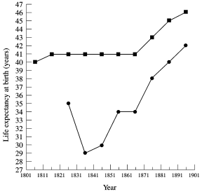
Land, Kleinstädte
Rural and sub-urban
Life Expectancy at Birth (Years)
Urban
Großstädte
Life Expectancy in England and Wales (Szreter 1999)

Slide 14
Mega-City
Def.: City with more than 10 million inhabitants
1980 | 1990 | 2000 | 2015 | 2020
New York, Mexico City, Sao Paulo, Shanghai, Tokyo | New York, Mexico City, Sao Paulo, Shanghai, Tokyo, Los Angeles, Buenos Aires, Mumbai, Kalkuta, Peking, Seoul | New York, Mexico City, Sao Paulo, Shanghai, Tokyo, Los Angeles, Buenos Aires, Mumbai, Kalkuta, Peking, Seoul, Reio de Janeiro, Lagos, Cairo, Krachi, Delhi, Dhaka, Jakarta, Manila | Tokyo, Jakarta, Delhi, Karachi, Seoul, Shanghai, Mumbai, New York City, Mexico City, Beijing, Sao Paulo, Lagos, Osaka, Manila, Cairo, Los Angeles, Dhaka, Moscow, Buenos Aires, Lahore, Bangkok, Istanbul, Rio de Janeiro, Tehran, London, Guangzhou, Kinshasa, Paris, Shenzhen, Kolkata, Rhine-Ruhr, Tianjin, Bengaluru, Chennai, Hyderabad, Chongqing | Shanghai, Chongqing, Peking, Guangzhou, Delhi, Kinshasa, Karachi, Shenzhen, Istanbul, Lagos, Tokio, Moskau, Mumbai, São Paulo, Chengdu, Lahore, Tianjin, Jakarta, Bangkok, Lima, Seoul, Kairo, Hyderabad, Mexiko-Stadt, Hangzhou, Ho Chi Minh Stadt, London, Dhaka, Wuhan, Teheran,New York City, Bangalore, Shenyang, Dongguan, Bagdad, Riad, Hongkong, Bogota, Foshan, Xi’an, Chennai, Rio de Janeiro, Zhengzhou, Nanjing, Daressalam, Santiago, Surat, Qingdao, Singapur, Ankara, Ahmedabad, Shantou, Sankt Petersburg, Alexandria, Rangun, Casablanca, Harbin
China: 18
Indien: 7
https://www.laenderdaten.info/megacities.php

Slide 15
Development of Population of Selected Cities, 1950-2023
City | 1950 [Mio.] | 2023 [Mio.] | Factor | p.a.
Lagos | 0,29 | 14,23 | 49,1 | 5,48%
Kinshasa | 0,2 | 14,67 | 73,4 | 6,06%
Sao Paulo | 2,33 | 12,41 | 5,3 | 2,32%
Mexico City | 2,88 | 9,21 | 3,2 | 1,61%
Mumbai | 2,86 | 12,44 | 4,3 | 2,03%
Tokio | 11,28 | 13,96 | 1,2 | 0,29%
Shanghai | 6,07 | 24,87 | 4,1 | 1,95%
Berlin | 3,34 | 3,65 | 1,1 | 0,12%
https://www.laenderdaten.info/megacities.php
Notes:
Abb. zu verschiedenen Städten 1950, 1980, 2005 (Tokio, Mumbai, Mexico-City, Sao Paulo, New York, Shanghai, Lagos, Kinshasa, Berlin)
Der überweigende teil der weltweiten städtischen Bevölkerung lebt jedoch in Städten mit weniger als 500,000 Einwohnern. Diese sind vergleichsweise flexibel, aber personell, institutionell und technisch schlecht ausgesattet.

Slide 16
Mega-Cities in low and lower middle income countries
Megacity | Inhabitants
Delhi | 18498200
Kinshasa | 14970000
Karachi | 14910400
Lagos | 14234000
Mumbai | 12442400
Lahore | 11126300
Hyderabad | 9482000
Ho Chi Minh City | 8993100
Dhaka | 8906000
Bangalore | 8443700
Chennai | 7088000
Daressalam | 6400000
Surat | 6176000
Ahmedabad | 5633900
Rangun | 5160500

Slide 17
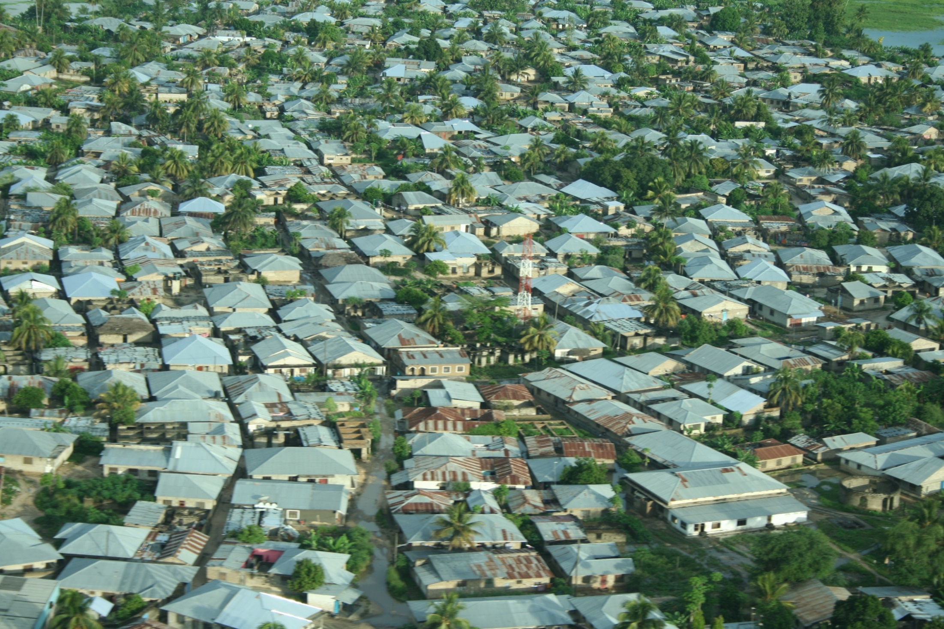
Health Promotion: here?
Notes:
Infrastruktur wächst nicht mit der Bevölkerung (vgl. „gececondu“)
Fehlende wirtschaftliche Perspetiven
Vulnerabilität am größten für die Ärmsten (Erdrutsche, Überschwemmungen, Chemieunfälle…)

Slide 18
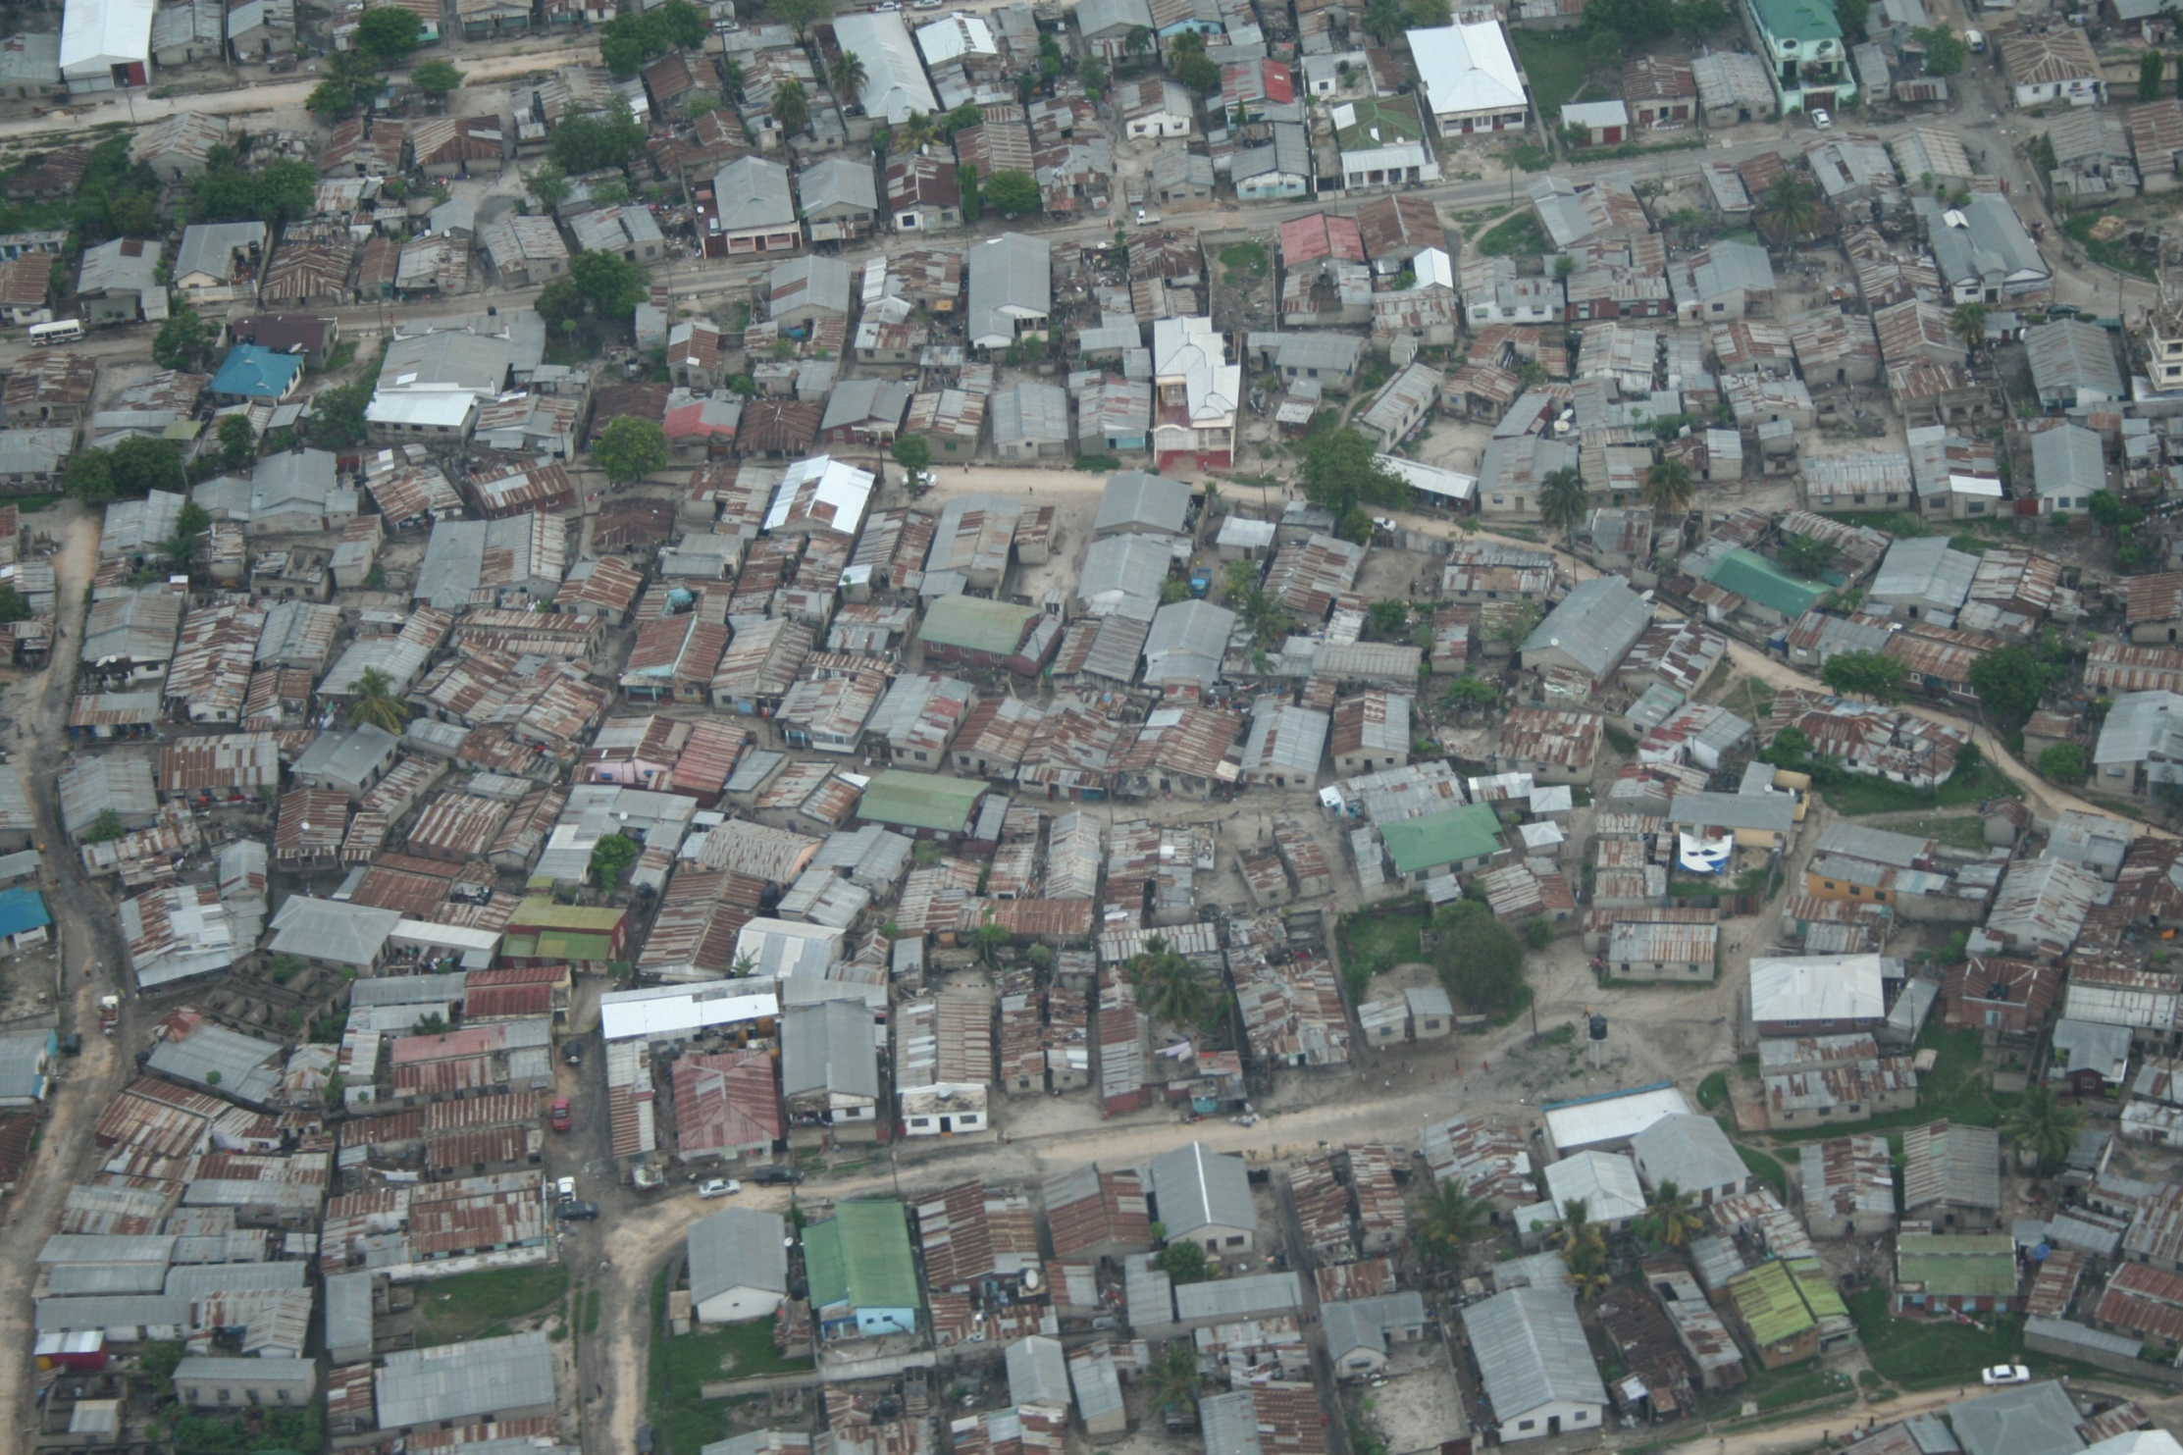
or here?
Notes:
Eigene Erfahrungen aus Ankara und Beirut

Slide 19
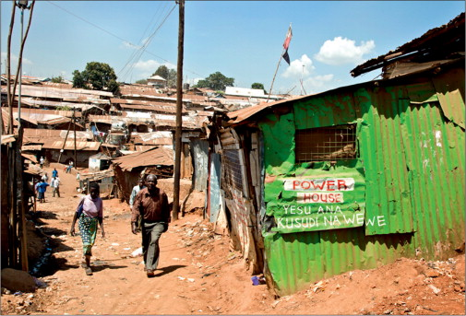
http://www.thelancet.com/journals/lancet/article/PIIS0140673613608697/images?imageId=fx1&sectionType=lightBlue&hasDownloadImagesLink=false

Slide 20
Diseases of Higher Prevalence in Megacities
Diseases of Digestive Organs
High child mortality
Diseases of the Lungs, Asthma
Strong pollution
Mexico City is considered the “most dirty city”
Ozone > WHO standard on more that 300 days / year
Hearing Loss
Noise pollution
Nervousness, communication disorders, sleep disorder
Obesity
Allergies
Diabetes

Slide 21
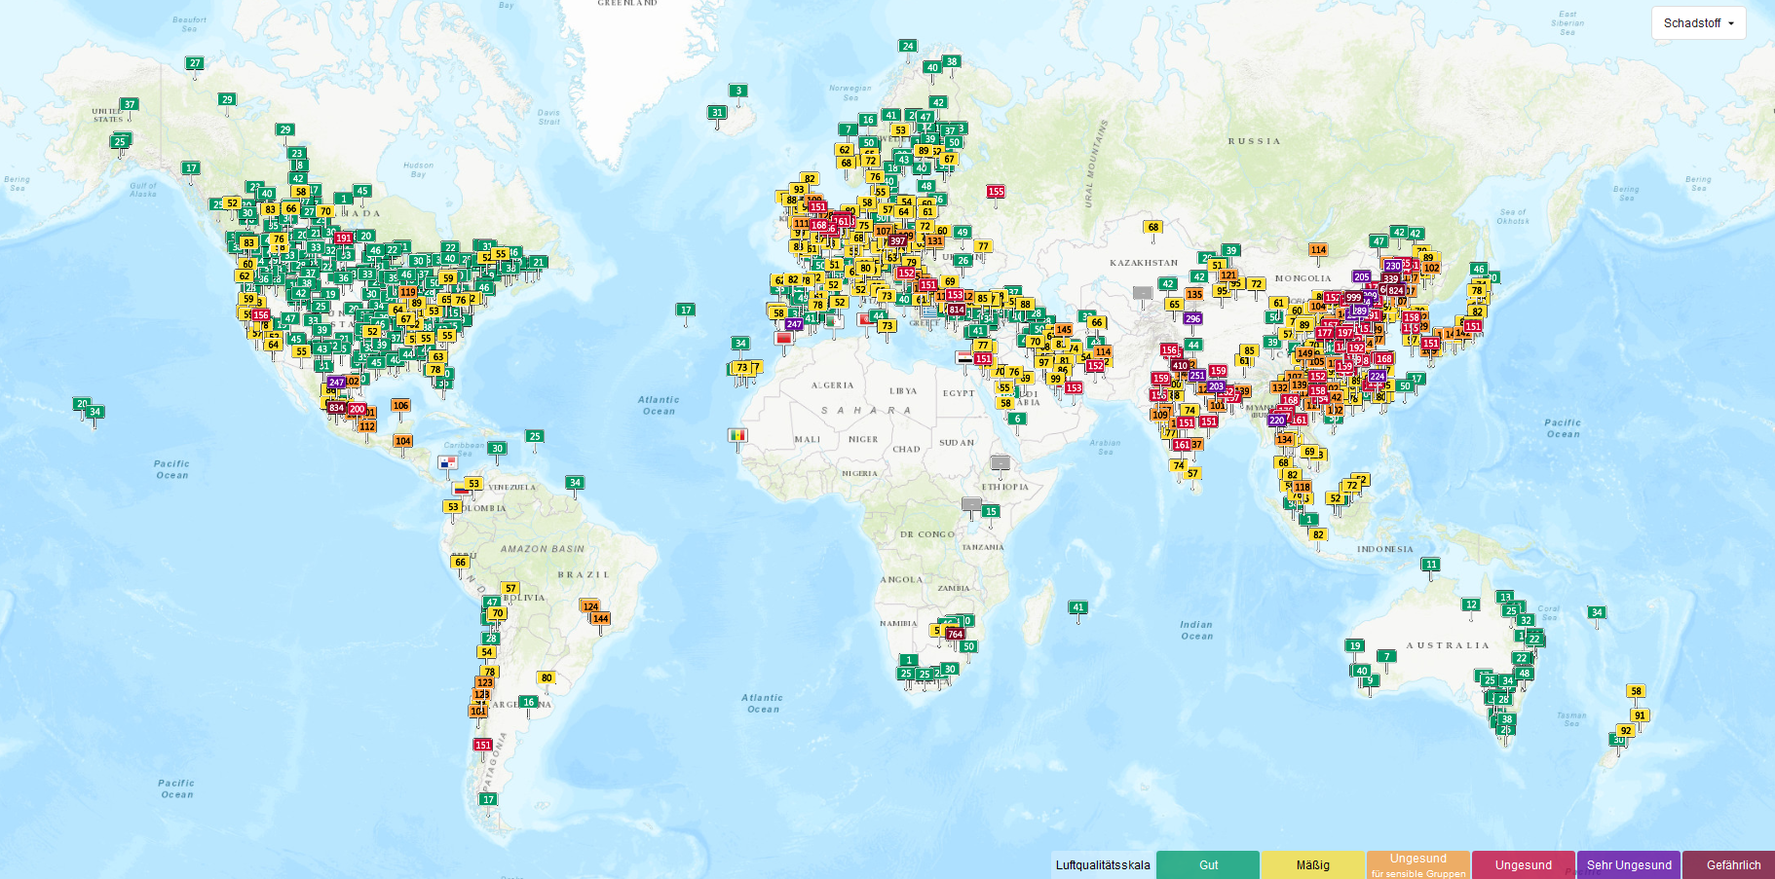
Air-Quality Index (AQI US) Cities Ranking
Good
Medium
Unhealthy for sensitive groups
Unhealthy
Very un-healthy
Dangerous
https://waqi.info/de

Slide 22
Air-Quality Index (AQI US) Cities Ranking
1 Shijiazhuang 188
2 Xingtai 187
3 Delhi 185
4 Dubai 181
5 Abu Dhabi 177
6 Dhaka 165
7 New Delhi 164
8 Noida 164
9 Gurugram 162
10 Beijing 159
11 Tianjin 153
12 Manama 141
...
121 Hamburg 42
122 Nuremberg 42
…
Greifswald 28
…
154 Lausanne 27
155 Vilnius 25
156 Wellington 20
157 Stockholm 16
https://air-quality.com/places

Slide 23
Problems in Slums

Slide 24
Risk Factors
Demand for Health Services
Epidemiology of Non-Infectious Diseases
Risk Factors
Nutrition
Water and Hygiene
Smoking, Alcohol and Environmental Influences
Pregnancy and Delivery
Health in unstable Populations
Health and Health Care in Megacities
Filter Between Need and Demand

