Slide 1
International Health Care Management II
Part 1.3
Steffen Fleßa
Institute of Health Care Management
University of Greifswald

Slide 2
Filters
Demand for Health Services
  Epidemiology of Non-Infectious Diseases
  Risk Factors
  Filter Between Need and Demand
    Distance and Demand
    Price Elasticity and Insurance

Slide 3
  1.3 Filter Between Need and Demand
  1.3.1 Distance and Demand
Service Character:
  Cannot be stored
  Cannot be transported
  Requires presence of patient
Consequence: Production and sales in unity of place, time and action
Consequence: Overcoming distance is essential

Slide 4
Distance-Friction-Effect

Slide 5
Distance-Friction-Effect
Trans-
actions
Distance

Slide 6
Newton‘s Gravity Formula
G Gravity within two centers
C Constant
M_{i} Mass of center i
d Distance between two centers
α Friction constant, depending on infrastructure, mental mobility, relative benefit
Problem: Curative medicine shows small alpha, prevention high alpha

Slide 7
Actual Catchment Area

Slide 8
Catchment Area of Minimal Distance

Slide 9
Catchment Area Kajiado Hospital, Kenya

Slide 10
Catchment Area Thikai Health Centre, Kenya

Slide 11
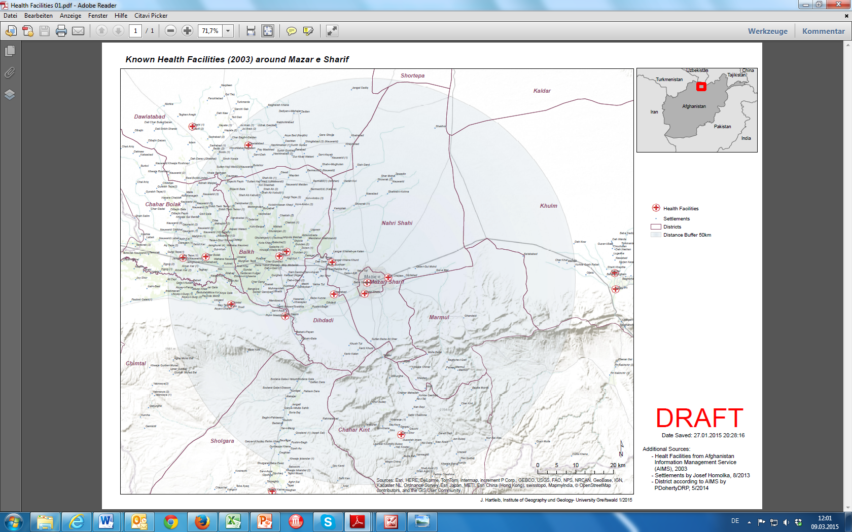
Health Care in Balkh Province, Afghanistan

Slide 12
Travel time to Balkh Provincial Hospital

Slide 13
1.3.2 Price Elasticity and Insurance
Procedure:
  Economic basics implied
  Here: exceptions
To Repeat: Definition of Elasticity
  Price Elasticity
  Cross-Price Elasticity
  Income Elasticity

Slide 14
Occupancy and Fees of 24 Church Hospitals

Slide 15
Demand for Outpatient Services in Mvumi Hospital

Slide 16
Fee Waiver for Poverty Groups
Definition of Poverty
  absolute poverty (1 US$)
  relative poverty: exclusion from “normal” way of life
Problems:
  Determining criteria
    Poverty in income?
    Poverty in assets? (Massai owning 200 cows?)
  Side-payments

Slide 17
Poverty measurement
Fernandes, 2022

Slide 18
Impoverishment
Fernandes, 2022

Slide 19
Impoverishment for three measures 2009 and 2014 (Cambodia).
Fernandes, 2022

Slide 20
Share of Costumers of Health Facilities Having to Pay for Services That Are Free of Charge (Kenya)
70%
60%
55%
54%
60%
50%
45%
40%
30%
20%
10%
0%
Immunisation
Antenatal
Family planning
Delivery

Slide 21
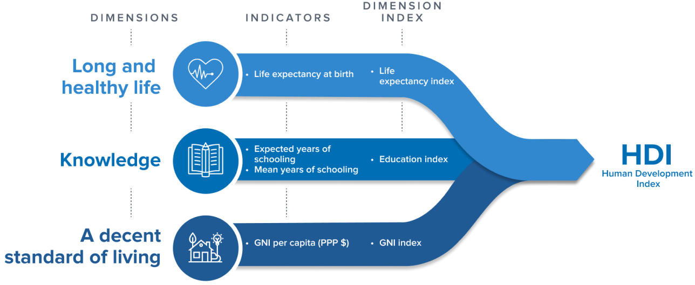
Human Development Index
“Multidimensional Poverty”: Proportion of population that are considered poor under various dimensions
https://hdr.undp.org/data-center/human-development-index#/indicies/HDI

Slide 22
Human Development Ranking
HDI rank | country | HDI
160 | Tanzania (United Republic of) | 0,549
161 | Pakistan | 0,544
162 | Togo | 0,539
163 | Haiti | 0,535
163 | Nigeria | 0,535
165 | Rwanda | 0,534
166 | Benin | 0,525
166 | Uganda | 0,525
168 | Lesotho | 0,514
169 | Malawi | 0,512
170 | Senegal | 0,511
171 | Djibouti | 0,509
172 | Sudan | 0,508
173 | Madagascar | 0,501
174 | Gambia | 0,500
175 | Ethiopia | 0,498
176 | Eritrea | 0,492
177 | Guinea-Bissau | 0,483
178 | Liberia | 0,481
179 | Congo (Democratic Republic of the) | 0,479
180 | Afghanistan | 0,478
181 | Sierra Leone | 0,477
182 | Guinea | 0,465
183 | Yemen | 0,455
184 | Burkina Faso | 0,449
185 | Mozambique | 0,446
186 | Mali | 0,428
187 | Burundi | 0,426
188 | Central African Republic | 0,404
189 | Niger | 0,400
190 | Chad | 0,394
191 | South Sudan | 0,385
https://hdr.undp.org/sites/default/files/2021-22_HDR/HDR21-22_Statistical_Annex_HDI_Table.xlsx

Slide 23
Lorenz-Chart of Cambodia (2004)
(World Bank 2008)

Slide 24
Consumption per capita in Cambodia (Worldbank 2012)

Slide 25
Dynamics of Poverty

Slide 26
Wealth
Wealth of Assets
  Financial Assets
  Real Estate Assets
Wealth of Income
⇨ Statistics vary significantly!

Slide 27
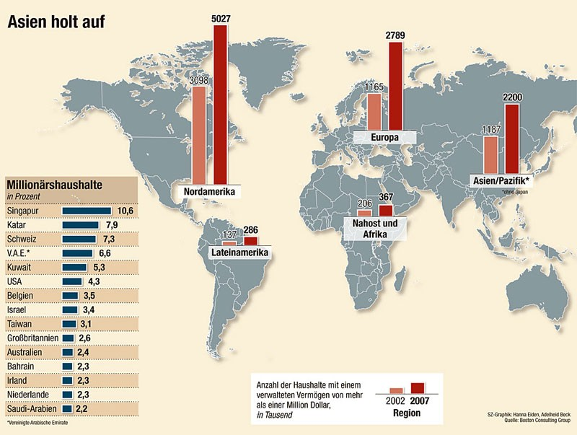
Millionaires Worldwide [in thousands]
Europe
Millionaire housholds [%]
Northern America
Asia/Pacific
Near East and Africa
Latin America
http://www.sueddeutsche.de/geld/vermoegen-weltweit-neue-deutsche-millionaere-1.708921

Slide 28
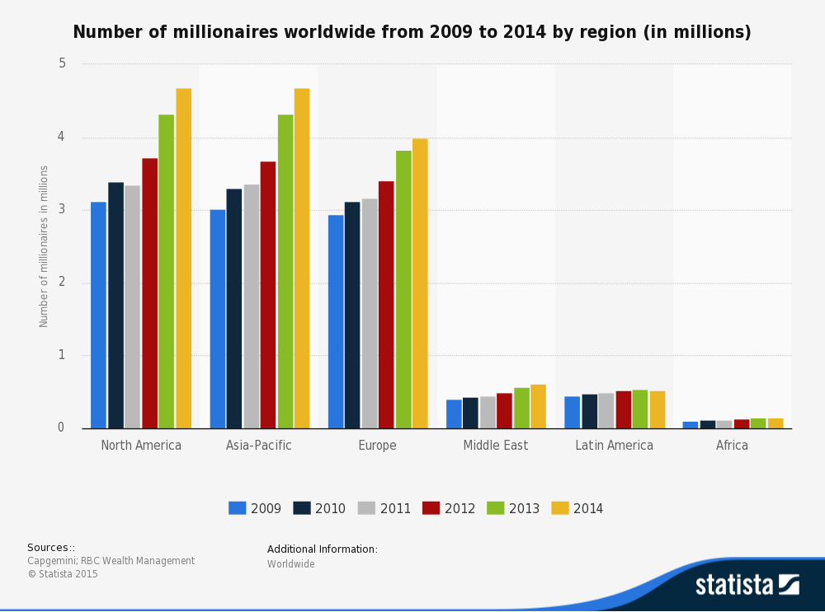
https://d28wbuch0jlv7v.cloudfront.net/images/infografik/normal/chartoftheday_3890_the_countries_with_the_most_millionaires_n.jpg

Slide 29

Countries with the most millionaires in 2018 and 2019 (in 1,000s)
Number of millionaires in thousands
Note(s): Worldwide; 2018 and 2019
Further information regarding this statistic can be found on page 8.
Source(s): Capgemini; RBC Wealth Management; ID 263491
2

Slide 30

“Two worlds of health”
Health care for the poor majority and rich minority completely separate
Example: Cambodia
  Strong increase of cosmetic surgery
    Status 2016: 32 hospitals / clinics in Cambodia offering cosmetic surgery!
  Incl. hymen reconstruction
  Advertisement, discount, …: business!

Slide 31
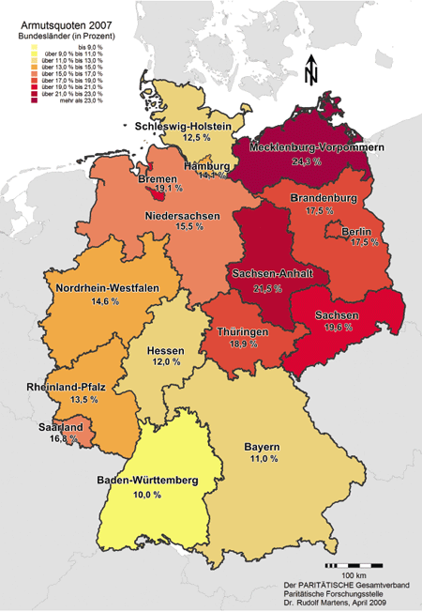
Poverty in Germany
Leader MV: 24.3%
www.armutsatlas.de

Slide 32
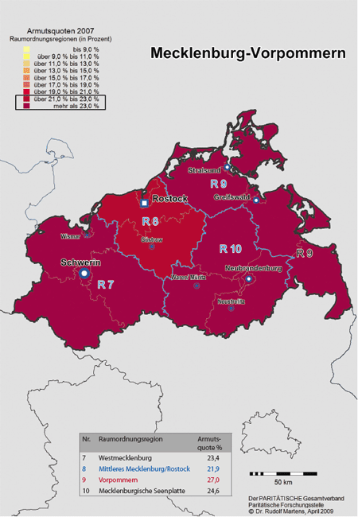
Poverty in Mecklenburg-Western Pomerania
Leader Western Pomerania: 27.0 %
www.armutsatlas.de

Slide 33
Consequences
Large proportion of the world’s population cannot afford even a minimum of health care
Health insurance is a possibility to pool the risk of catastrophic payment
A proportion of the German population would also not be able to pay for health care

Slide 34
Disadvantages of Insurance
Standard Knowledge:
  Adverse Selection
  Moral Hazard
  Overhead Expenses
  Risk
Disadvantages in Countries Poor of Resources:
  Need for Catching Up
  Problems in Institutions
  Ethnological Problems

Slide 35
Filters
Demand for Health Services
  Epidemiology of Non-Infectious Diseases
  Risk Factors
  Filter Between Need and Demand
    Distance and Demand
    Price Elasticity and Insurance

