Slide 1
International Health Care Management II Part 2.1-1
Steffen Fleßa
Institute of Health Care Management
University of Greifswald

Slide 2
Supply of Health Services: Structure
Demand for Health Services
Supply of Health Services
Factors of Production
Buildings and Equipment
Staff
Problems of Donations
Spatial Structure of Supply
Levels of Care
Provider Portfolio
Health Care Systems and Reforms

Slide 3
2.1.1 Buildings and Equipment
Basic Problems:
Applied Technology
No maintenance
Consumption of own structure

Slide 4
Dimensions of Applied Technology
Functional Adjustment:
Technology fulfils what is required, but not more than that
e.g.
Basic radiographic system
Ramps instead of elevators in developing countries
Robust equipment that does not need much maintenance
Resource Adjustment:
Technology is adjusted to resources
E.g.
No devices with high cost of maintenance
Technology that can be operated by local staff

Slide 5
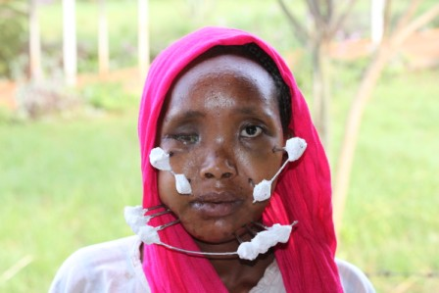
Example
„Fixateur externe“ made from bicycle spokes
Source: http://www.airahospital.org/?tag=appropiate-technology

Slide 6
Precondition: Strategic Planning
Equipment Life Cycle
Demand Analysis
Standardization
Order
Utilization and Maintenance
Disposal

Slide 7
Maintenance
Culture of Maintenance
“Climate-Theory”: tropical climate with steady supply of food fosters short-term planning
WHO-Standards:
1% of original value of buildings for maintenance p.a.
5% of original value of devices for maintenance p.a.

Slide 8
Consumption of Structure
Buildings and
Equip.
DONATIONS
Drugs
and
Staff
FEES
Mainte-nance and Develop-ment
Consumption of Structure

Slide 9
Quality of Structure Kenya Service Provision Assessment Survey (2004)

Slide 10
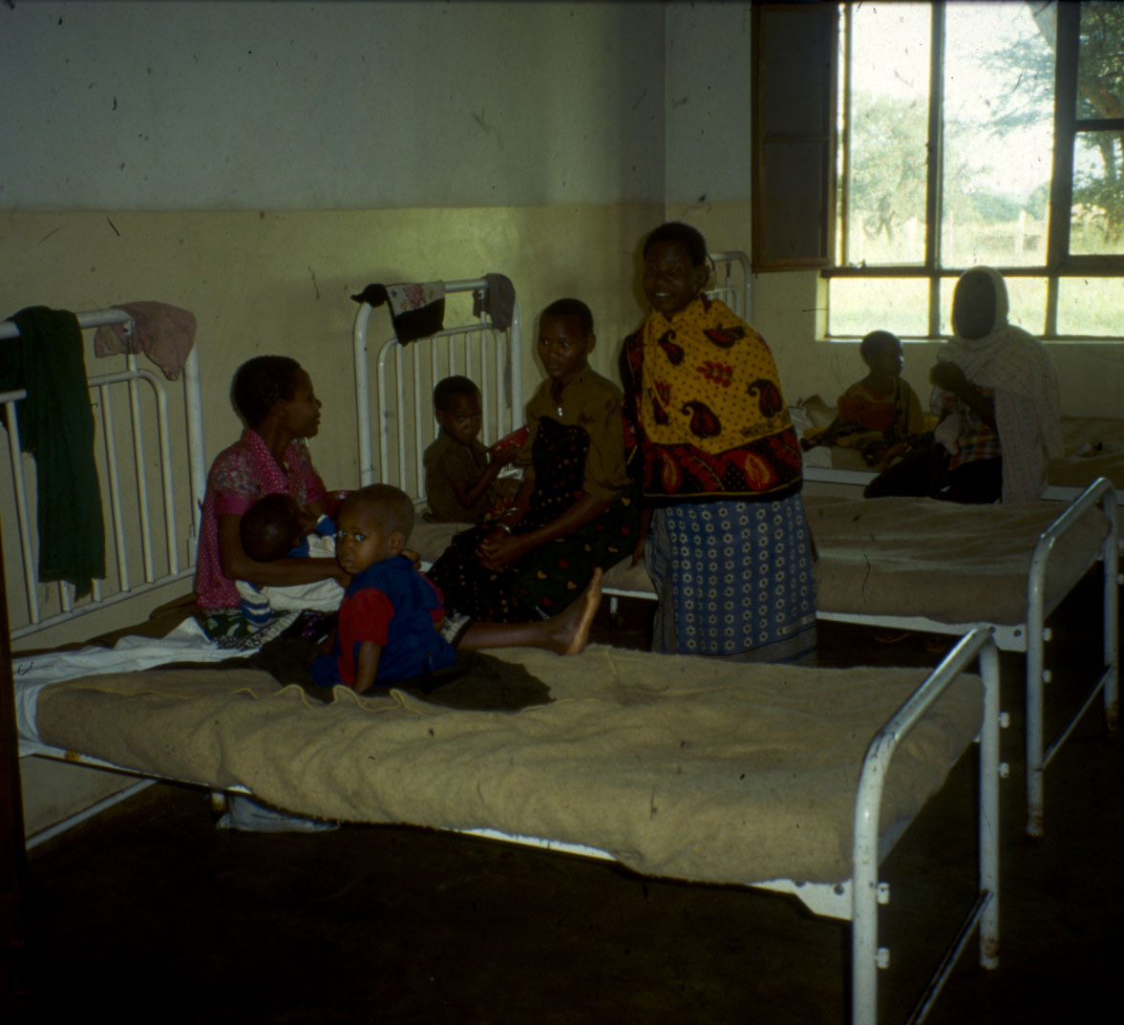
In the beginning…

Slide 11
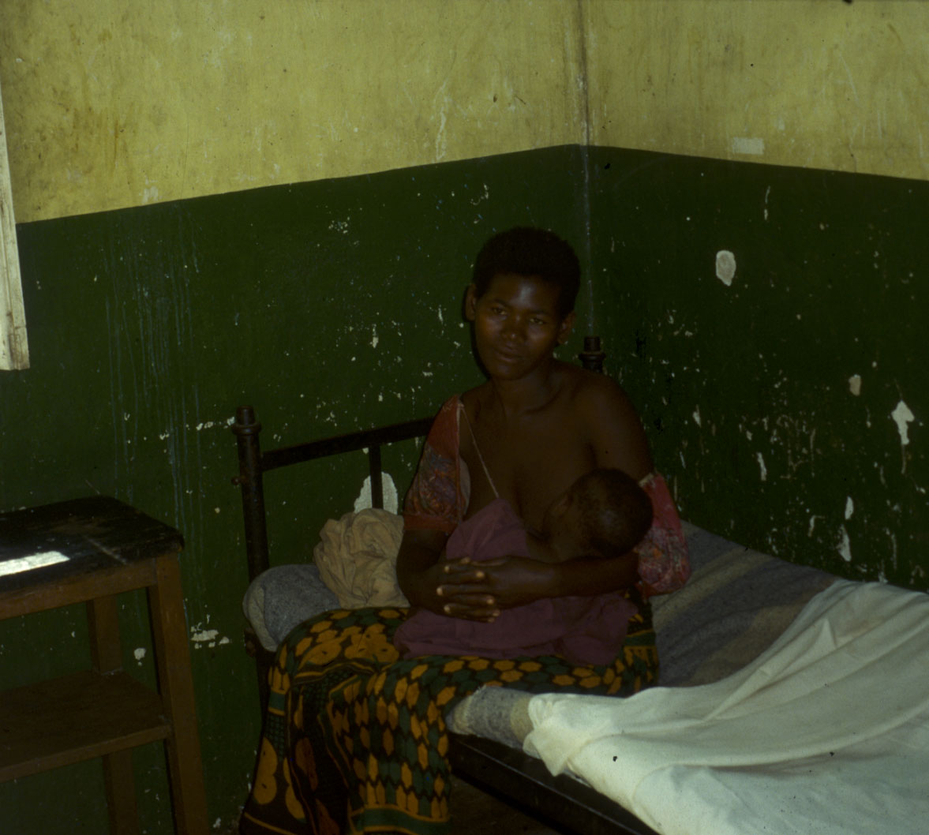
… then …

Slide 12
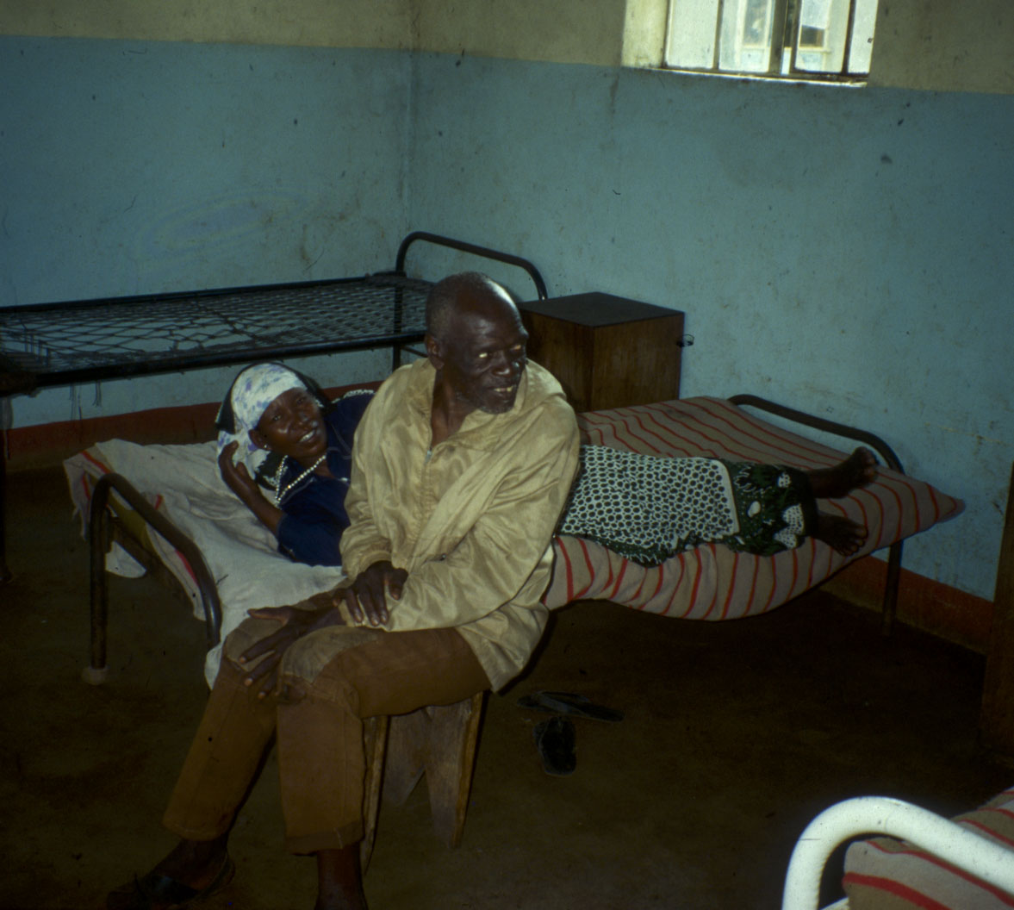
… then …

Slide 13
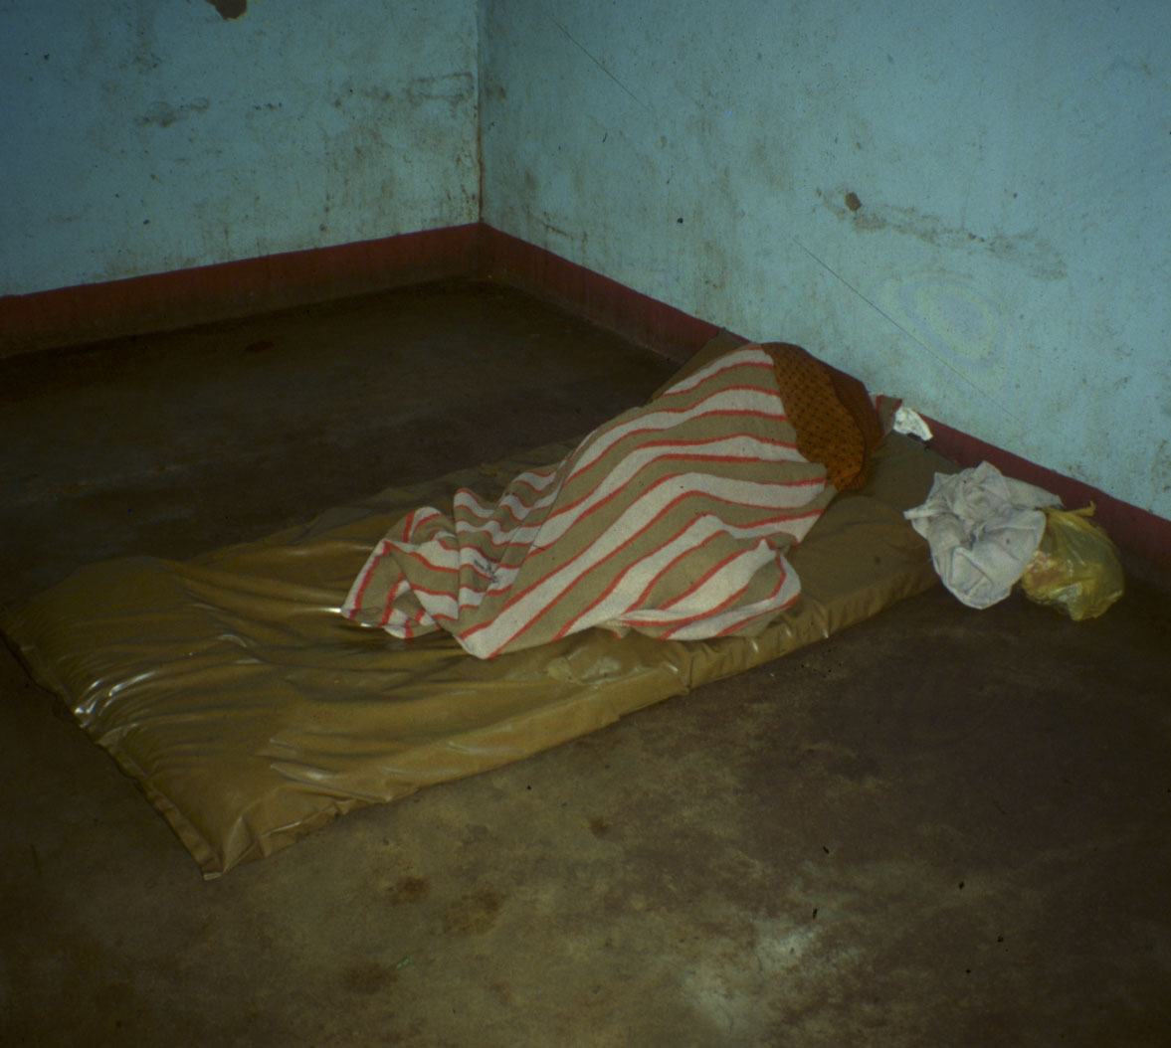
… and finally …

Slide 14
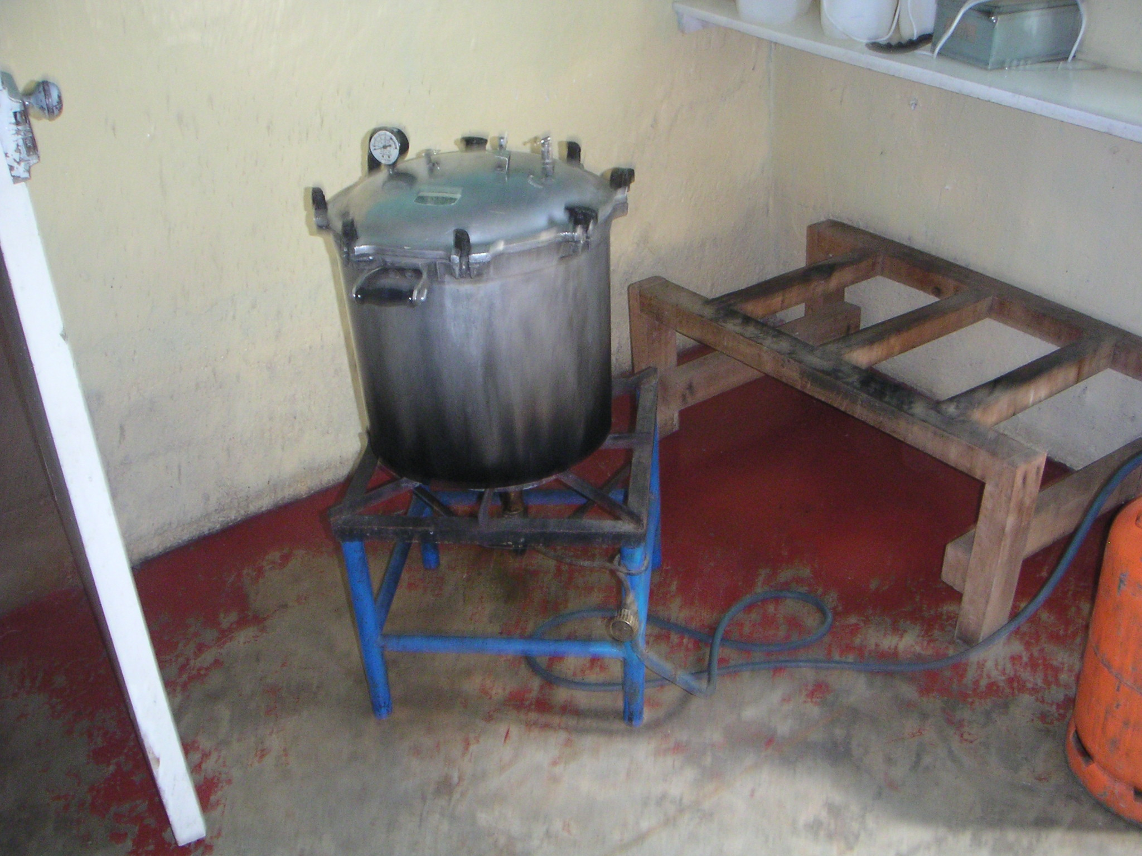

Slide 15
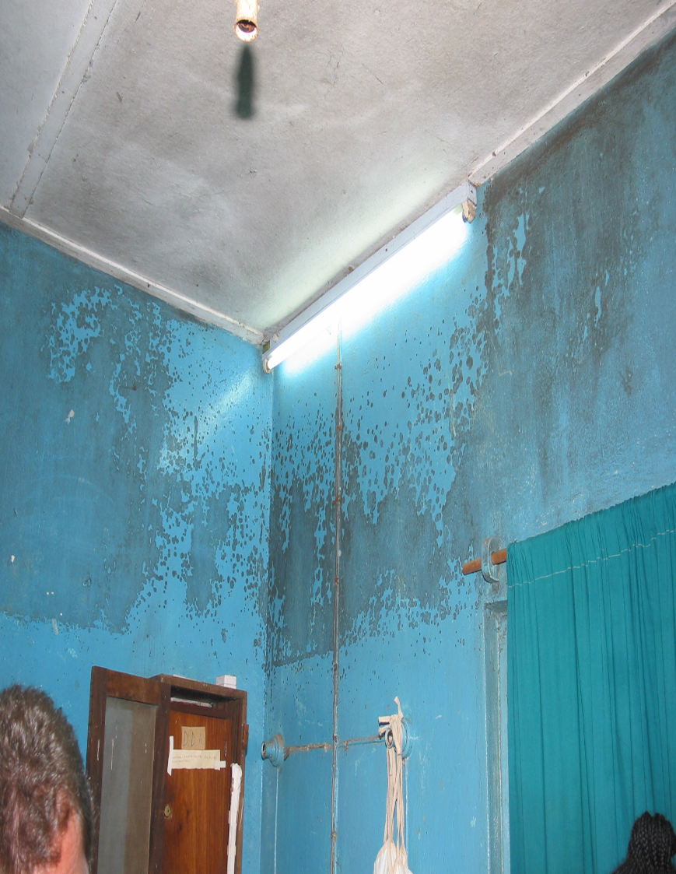
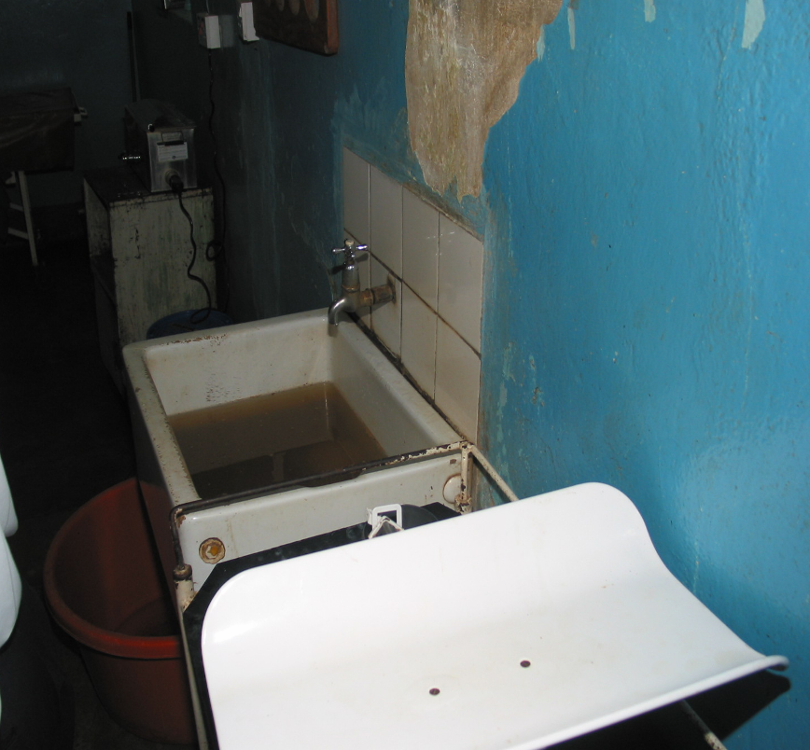
… the view of a woman in labor…

Slide 18
Quality
Of 421 million annual global hospitalizations, approx. 42.7 million result in adverse events→ loss of 23 million disability adjusted-life years (DALYs); 2/3 occur in low and middle-income countries
Jha AK, Larizgoitia I, Audera-Lopez C, Prasopa-Plaizier N, Waters H, Bates DW. The global burden of unsafe medical care: analytic modelling of observational studies. BMJ Qual Saf 2013; 22(10): 809-15.
WHO systematic review of 900 studies from 1990-2009: only 40% of patients in public health facilities, and only 6-19% of patients in private facilities were treated according to standard guidelines.
Holloway KA, Ivanovska V, Wagner AK, Vialle-Valentin C, Ross-Degnan D. Have we improved use of medicines in developing and transitional countries and do we know how to? Two decades of evidence. Trop Med Int Health 2013; 18(6): 656-64.
Notes:
Yet, much of the care received in high-, middle- and low-income settings does not meet these criteria.

Slide 19
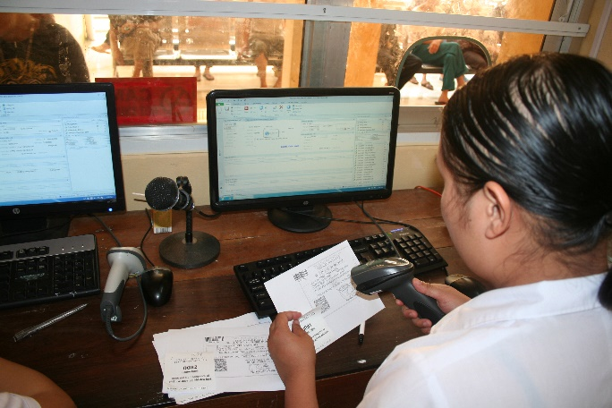
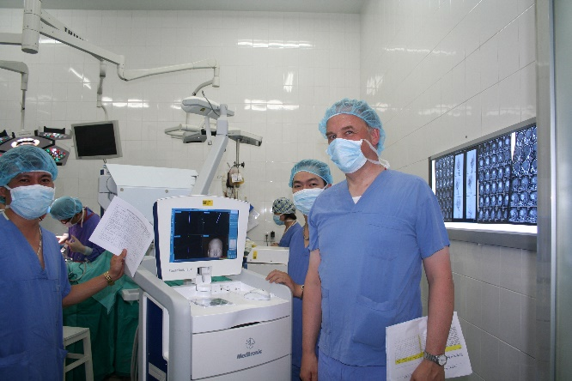
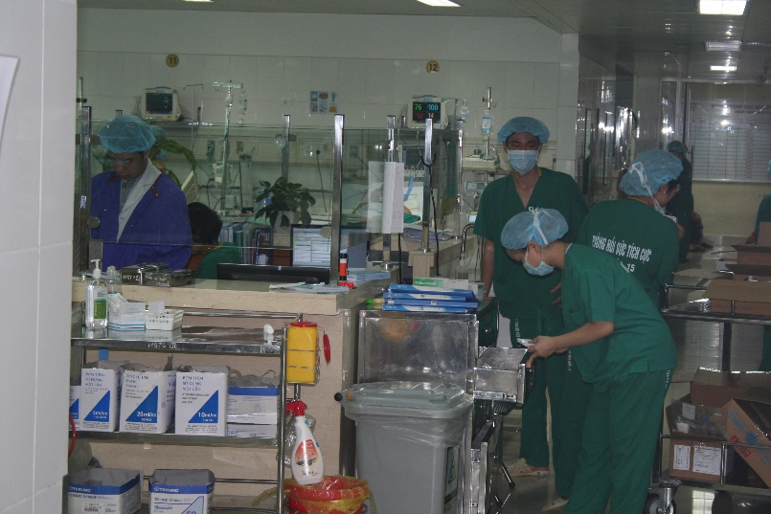
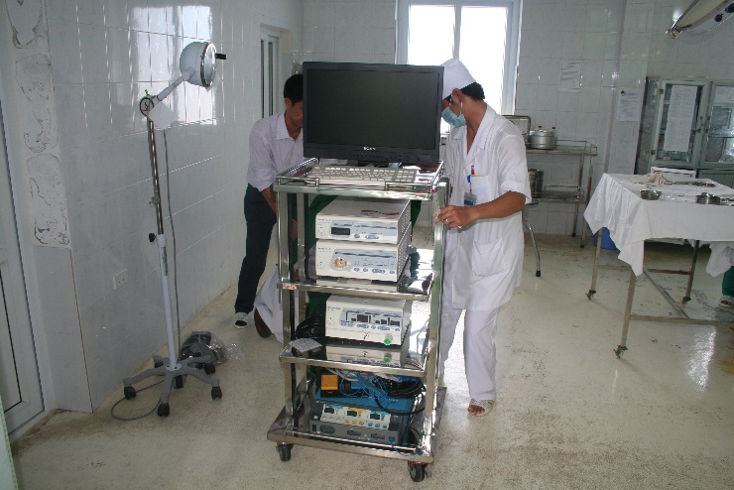
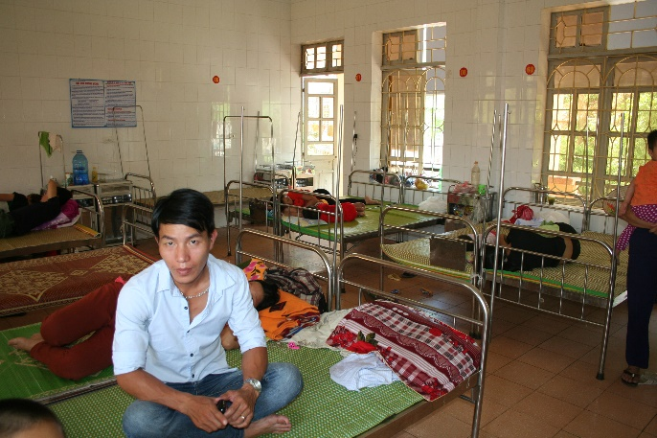
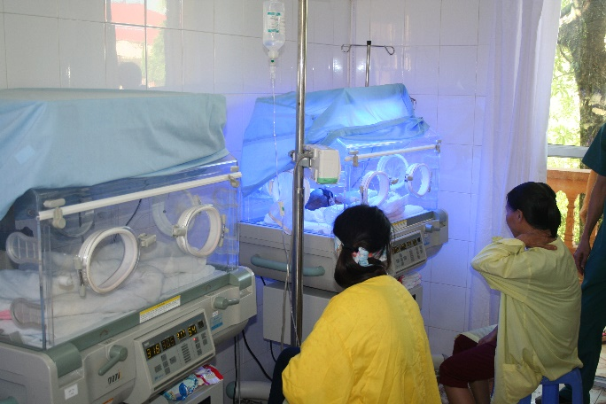
But: middle-income countries!

Slide 20
Supply of Health Services: Structure
Demand for Health Services
Supply of Health Services
Factors of Production
Buildings and Equipment
Staff
Problems of Donations
Spatial Structure of Supply
Levels of Care
Provider Portfolio
Health Care Systems and Reforms

