Slide 1
International Health Care Management II Part 2.1-2
Steffen Fleßa
Institute of Health Care Management
University of Greifswald

Slide 2
Supply of Health Services: Structure
Demand for Health Services
Supply of Health Services
Factors of Production
Buildings and Equipment
Staff
Problems of Donations
Spatial Structure of Supply
Levels of Care
Provider Portfolio
Health Care Systems and Reforms

Slide 3
2.1.2 Staff Medical Training in the USA
High School: 12 Years

Slide 4
Medical Training in the USA
Bachelor Studies (i.e. Human Biology): 4 Years
High School: 12 Years

Slide 5
Medical Training in the USA
Medical Studies (MD): 4 Years
Bachelor Studies
: 4 Years
High School: 12 Years

Slide 6
Medical Training in the USA
Specialist 4 Years
Medical Studies (MD): 4 Years
Bachelor Studies
: 4 Years
High School: 12 Years

Slide 7
Medical Training in the USA
Specialist 4 Years
PhD 3 Years
Medical Studies (MD): 4 Years
Bachelor Studies:
4 Years
High School: 12 Years

Slide 8
Medical Training in Tanzania
Time of Study (Years)
Primary School: 7 Years

Slide 9
Medical Training in Tanzania
Time of Study (Years)
Secondary School (O-Level): 4 Years
Primary School: 7 Years

Slide 10
Medical Training in Tanzania
Time of Study (Years)
20
Secondary School (A-Level): 2 Years
Secondary School (O-Level): 4 Years
Primary School: 7 Years

Slide 11
Medical Training in Tanzania
Time of Study (Years)
Military Service
Secondary School (A-Level): 2 Years
Secondary School (O-Level): 4 Years
Primary School: 7 Years

Slide 12
Medical Training in Tanzania
Time of Study (Years)
Medical Officer Studies: 6 Years
Military Service
Secondary School (A-Level): 2 Years
Secondary School (O-Level): 4 Years
Primary School: 7 Years

Slide 13
Medical Training in Tanzania
Time of Study (Years)
Medical Officer Studies: 6 Years
Military Service
Medical Assistant Training: 3 Years
Secondary School (A-Level): 2 Years
Secondary School (O-Level): 4 Years
Primary School: 7 Years

Slide 14
Medical Training in Tanzania
Time of Study (Years)
Medical Officer Studies: 6 Years
Ass. Med. Off. 2 Years
20
Professional Experience
Military Service
Medical Assistant Training: 3 Years
Secondary School (A-Level): 2 Years
Secondary School (O-Level): 4 Years
10
Primary School: 7 Years

Slide 15
Medical Training in Tanzania
Time of Study (Years)
Medical Officer Studies: 6 Years
Ass. Med. Off. 2 Years
20
Professional Experience
Military Service
Medical Assistant Training: 3 Years
Secondary School (A-Level): 2 Years
Secondary School (O-Level): 4 Years
10
Rural Medical Aid: 3 Years
Primary School: 7 Years

Slide 16
Medical Training in Tanzania
Time of Study (Years)
Medical Officer Studies: 6 Years
Ass. Med. Off. 2 Years
20
Professional Experience
Military Service
MA-Training
Medical Assistant Training: 3 Years
Secondary School (A-Level): 2 Years
Professional Experience
Secondary School (O-Level): 4 Years
10
Rural Medical Aid: 3 Jahre
Rural Medical Aid: 3 Years
Primary School: 7 Years

Slide 17
Medical Training in Tanzania
Time of Study (Years)
Medical Officer Studies: 6 Years
Ass. Med. Off. 2 Years
20
Professional Experience
Professional Experience
Military Service
MA-Training
Medical Assistant Training: 3 Years
Secondary School (A-Level): 2 Years
Professional Experience
Secondary School (O-Level): 4 Years
10
Rural Medical Aid: 3 Years
Primary School: 7 Years

Slide 18
Training in Nursing Care in the USA
 | Length of study (years) | Training | work
Practical Nurse | 1 | hospital | bedside-nursing with supervision

Slide 19
Training in Nursing Care in the USA
 | Length of study (years) | Training | work
Practical Nurse | 1 | hospital | bedside-nursing with supervision
Diploma in Nursing | 2 | hospital | bedside nursing

Slide 20
Training in Nursing Care in the USA
 | Length of study (years) | Training | work
Practical Nurse | 1 | hospital | bedside-nursing with supervision
Diploma in Nursing | 2 | hospital | bedside nursing
Associate Degree | 2 | college + hospital | bedside nursing

Slide 21
Training in Nursing Care in the USA
 | Length of study (years) | Training | work
Practical Nurse | 1 | hospital | bedside-nursing with supervision
Diploma in Nursing | 2 | hospital | bedside nursing
Associate Degree | 2 | college + hospital | bedside nursing
BA for Registered Nursing | 4 (basic) or Diploma/ Assosciate +2 | university or college + hospital | bedside nursing

Slide 22
Training in Nursing Care in the USA
 | Length of study (years) | Training | work
Practical Nurse | 1 | hospital | bedside-nursing with supervision
Diploma in Nursing | 2 | hospital | bedside nursing
Associate Degree | 2 | college + hospital | bedside nursing
BA for Registered Nursing | 4 (basic) or Diploma/ Assosciate +2 | university or college + hospital | bedside nursing
Master’s Degree in Nursing | BA+2 | university | specialist nurse

Slide 23
Training in Nursing Care in the USA
 | Length of study (years) | Training | work
Practical Nurse | 1 | hospital | bedside-nursing with supervision
Diploma in Nursing | 2 | hospital | bedside nursing
Associate Degree | 2 | college + hospital | bedside nursing
BA for Registered Nursing | 4 (basic) or Diploma/ Assosciate +2 | university or college + hospital | bedside nursing
Master’s Degree in Nursing | BA+2 | university | specialist nurse
Doctoral Degree in Nursing | BA + >3 | university | div.

Slide 24
Training in Nursing Care in Tanzania
Time of Study (Years)
15
10
Primary School: 7 Years

Slide 25
Training in Nursing Care in Tanzania
Time of Study (Years)
15
Secondary School (O-Level):4 Years
10
Primary School: 7 Years

Slide 26
Training in Nursing Care in Tanzania
Time of Study (Years)
Nursing Training A-Nurse: 4 Years
15
Secondary School (O-Level):4 Years
10
Primary School: 7 Years

Slide 27
Training in Nursing Care in Tanzania
Time of Study (Years)
Nursing Training A-Nurse: 4 Years
15
Secondary School (O-Level):4 Years
10
Pre-Nursing Course
Primary School: 7 Years

Slide 28
Training in Nursing Care in Tanzania
Time of Study (Years)
Nursing Training A-Nurse: 4 Years
15
Nursing Training B-Nurse: 3 Y.
Secondary School (O-Level):4 Years
10
Pre-Nursing Course
Primary School: 7 Years

Slide 29
Training in Nursing Care in Tanzania
Time of Study (Years)
Nursing Training A-Nurse: 4 Years
15
Mid-Wifery 1 Y.
Nursing Training B-Nurse: 3 Y.
Secondary School (O-Level):4 Years
10
Pre-Nursing Course
Primary School: 7 Years

Slide 30
Training in Nursing Care in Tanzania
Time of Study (Years)
A-Nurse 1 Y.
Nursing Training A-Nurse: 4 Years
15
Professional Experience
Midwifery 1 Y.
Nursing Training B-Nurse: 3 Y.
Secondary School (O-Level):4 Years
10
Pre-Nursing Course
Primary School: 7 Years

Slide 31
Training in Nursing Care in Tanzania
Time of Study (Years)
A-Nurse 1 Y.
Nursing Training A-Nurse: 4 Years
15
Professional Experience
Nursing Assis-tants
Midwifery 1 Y.
Nursing Training B-Nurse: 3 Y.
Secondary School (O-Level):4 Years
10
Pre-Nursing Course
Primary School: 7 Years

Slide 32
Training in Nursing Care in Tanzania
Time of Study (Years)
A-Nurse 1 Y.
Nursing Training A-Nurse: 4 Years
15
Professional Experience
Nursing Assis-tants
Nursing Atten-dants (semi-skilled)
Midwifery 1 Y.
Nursing Training B-Nurse: 3 Y.
Secondary School (O-Level):4 Years
10
Pre-Nursing Course
Primary School: 7 Years

Slide 33
Training in Nursing Care in Tanzania
Time of Study (Years)
A-Nurse 1 Y.
Nursing Training A-Nurse: 4 Years
15
Professional Experience
Nursing Assis-tants
Nursing Atten-dants (semi-skilled)
Midwifery 1 Y.
Nursing Training B-Nurse: 3 Y.
Secondary School (O-Level):4 Years
10
Pre-Nursing Course
Primary School: 7 Years

Slide 34
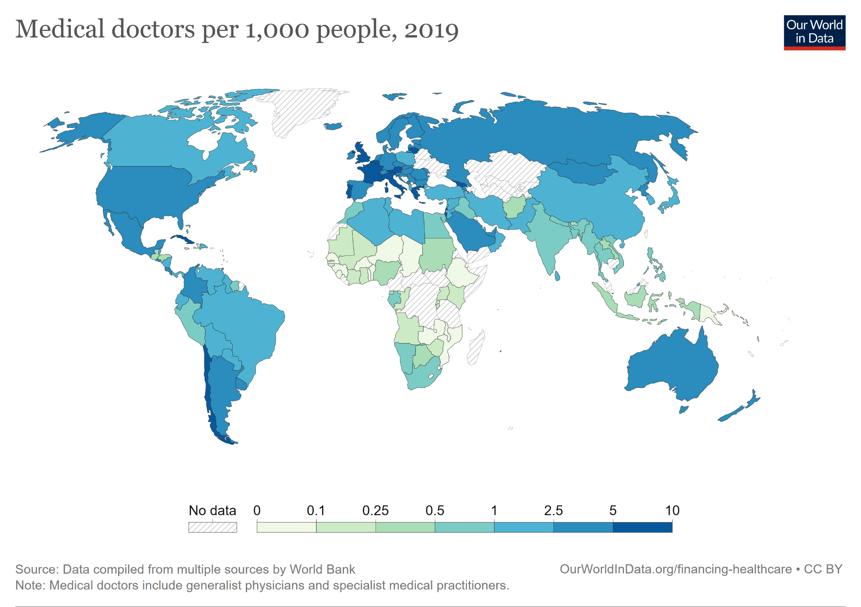

Slide 35
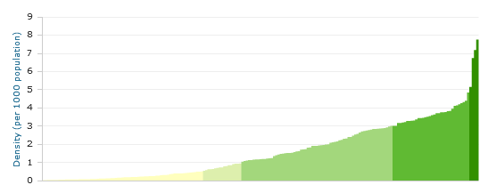
Staff Ratios: Physicians per 1,000 Inhabitants
Latest available data (access 2014)
http://www.who.int/gho/health_workforce/physicians_density/en/

Slide 36
Physicians per 1000 pop.
Country | latest
Niger | 0,0345
South Sudan | 0,0374
Malawi | 0,0501
Liberia | 0,0510
Tanzania | 0,0512
Chad | 0,0611
Benin | 0,0647
Papua New Guinea | 0,0661
Burundi | 0,0717
Central African Republic | 0,0718
Sierra Leone | 0,0740
Eritrea | 0,0821
Gambia, The | 0,0823
Togo | 0,0827
Mozambique | 0,0850
Senegal | 0,0881
Burkina Faso | 0,0940
Congo, Rep. | 0,1037
Ethiopia | 0,1059
Zambia | 0,1168
Rwanda | 0,1182
Mali | 0,1286
Cameroon | 0,1292
Eswatini | 0,1422
Uganda | 0,1537
Kenya | 0,1565
Cote d'Ivoire | 0,1623
Ghana | 0,1701
Heavily indebted poor countries (HIPC) | 0,1858
Mauritania | 0,1865
Guinea-Bissau | 0,1956
Zimbabwe | 0,1990
Madagascar | 0,1991
Angola | 0,2140
Guinea | 0,2245
Africa Eastern and Southern | 0,2300
Sub-Saharan Africa (excluding high income) | 0,2333
Sub-Saharan Africa | 0,2335
Sub-Saharan Africa (IDA & IBRD countries) | 0,2335
Haiti | 0,2343
Africa Western and Central | 0,2386
Pre-demographic dividend | 0,2452
Afghanistan | 0,2538
Sudan | 0,2618
Country | latest
Italy | 3,9477
Argentina | 4,0596
Kazakhstan | 4,0712
Netherlands | 4,0794
Euro area | 4,1249
Australia | 4,1292
Iceland | 4,1416
Czechia | 4,1533
Bulgaria | 4,2071
Denmark | 4,2247
Switzerland | 4,3804
Sweden | 4,4055
Germany | 4,4348
Spain | 4,4411
Trinidad and Tobago | 4,4760
Belarus | 4,5382
Lithuania | 4,6268
Finland | 4,6404
Uruguay | 4,9398
Norway | 5,0470
Georgia | 5,1085
Austria | 5,2933
Portugal | 5,4837
Greece | 6,3072
Cuba | 8,4199
https://databank.worldbank.org/reports.aspx?source=world-development-indicators#

Slide 37
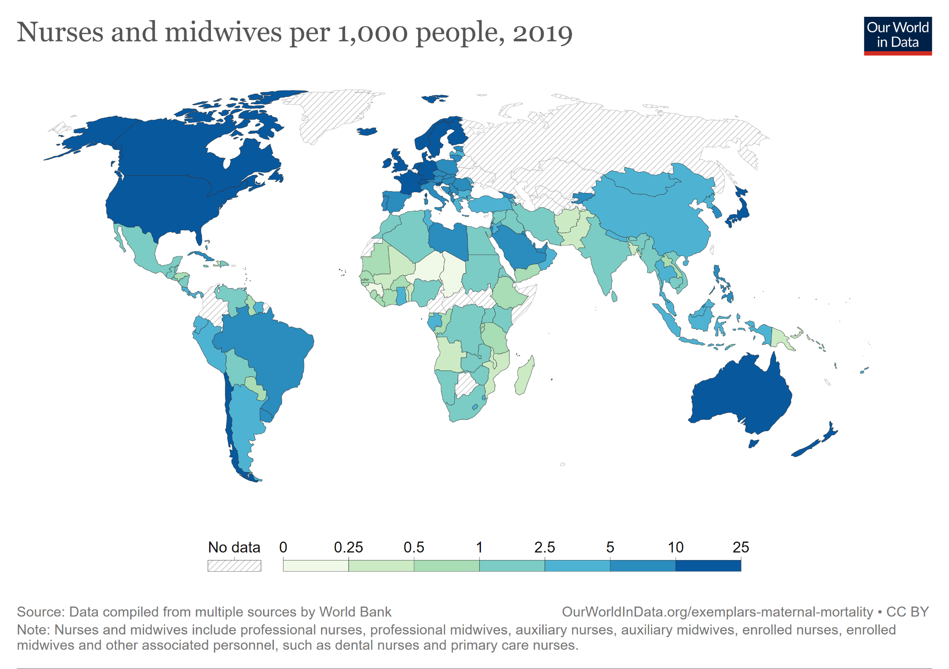

Slide 38
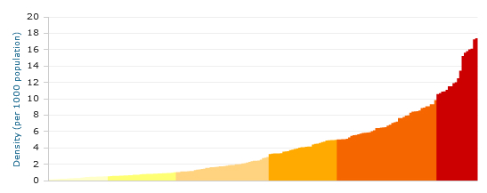
Staff Ratios: Nurses and midwives per 1,000 Inhabitants
Latest available data (access 2014)
http://http://gamapserver.who.int/gho/interactive_charts/health_workforce/NursingMidwiferyDensity/atlas.html/

Slide 39
Nurses/midwives per 1000 pop.
Country | latest
Chad | 0,2029
Niger | 0,2234
Central African Republic | 0,2561
Madagascar | 0,2980
Benin | 0,3029
Equatorial Guinea | 0,3102
South Sudan | 0,3395
Cameroon | 0,3631
Haiti | 0,3977
Angola | 0,4075
Mali | 0,4408
Afghanistan | 0,4461
Papua New Guinea | 0,4529
Pakistan | 0,4832
Mozambique | 0,4849
Bangladesh | 0,4891
Togo | 0,5071
Senegal | 0,5404
Tanzania | 0,5672
Guinea | 0,5796
Burundi | 0,6487
Cote d'Ivoire | 0,6556
Malawi | 0,7090
Honduras | 0,7287
Paraguay | 0,7387
Sierra Leone | 0,7525
Ethiopia | 0,7844
Yemen, Rep. | 0,7852
Guinea-Bissau | 0,7907
Country | Latest
Slovenia | 10,4570
Denmark | 10,5355
Canada | 11,0730
High income | 11,2609
Netherlands | 11,6429
Belgium | 11,7356
Post-demographic dividend | 11,7739
New Zealand | 11,7764
France | 11,7833
Sweden | 11,8549
Japan | 11,9480
Luxembourg | 12,1744
Ireland | 13,0118
Australia | 13,1388
Germany | 14,1887
North America | 15,2153
United States | 15,6850
Iceland | 16,7800
Switzerland | 18,2605
Norway | 18,4218
Finland | 22,3080
https://databank.worldbank.org/reports.aspx?source=world-development-indicators#

Slide 40
Foreign Staff
Reasons:
Training in Foreign Country
E.g. Germans studying medicine in Italy
E.g. students from developing countries studying in former SU
Collaboration in Countries in High Need
E.g. German physicians in Scandinavia
E.g. German physicians in UK’s NHS
Collaboration in Countries with a High Level of Income
E.g. nurses from Eastern Europe in Germany
E.g. Indian physician in USA
E.g. Malawian physician in Sambia
Problem: Brain Drain
Collaboration for Charitable Reasons (E.g. development aid)

Slide 41
Cost of a Development Worker (Physician, 2 Year Period)
Cost category |  | Amount
Preparation | Orientation course | 10,000 €
 | Language course English | 10,000 €
 | Language course local language | 5,000 €
 | Transport | 15,000 €
Running Expenditure | Gross salary | 157,000 €
 | Tuition children | 48,000 €
 | Insurances etc. | 5,000 €
Repatriation allowance |  | 18,000 €
Total cost |  | 268,000 €

Slide 42
Cost of a Development Worker (cont.)
Cost: 11,166 € per months of service on the job.
Salary of a local physician: < 500 € p. month.
→ Personnel in development assistance can only be justified when
no adequate staff is available in the country
no adequate staff can be obtained through south-south
Accompanying training of local staff

Slide 43
Excursus: Internal Brain Drain
High salary differentiation within one country
Urban - rural
Professions (e.g. nurse working as flight attendant)
Employer
International Health Partnerships
Clinton Foundation, Global Fund,…: salary = 3 * local average
Status (e.g. physicians in administration)

Slide 44
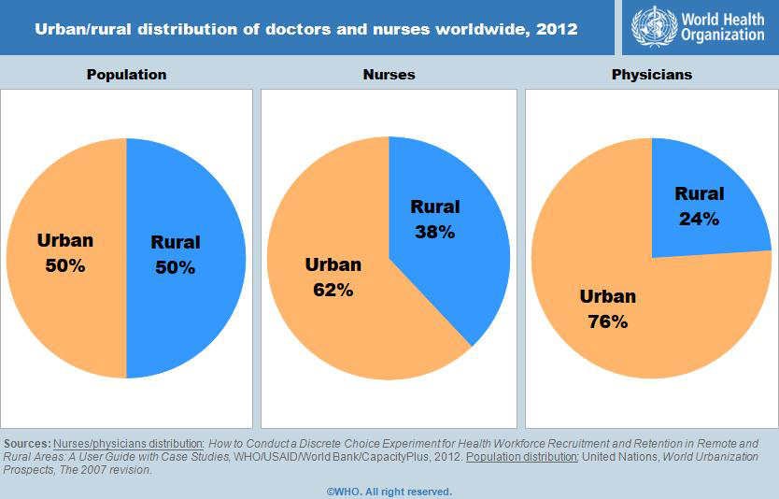
Urban / Rural Distribution
http://www.who.int/gho/health_workforce/hrh_002.jpg?ua=1

Slide 45
Countries Showing a Deficit in Staff
Source: World Health Report 2006, p. xviii

Slide 46
Supply of Health Services: Structure
Demand for Health Services
Supply of Health Services
Factors of Production
Buildings and Equipment
Staff
Problems of Donations
Spatial Structure of Supply
Levels of Care
Provider Portfolio
Health Care Systems and Reforms

