Slide 1
International Health Care Management II Part 2.1-3
Steffen Fleßa
Institute of Health Care Management
University of Greifswald

Slide 2
Supply of Health Services: Structure
Demand for Health Services
Supply of Health Services
Factors of Production
Buildings and Equipment
Staff
Problems of Donations
Spatial Structure of Supply
Levels of Care
Provider Portfolio
Health Care Systems and Reforms

Slide 3
Foreign Development Aid in the Health Care Sector, 1990 [Million US$/Year]
2.1.3 Problems in Donations

Slide 4
Foreign Development Aid in the Health Care Sector, 1990 [Million US$/Year]

Slide 5
Overall Development Assistance for Health
https://www.healthdata.org/research-analysis/library/financing-global-health-2021-global-health-priorities-time-change

Slide 6
Total Health Spending by Source of Financing
https://www.healthdata.org/research-analysis/library/financing-global-health-2021-global-health-priorities-time-change

Slide 7
Government Health Spending as Fraction of Total Health Spending 2019
https://www.healthdata.org/research-analysis/library/financing-global-health-2021-global-health-priorities-time-change

Slide 8
Development Assistance for Health by Focus Areas
https://www.healthdata.org/research-analysis/library/financing-global-health-2021-global-health-priorities-time-change
Covid-19

Slide 9
Development Assistance for Health by Channel of Assistance
https://www.healthdata.org/research-analysis/library/financing-global-health-2021-global-health-priorities-time-change

Slide 10
Development Collaboration: multiple players
WHO
INT NGO
CIDA
UNAIDS
3/5
GIZ
RNE
UNICEF
Norad
WB
Sida
USAID
T-MAP
MOF
UNTG
PMO
CF
DAC
GFCCP
PRSP
PEPFAR
HSSP
GFATM
MOEC
MOH
SWAP
CCM
NCTP
CTU
CCAIDS
NACP
LOCALGVT
CIVIL SOCIETY
PRIVATE SECTOR
Source: WHO: Mbewe

Slide 11
Source; Don De Savigny & COHRED

Slide 12
International Organizations
WHO World Health Organisation
UNAIDS Joint United Nations Programme on HIV/AIDS
UNICEF United Nations Children Fund
UNFPR United Nations Population Fund
UNHCR United National High Commissioner for Refugees
World Bank The International Bank of Development and Reconstruction
IMF International Monetary Fund
USAID United States Agency for International Development
DANIDA Danish International Development Assistance
DFID Department for International Development
JICA Japanese International Cooperation Agency
SIDA Swedish International Development Cooperation Agency

Slide 13
International Programs
EPI Extended Programme on Immunization
GAVI Global Alliance for Vaccines and Immunization
GFATM Global Fund to Fight Aids, Tuberculosis and Malaria
PEPFAR United States President’s Emergency Plan for AIDS Relief
TOWA Total war against HIV and AIDS project

Slide 14
CDC
Centers for Disease Control and Prevention, Atlanta
National public health institute of the United States (federal agency)
Objective: control and prevention of
Infectious diseases, e.g. Aids, measles, antrax, influenza, Ebola…
Non-infectious diseases (less important!), e.g. obesity
Annual budget: 7 billion US$
Staff: 15,000 (850 “commissioned officer”, close to armed forces)

Slide 15
National Organizations Germany
DSW Deutsche Stiftung Weltbevölkerung
CIM Centrum für internationale Migration und Entwicklung
DAAD Deutscher Akademischer Austauschdienst
GIZ Gesellschaft für internationale Zusammenarbeit
KfW Kreditanstalt für Wiederaufbau, Entwicklungsbank
INWENT Internationale Weiterbildung und Entwicklung
DED Deutscher Entwicklungsdienst
BMZ Bundesministerium für Wirtschaftliche Zusammenarbeit und Entwicklung
EED Evangelischer Entwicklungsdienst
Brot Brot für die Welt
AGEH Arbeitsgemeinschaft für Entwicklungshilfe
ADVENIAT Bischöfliche Hilfsaktion ADVENIAT
MISEREOR Bischöfliches Hilfswerk MISEREOR
DIFÄM Deutsches Institut für Ärztliche Mission
MÄI Missionsärztliches Institut Würzburg

Slide 16
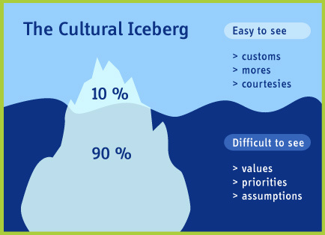
Notes on Service Delivery in International Management
Culture
Mental Programming
Basic Behavioral Patterns
Primary and Secondary Culture
„Iceberg Theory“
http://slowly-by-slowly.com/2012/02/07/icebergs-in-turkiye/

Slide 17
Dimensions of National Culture According to Hofstede
Power Distance
extent to which the less powerful members of institutions and organisations within a country expect and accept that power is distributed unequally
Individuality
degree of interdependence a society maintains among its members
Masculinity
Relevance of of competition, achievement and success
Avoiding Uncertainty
Relevance of strategies to avoid ambiguity or uncertainty
Long-term Orientation
Relevance of future in comparison to the present
Indulgence
extent to which people try to control their desires and impulses
https://www.hofstede-insights.com/country-comparison-tool

Slide 18
Dimensions of National Culture acc. to Hofstede
https://www.hofstede-insights.com/country-comparison-tool

Slide 19
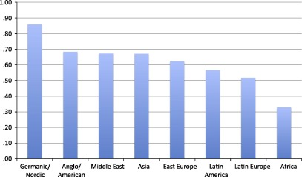
Time Preference
Percentage of participants who chose the $3800 option when they were asked to choose between $3400 this month or $3800 next month (http://dx.doi.org/10.1016/j.joep.2015.12.001)
http://dx.doi.org/10.1016/j.joep.2015.12.001

Slide 20
Typical Problems of Management in Foreign Culture
Handling Complexity
Target System
Decision Making
Motivation
Style of Leadership

Slide 21
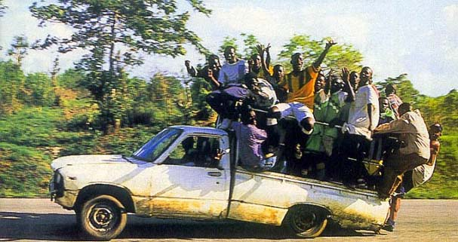

Slide 22
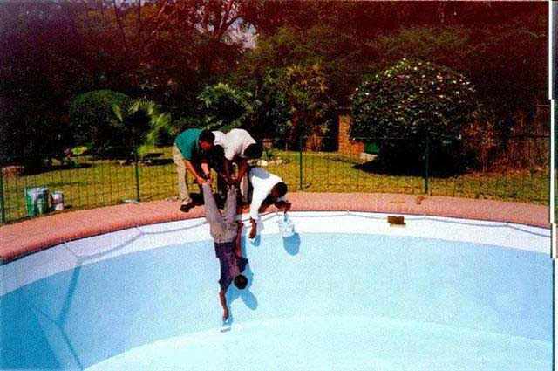

Slide 23
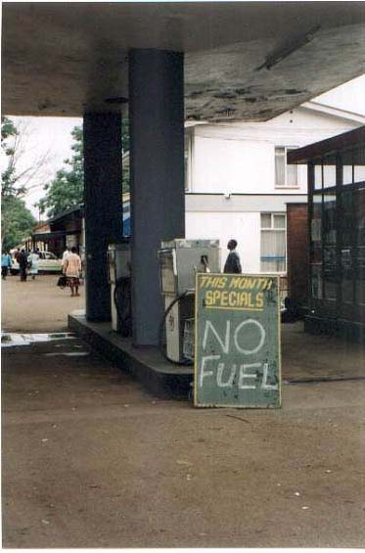

Slide 24
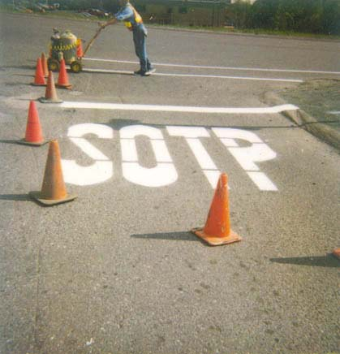

Slide 26
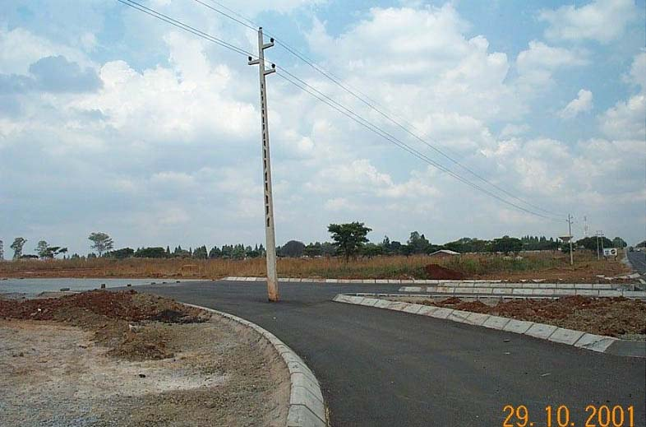

Slide 27
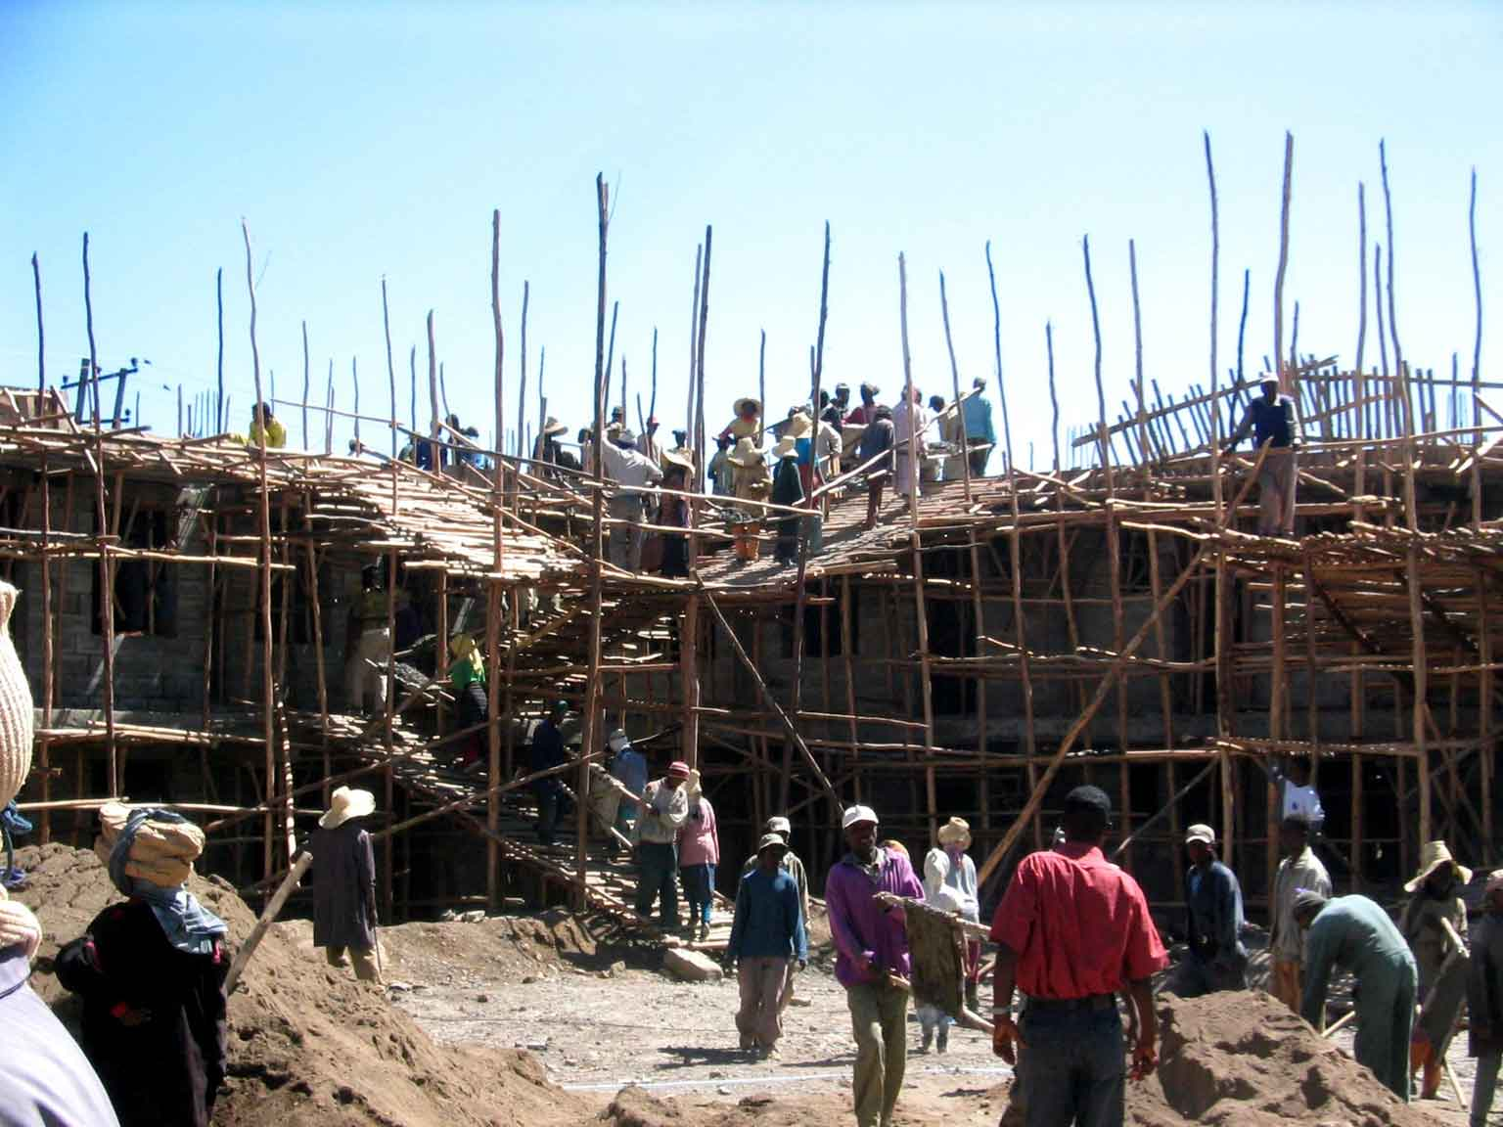

Slide 28
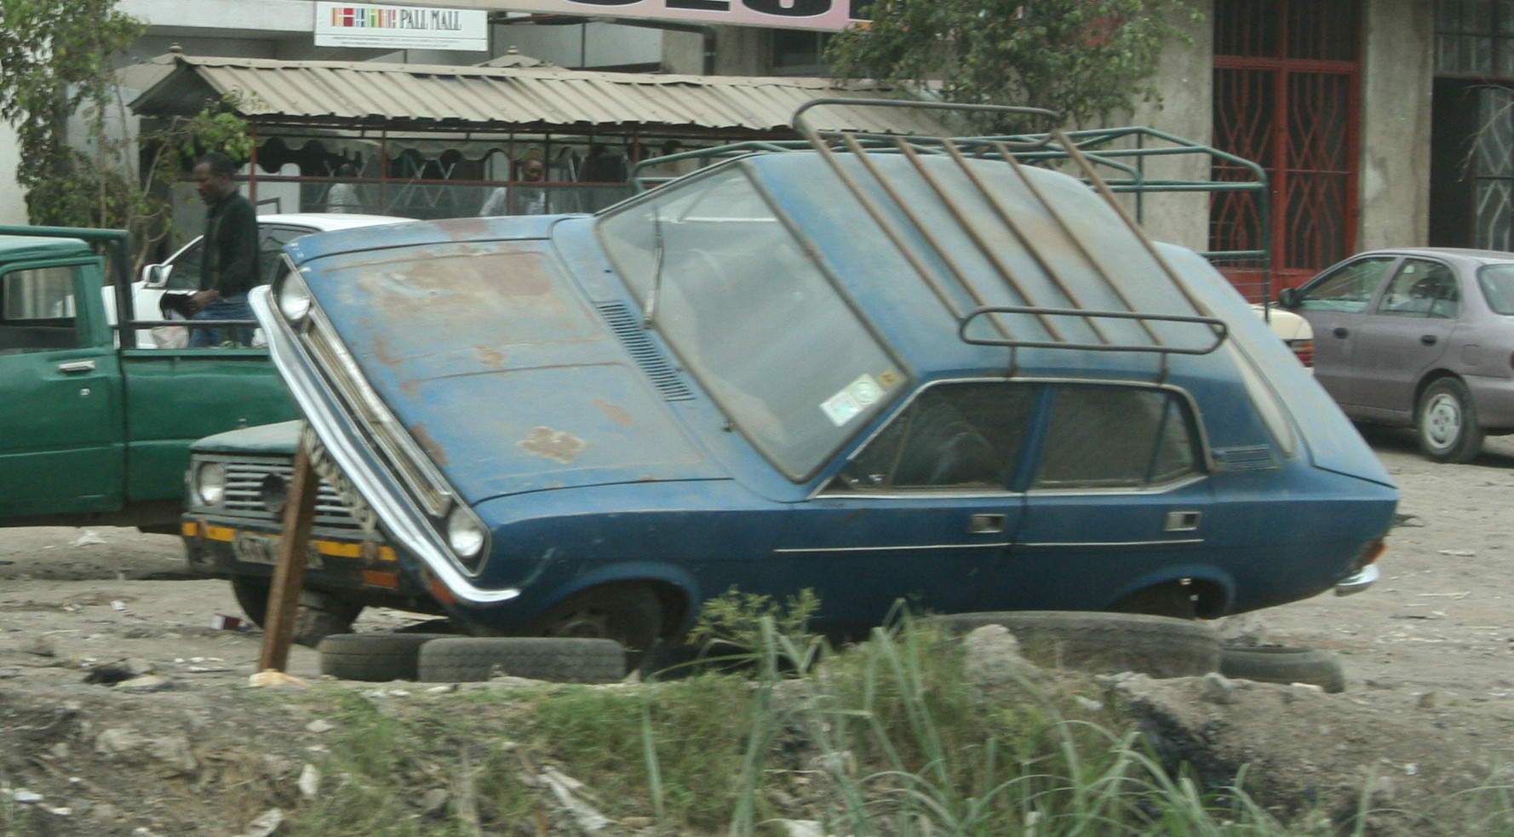

Slide 29
Supply of Health Services: Structure
Demand for Health Services
Supply of Health Services
Factors of Production
Buildings and Equipment
Staff
Problems of Donations
Spatial Structure of Supply
Levels of Care
Provider Portfolio
Health Care Systems and Reforms

