Slide 1
International Health Care Management II
Part 2.2
Steffen Fleßa
Institute of Health Care Management
University of Greifswald

Slide 2
Supply of Health Services: Structure
Demand for Health Services
Supply of Health Services
  Factors of Production
    Buildings and Equipment
    Staff
    Problems of Donations
  Spatial Structure of Supply
  Levels of Care
  Provider Portfolio
Health Care Systems and Reforms

Slide 3
2.2 Spatial Structure of Supply
Spatial Disparity: uneven distribution of resources in developing countries
  Total country
  Districts and cities

Slide 4
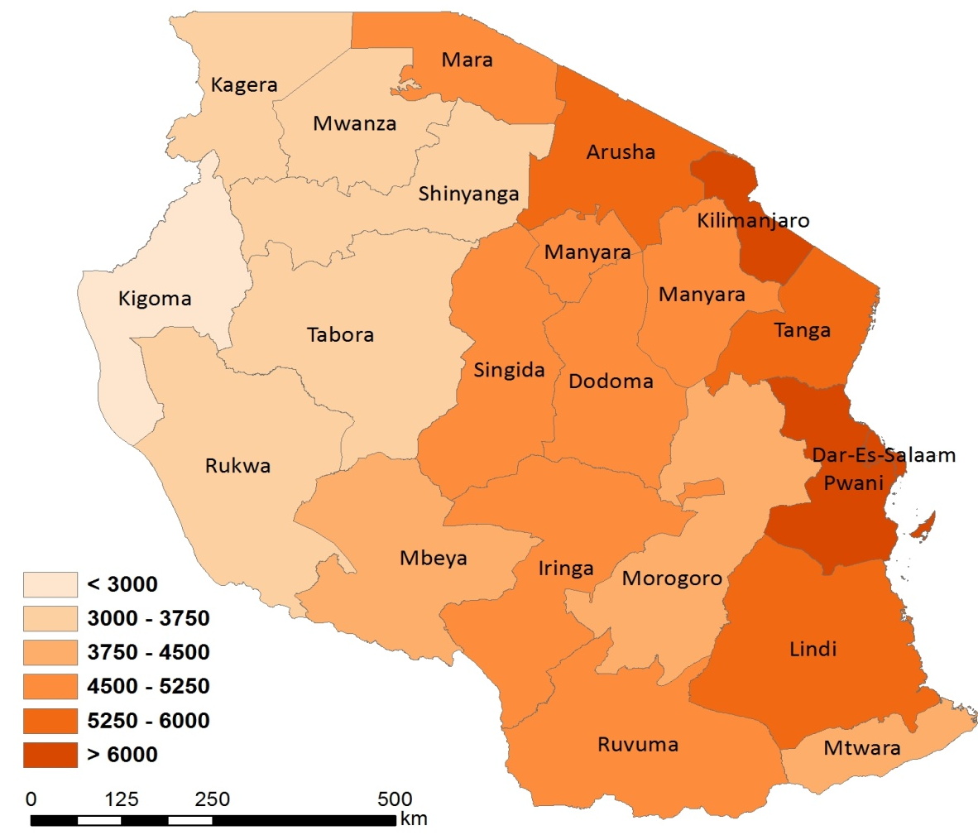
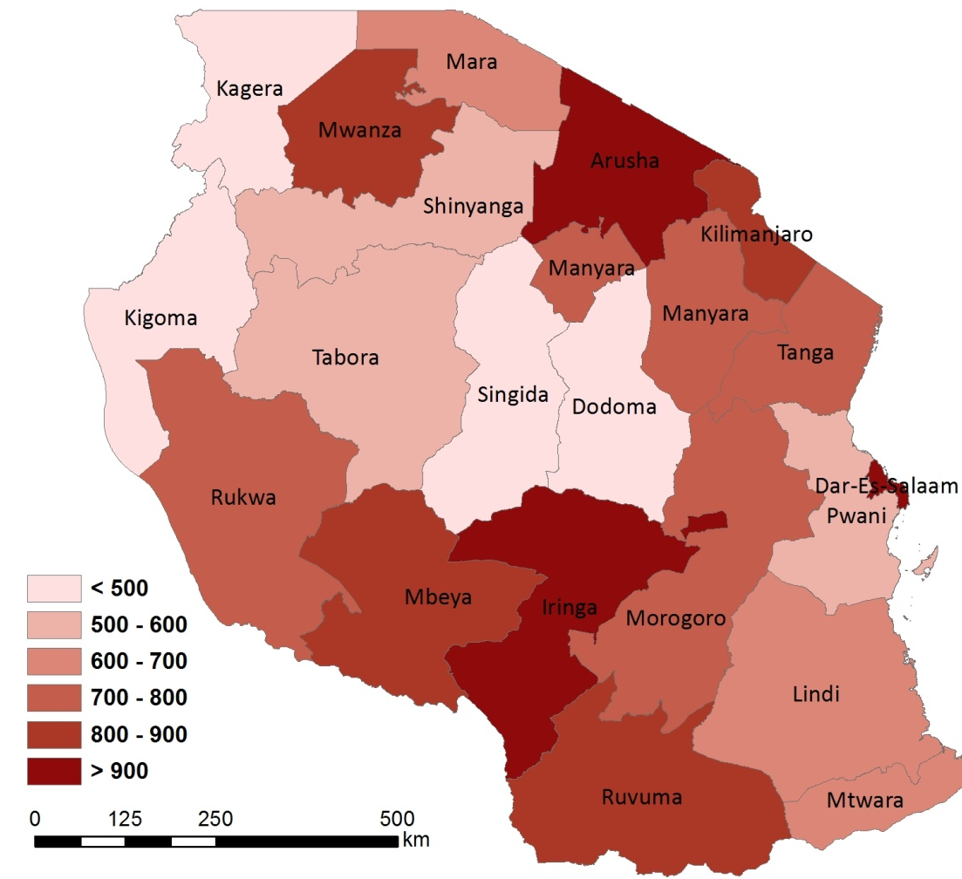
Health Expenditure per capita
(1,000 p.a., at 2010 prices)
Source: Simon 2014
Health Expenditure per capita
(Tshs. p.a., at 2010 prices)
GDP per capita
(1,000 Tshs. p.a., at 2010 prices)

Slide 5
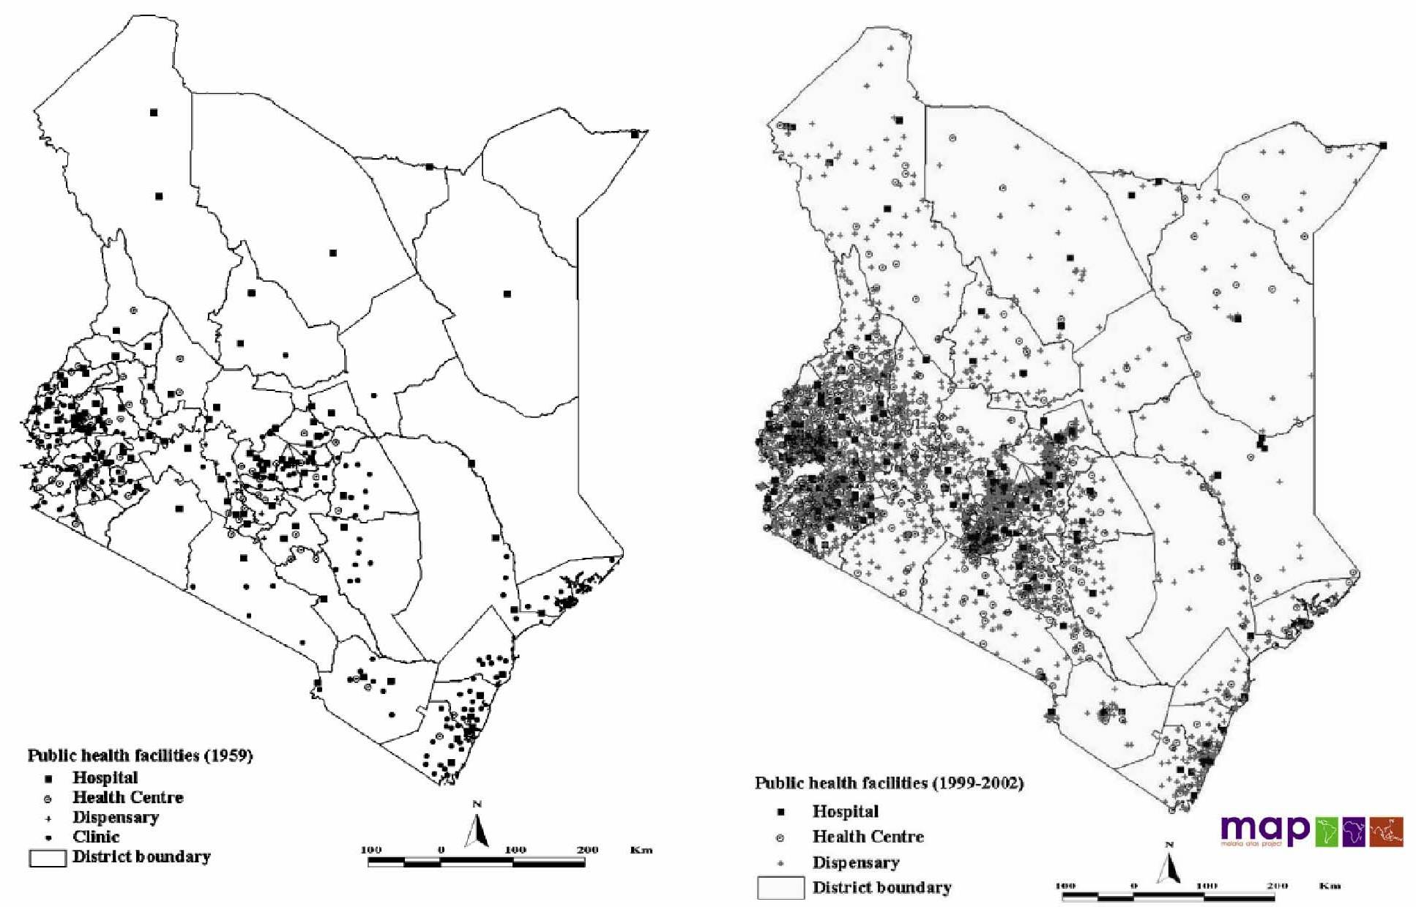
Health Facilities
(1959=308; 2002=2052)

Slide 6
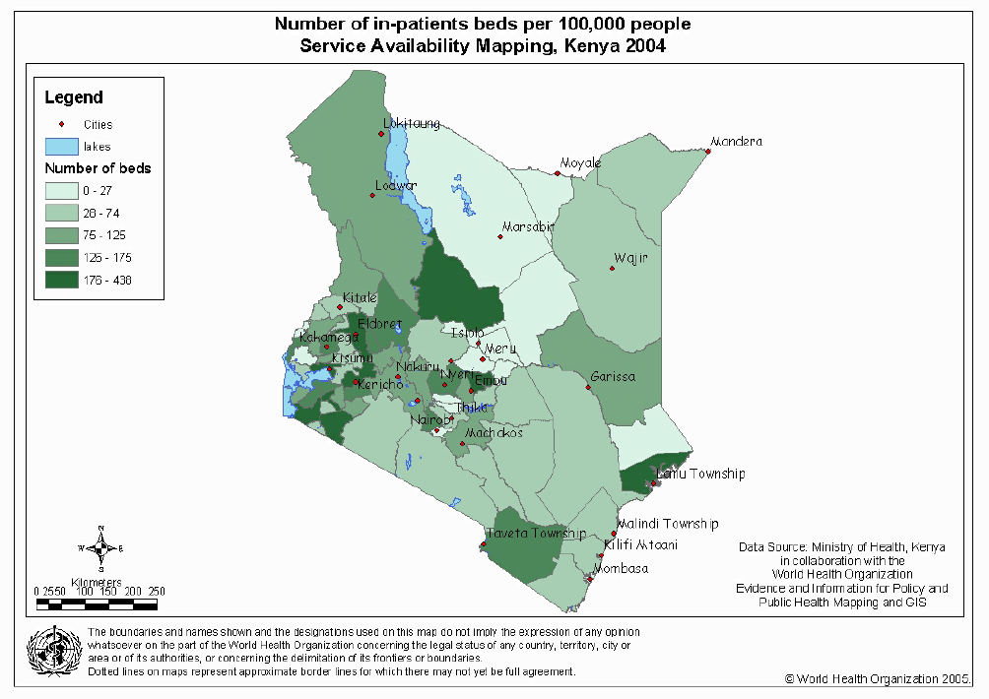

Slide 7
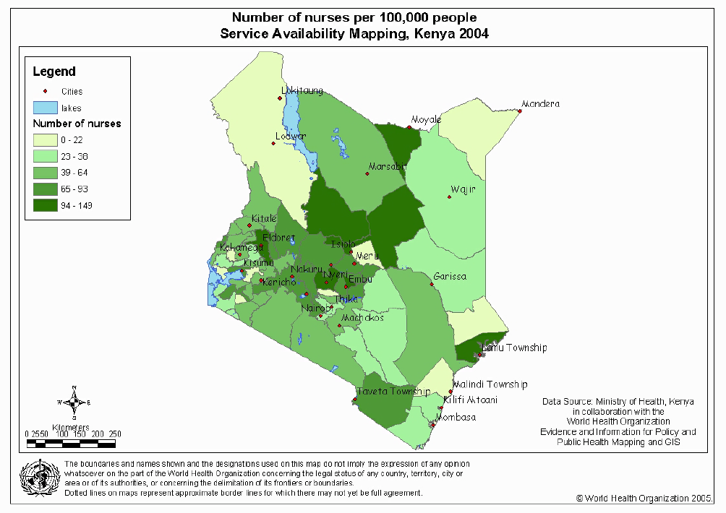

Slide 8
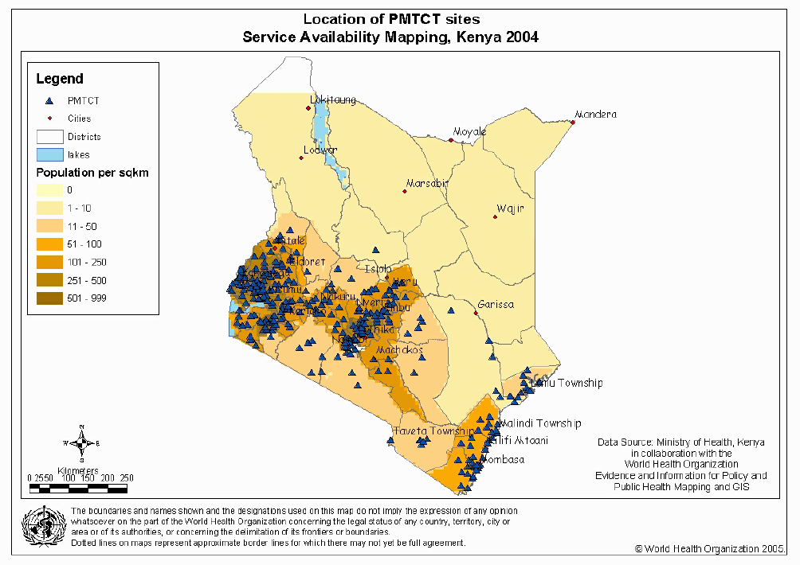

Slide 9
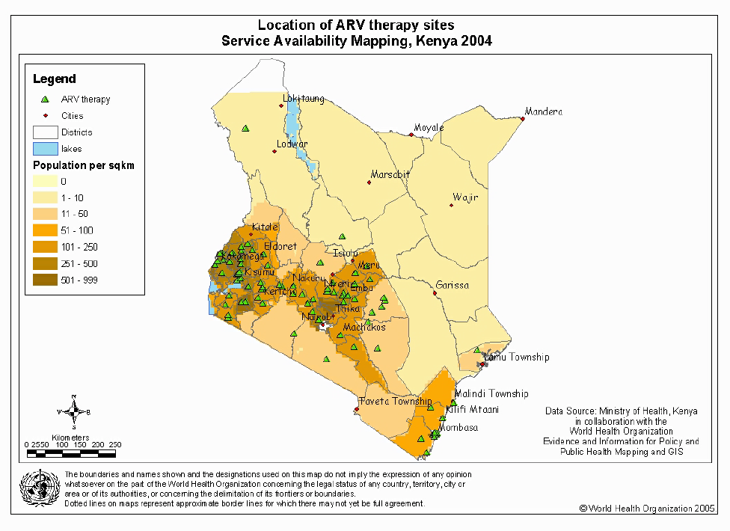

Slide 10
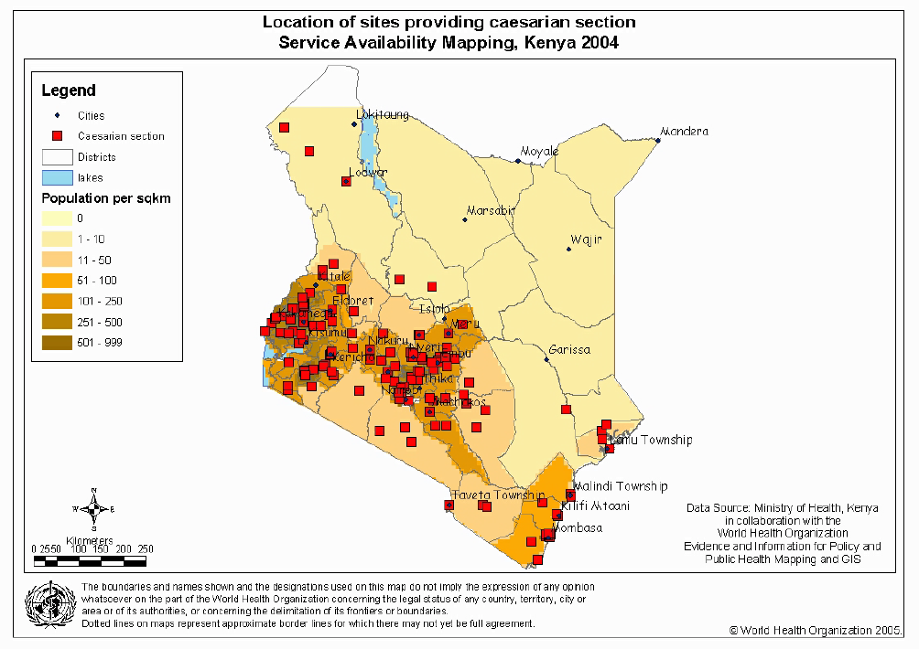

Slide 11
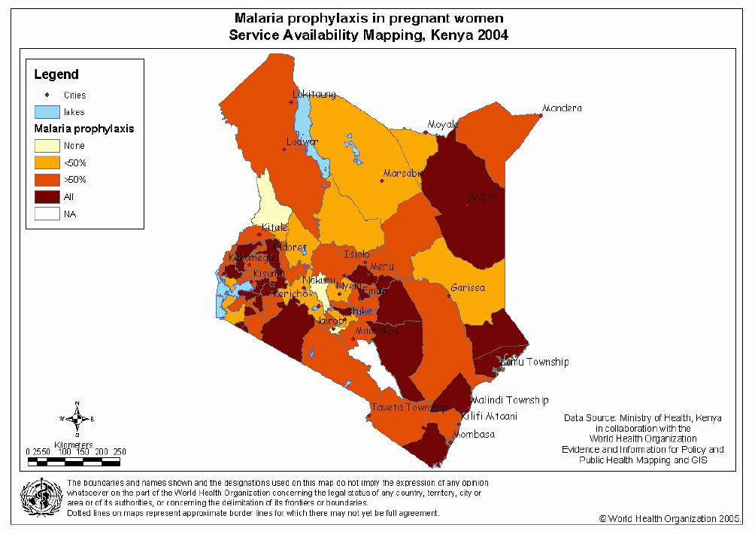

Slide 12
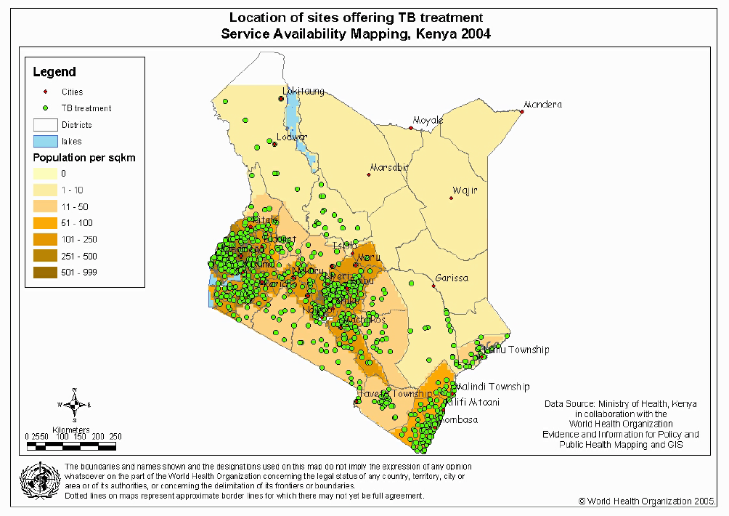

Slide 13
(
(2005)

Slide 14
(2005)

Slide 15
(2005)

Slide 16
Development of Catchment Areas

Slide 17
Formation of Hexagons

Slide 18
Hierarchical Structures

Slide 19
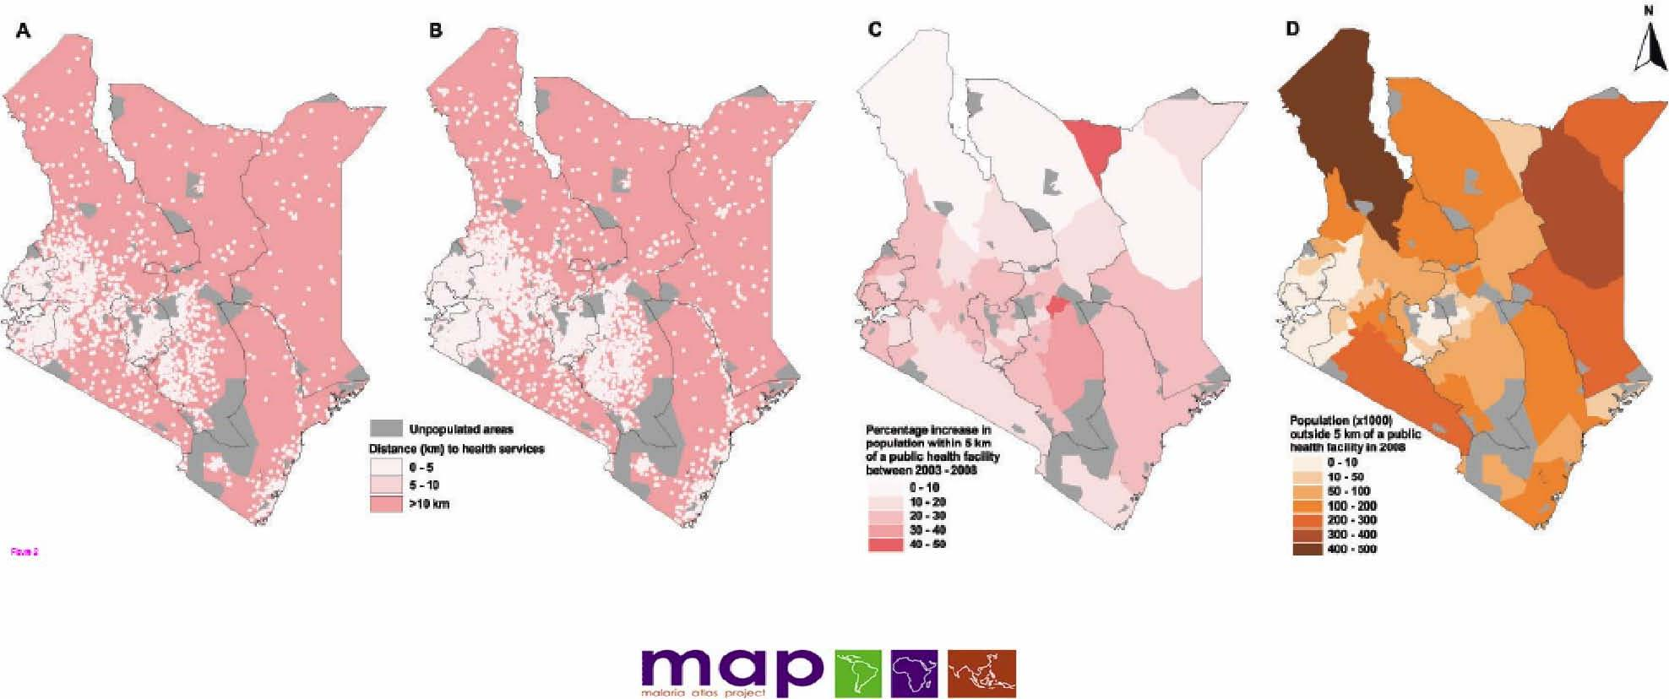
Accessibility
A: Distance 2003
B: Distance 2008
C: Improvement
D: Share of population > 5 km

Slide 20
Why are they not coming from there?

Slide 21
Why are they not coming from there?

Slide 22
Why are they not coming from there?

Slide 23
Where should we start investing and where stop?

Slide 24
Example: Health Facilities in Three Kenyan Districts

Slide 28
Quality in Structure

Slide 29
Supply of Health Services: Structure
Demand for Health Services
Supply of Health Services
  Factors of Production
    Buildings and Equipment
    Staff
    Problems of Donations
  Spatial Structure of Supply
  Levels of Care
  Provider Portfolio
Health Care Systems and Reforms

