Slide 1
International Health Care Management II Part 2.3
Steffen Fleßa
Institute of Health Care Management
University of Greifswald

Slide 2
Supply of Health Services: Structure
Demand for Health Services
Supply of Health Services
Factors of Production
Buildings and Equipment
Staff
Problems of Donations
Spatial Structure of Supply
Levels of Care
Provider Portfolio
Health Care Systems and Reforms

Slide 3
2.3 Levels of Care
Health Care Pyramid
Tertiary
Hospitals
Regional Hospitals
District Hospitals
Health Care Centers
Dispensaries
Village Health Workers, Traditional Midwives

Slide 4
3.3 Levels of Care
Health Care Pyramid
Tertiary
Hospitals
Regional Hospitals
District Hospitals
Health Care Centers
Dispensaries
Village Health Workers, Traditional Midwives

Slide 5
Levels of Care
Health Care Pyramid
Tertiary
Hospitals
Regional Hospitals
District Hospitals
Health Care Centers
Dispensaries
Village Health Workers, Traditional Midwives

Slide 6
Levels of Care
Health Care Pyramid
Tertiary
Hospitals
Regional Hospitals
District Hospitals
Health Care Centers
Dispensaries
Village Health Workers, Traditional Midwives

Slide 7
Quality in Structure and Level of Care Kenya Service Provision Assessment Survey (2004)

Slide 8
Quality in Structure (Cost per outpatient visit in a private hospital, Kenya 2005)
Cost per Out-patient Visit [Ksh]
4,500
4,218
4,011
4,000
3,500
3,427
3,230
3,000
2,587
2,600
2,500
2,171
2,173
2,000
1,941
1,607
1,750
1,500
1,376
1,384
1,432
1,016
1,024
1,170
1,000
835
864
982
784
525
578
500
-
Hospital Code
Hospital Code

Slide 9
Quality in Structure (Cost per outpatient visit in a private hospital, Kenya 2005)
There are also private hospitals of high quality for the rich!
Cost per Ambulance Visit [Ksh]
There are private hospitals of low quality for the poorer!
4,500
4,218
4,011
4,000
3,500
3,427
3,230
3,000
2,587
2,600
2,500
2,171
2,173
2,000
1,941
1,607
1,750
1,500
1,376
1,384
1,432
1,016
1,024
1,170
1,000
835
864
982
784
525
578
500
-
Hospital Code
Hospital Code

Slide 10
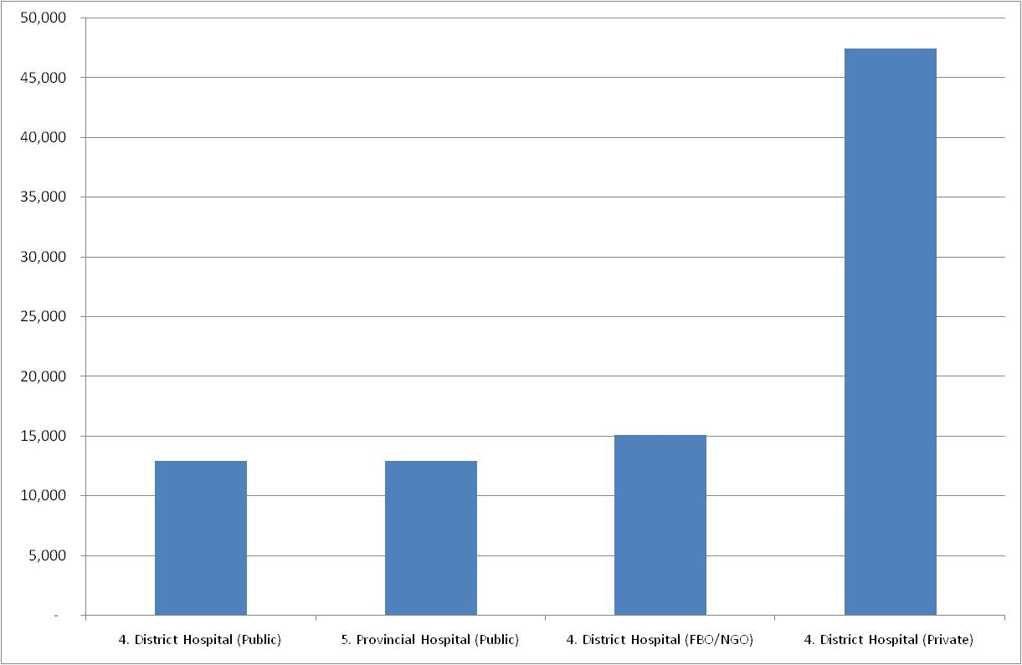
Cost per Admission 2007 (Kenya Costing Model)
Priv. Distr.
Hospital
Cost per admission [Ksh]
NGO. Distr.
Hospital
Publ. Distr.
Hospital
Publ. Prov.
Hospital

Slide 11
Traditional Medicine
Spiritual Background of Medicine
disabilities and taboos
Child mortality and fontanel
Evil eye, protecting small children
Cycle and reincarnation, „living dead“
Forms of Traditional Healers
Traditional midwives
Herbalists
Traditional surgeons
Spiritual healers

Slide 12
Traditional Medicine
Spiritual Background of Medicine
disabilities and taboos
Child mortality and fontanel
Evil eye, protecting small children
Cycle and reincarnation, „living dead“
Forms of Traditional Healers
Traditional midwives
Herbalists
Traditional surgeons
Spiritual healers

Slide 13
Supply of Health Services: Structure
Demand for Health Services
Supply of Health Services
Factors of Production
Buildings and Equipment
Staff
Problems of Donations
Spatial Structure of Supply
Levels of Care
Provider Portfolio
Health Care Systems and Reforms

