Slide 1
International Health Care Management II Part 4.2
Steffen Fleßa
Institute of Health Care Management
University of Greifswald

Slide 2
Health Care Reform: Structure
Demand for Health Services
Supply of Health Services
Factors of Production
Buildings and Equipment
Staff
Problems of Donations
Spatial Structure of Supply
Levels of Care
Provider Portfolio
Health Care Reforms
Costs
Options of Funding
Health Care Systems by International Comparison

Slide 3
3.3 Health Care Systems by International Comparison
Overview
Criteria for Classification
Organization of funding (predominantly)
Social insurance
Private insurance
Insurance-free health care system (developing countries)
Organization of service providing
Private service providers
Public organizations provide services
Non-governmental, non-profit organizations provide services
Market Interventions
Free negotiations on prices
Market interventions of the state

Slide 4
Examples
Country
Predominating Organization of Funding
Predominating Provision of Services
USA
Private Insurance
Private Service Providers, Managed Care Organizations
Switzerland
Private Insurance Accompanied by Subsidies
Outpatient: private
Inpatient: partly public
Managed Care Organizations
Germany
Social Insurance
Outpatient: private
Inpatient: partly public
Netherlands
Social Insurance with Basic Insurance
Predominantly private
Austria
Social Insurance
Outpatient: private
Inpatient: predominantly public

Slide 5
Country
Predominating Organization of Funding
Predominating Provision of Services
France
Social Insurance
Outpatient: private
Inpatient: predominantly public
Greece
National Health Service with Funding via Premiums
Predominantly public
Canada
National Health Service
Outpatient: private
Inpatient: public
Italy
National Health Service with Funding via Premiums
Predominantly public
United Kingdom
National Health Service
Predominantly public
Sweden
National Health Service
Predominantly public

Slide 6
Government
Health Care Provider
NPO
Private
Beveridge
Social Insurance
Private
Out-of-Pocket
Social Protection

Slide 7
OPD
IPD
Germany
Government
5
Health Care Provider
NPO
Private
Beveridge
Social Insurance
Private
Out-of-Pocket
Social Protection

Slide 8
Great Britain
Germany
OPD
IPD
Germany
Government
Health Care Provider
NPO
Private
Beveridge
Social Insurance
Private
Out-of-Pocket
Social Protection

Slide 9
Great Britain
Germany
OPD
IPD
Germany
Government
Cambodia
Health Care Provider
NPO
Private
Beveridge
Social Insurance
Private
Out-of-Pocket
Social Protection

Slide 10
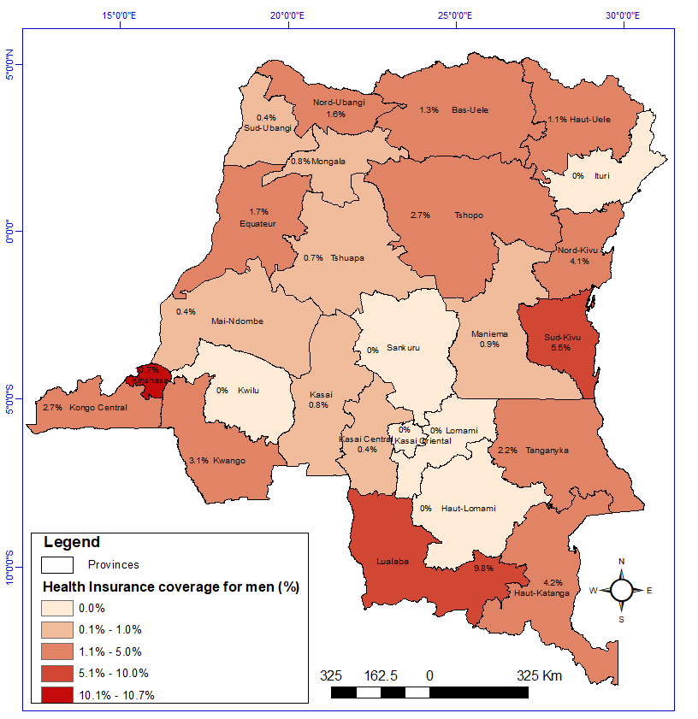
Health insurance coverage in the DRC (female)
Biringanine et al: Health insurance uptake, poverty and financial inclusion in the Democratic Republic of Congo

Slide 11
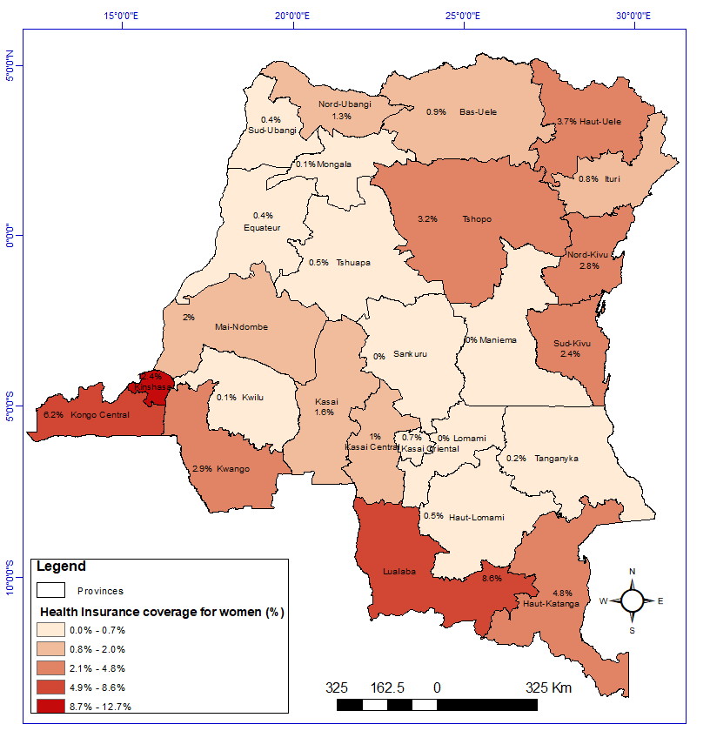
Health insurance coverage in the DRC (male)
Biringanine et al: Health insurance uptake, poverty and financial inclusion in the Democratic Republic of Congo

Slide 12
National Health Service in the United Kingdom
Overview
Founded: 1948
Dimension: almost 1,000,000 employees
Funding: predominantly tax funded
History (until the end of WW II)
Social insurance for workers
Registered general practitioners
Capitation fee for general practitioners
Hospitals: not covered
Beveridge-Report (1944): public health care planning, health is considered a basic right

Slide 13
National Health Service (cont.)
Organization
National Health Services Executive (top management directly supervised by ministry of health)
Health Authorities responsible for 500,000 inhabitants each
Primary Physician System: general practitioner acts as gatekeeper (local level)
Remuneration
Lump Sum per capita, part of remuneration is performance-related, resident registers with one physician
Target payments, special payment for successes, i.e. vaccination quota or participation in trainings
Few fee-for-service remunerations especially for patients with chronic diseases

Slide 14
National Health Service (cont.)
Funding
Basics: 90 % via tax return, low co-payment (i.e. drugs)
Allocation of budget to Health Authorities via a specific complex system based on demographic and epidemiologic data
Allocation leads to down scaling, investment backlog, low income for physicians
Internal Markets: Local Health Authorities can sign contracts with service providers (i.e. hospitals) that are not part of NHS. This leads to some extend of competition.

Slide 15
The US Health Care System
Funding
Predominantly private health insurance premiums
Predominantly employment based
Public Sector
Medicare, tax funded, > 65 years of age
Medicaid, support for the (very) poor
Veterans Health Administration (primarily veterans suffering from long-term effects)
Underlying Issue: up to 50 million without (sufficient) health coverage
https://data.cms.gov/summary-statistics-on-beneficiary-enrollment/medicare-and-medicaid-reports/medicare-monthly-enrollment

Slide 16
Children's Health Insurance Program (CHIP)
Basic Health Program (BHP)
ACA: Affordable Care Act 2010
https://commons.wikimedia.org/wiki/File:Health_Insurance_Coverage_in_the_U.S._2016_-_v1.png

Slide 17
Number of people with health insurance in the United States from 1990 to 2021 (in millions)
Patient Protection and Affordable Care Act (PPACA, 2010)
U.S. Americans with health insurance 1990-2021
Note(s): United States; 1990 to 2021
Further information regarding this statistic can be found on page 8.
Source(s): US Census Bureau; ID 200946
2

Slide 18
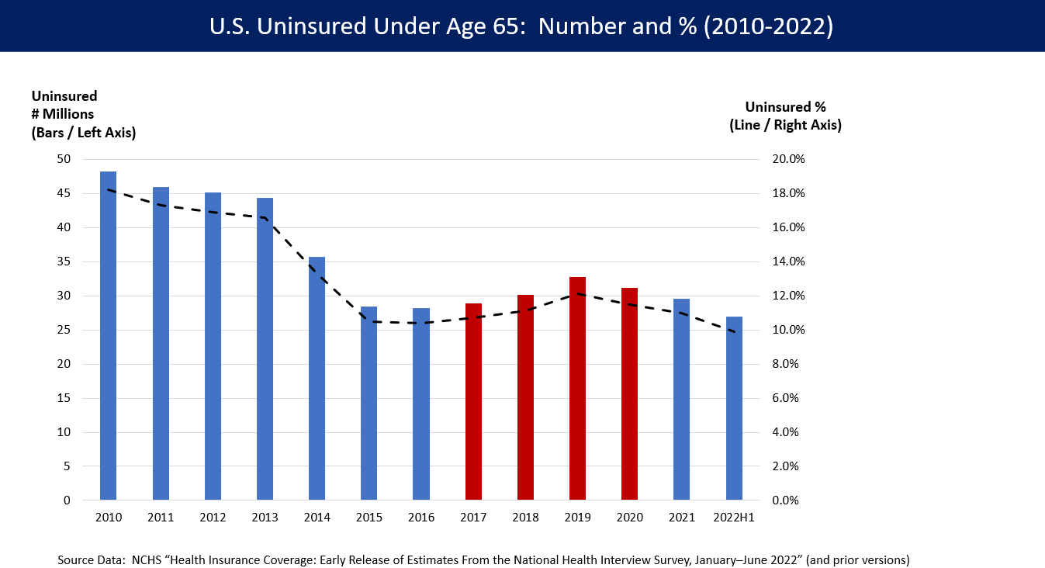
https://commons.wikimedia.org/wiki/File:US_Uninsured_Under_Age_65.png#/media/File:US_Uninsured_Under_Age_65.png

Slide 19
Percentage of People by Type of Health Insurance Coverage USA 2021
https://www.census.gov/library/publications/2022/demo/p60-278.html

Slide 20
Percentage of People Uninsured by Age Group 202/21 in USA
https://www.census.gov/library/publications/2022/demo/p60-278.html

Slide 21
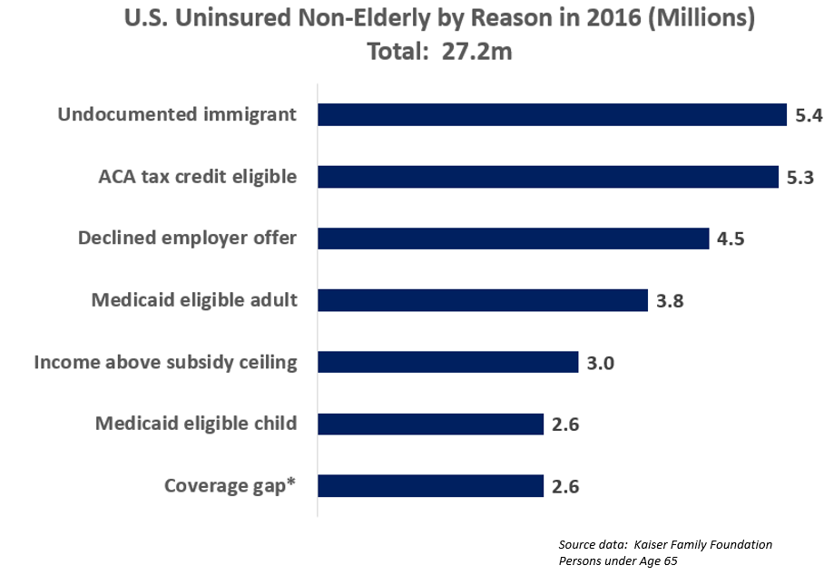
By Farcaster - Own work, CC BY-SA 4.0, https://commons.wikimedia.org/w/index.php?curid=61934482

Slide 22
Medicare
Health Insurance for older people that are not covered otherwise (problem: since insurance is predominantly employment based they stop at pension age)
Insurance for
Americans > 65 years
disabled people
patients suffering from renal failure
Funding: via taxes
Grant US-government 2020: 776 billion US$
Beneficiaries 2023: 66 million Americans enrolled (largest program in the US!)

Slide 23
Medicare
Part A: compulsory, hospitals services and outpatient care
Part B: optional additional coverage, part of outpatient physician and hospital services, expenses for additional hospital care (Medigap) as well as medical remedies and
Co-payment
Limitations to services
Remuneration of service providers
Strict budgeting
DRG-System

Slide 24
Medicaid
Goal: Health Coverage for People with Low Income
Funding: via taxes
Assessment Ceiling: variations within the states
„Basic Package“

Slide 25
Private Insurance
Normally Employment Based
Employer bears (part of) premium payment which is tax deductible as non-wage labor costs
Problems:
Employee looses coverage in unemployment
Employee looses coverage when entering retirement
Employee is tied to the insurance the employer has a contract with

Slide 26
Critical View on the System
United States National Health Care Act (US Congressional Bill, House of Representatives: HR 676)
Content: Expanded and Improved Medicare “for Everybody”
Consignor: John Conyers
24.1.2007
26.1.2009
Goal: "To provide for comprehensive health insurance coverage for all United States residents, and for other purposes… "to ensure that every American, regardless of income, employment status, or race, has access to quality, affordable health care services."

Slide 27
Health Care Reform 2010 (Obamacare)
Patient Protection and Affordable Care Act (PPACA)
23.3.2010
Content
Obligatory health insurance (partly subsidies/vouchers))
Health Insurance companies have to accept people despite their medical background
Special conditions for children (i.e. co-insurance for family members up to age 26)
Tax reliefs for businesses that insure their employees
Limitation of premiums (i.e. older people)
Broader access to Medicare (133% of poverty line, i.e. 14.856 US$ for a single living person in 2012)
Subsidies for poorer people

Slide 28
ObamaCare and Medicaid
https://www.sbmabenefits.com/how-is-obamacare-different-from-medicaid/

Slide 29
Criticism
Criticism
State intervention in functioning system of market economy
Accusation of socialism (“state takes over the health care industry“)
Cost increase
Public indebtedness
Increasing unemployment
Intervention in federal system

Slide 30
Evaluation
No change in system
Financial contribution to poorer people so they can afford private health insurance
Expenses: 1 Trillion US$ over 10 years
Success: has to be evaluated

Slide 31
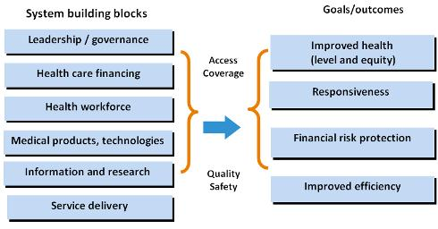
WHO Health System Framework (http://www.wpro.who.int/health_services/health_systems_framework/en/)

Slide 32
WHO Health System Framework (http://www.wpro.who.int/health_services/health_systems_framework/en/)

Slide 33
Health Economic Framework

Slide 34
Health Care Reform: Structure
Demand for Health Services
Supply of Health Services
Factors of Production
Buildings and Equipment
Staff
Problems of Donations
Spatial Structure of Supply
Levels of Care
Provider Portfolio
Health Care Reforms
Costs
Options of Funding
Health Care Systems by International Comparison

