Slide 1
International Health Care Management
Part 1.2.1
Steffen Fleßa
Institute of Health Care Management
University of Greifswald

Slide 2
Structure
International Public Health
2 Demand for Health Services
3 Supply of Health Services
4 Health Systems and Reforms

Slide 3
Structure
International Public Health
1.1 Background
1.2 Health and Development
1.3 Concepts
2 Demand for Health Services
3 Supply of Health Services
4 Health Systems and Reforms

Slide 4
1.2 Health and Development
1 International Public Health
1.1 Background
1.2 Health and Development
  1.2.1 Context
  1.2.2 Static Concept of Development
  1.2.3 Dynamic Concept of Development
  1.2.4 Health Care in Developing Countries
  1.3 Conceptions

Slide 5
1.2.1 Context
Hypothesis: Health and development are correlated
Approach:
  Theoretical concept
  Reality for Europe
  Reality for developing countries: 1.2.2-1.2.4

Slide 6
Solow Theory of Growth
Y Gross National Product
a Constant
K Capital Stock
α, β Partial Elasticity of Production
h Health
L Labor

Slide 7
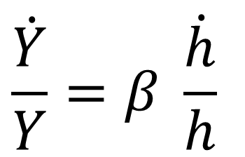
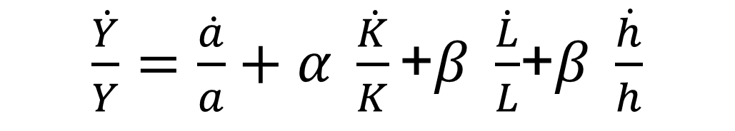
Health and Growth
$\frac{\dot{Y}}{Y}=\frac{\dot{a}}{a}+α \frac{\dot{K}}{K}\text{+}β \frac{\dot{L}}{L}$+$β \frac{\dot{h}}{h}$
$$\frac{\dot{Y}}{Y}=β \frac{\dot{h}}{h}$$

Slide 8
Vicious or Virtuous Circle?

Slide 9
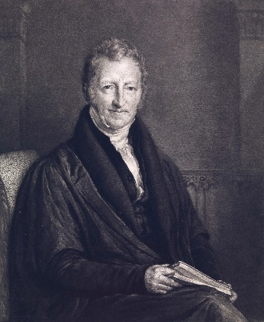
Development Traps
Poverty Trap: economic growth ➔ high birth rate ➔ economic burden ➔ deterioration in the health situation ➔ lower economic growth
Malthus Trap: economic growth ➔ high birth rate ➔ increasing demand for food ➔ linear increase in agricultural production, population grows exponentially ➔ lower economic growth
Thomas Robert Malthus (1766-1834)
Von John Linnell - https://wellcomeimages.org/indexplus/obf_images/fa/25/d2c7707f809bd259eb86d61d1cc5.jpgGallery: https://wellcomeimages.org/indexplus/image/L0069037.htmlWellcome Collection gallery (2018-04-05): https://wellcomecollection.org/works/f4ep87xc CC-BY-4.0, CC BY 4.0, https://commons.wikimedia.org/w/index.php?curid=38203021

Slide 16
Theory and Reality
Theory:
  development generates health
  health generates development
  health and development are correlated positively
Reality:
  Europe:
    Comparing countries: poorer countries only
    Comparing social groups: applicable
  Developing countries: applicable

Slide 17
Data Base
http://data.worldbank.org/topic/health
http://data.worldbank.org/data-catalog
http://data.euro.who.int/hfb/

Slide 18
Health and Development
Cor=0.57
Source: The World Bank, World Development Indicators 2010. http://data.worldbank.org/data-catalog

Slide 19
Health and Development
Cor=-0.46
Source: The World Bank, World Development Indicators 2010. http://data.worldbank.org/data-catalog

Slide 20
Europe

Slide 21
Europe

Slide 22
GNP and Life Expectancy in Europe
Cor=0.74
GNP p.c.

Slide 23
„The contribution of health to the economy in the European Union“
„…good health promotes earnings and labor supply. Of particular relevance to Europe, with its ageing population, they show how poor health increases the likelihood of early retirement. Taken together, this evidence provides a powerful argument for European governments to invest in the health of their populations, not only because better health is a desirable objective in its own right, but also because it is an important determinant of economic growth and competitiveness.” (Markos Kyprianou, European Commission 2005)
Suhrcke, Marc, et al. "The contribution of health to the economy in the European Union." Public health 120.11 (2006): 994-1001.

Slide 24
Global Health 2035
“There is an enormous payoff from investing in health
The returns on investing in health are impressive. Reductions in mortality account for about 11% of recent economic growth in low-income and middle-income countries as measured in their national income accounts. […] Between 2000 and 2011, about 24% of the growth in full income in low-income and middle-income countries resulted from VLYs [value of additional life-years] gained. This more comprehensive understanding of the economic value of health improvements provides a strong rationale for improved resource allocation across sectors.” (The Lancet Commission 2035, 2013)

Slide 25
Social Gradient
Principle: the lower an individual’s socioeconomic position the worse their health (social gradient in health)
Relevance:
  Globally: in high-, middle- and low-income countries
Levels:
  Incidence: the poor are more often sick
  Prevalence: the poor are more severe and longer sick
  Mortality: the poor have a higher mortality per case
https://www.who.int/news-room/questions-and-answers/item/social-determinants-of-health-key-concepts

Slide 26
Social Gradient
Examples:
  Childhood mortality rates
    E.g. Bolivia: mother no education: 100/1000 live births; secondary education: 40/1000 live births
  heart attack
  Diabetes
  Obesity
  Life expectancy
    indigenous Australians: 59.4 for males and 64.8 for females; non-indigenous Australians: 76.6 and 82.0
    men in the Calton neighbourhood of Glasgow: 54 years; men in Lenzie neighbourhood of Glasgow: 82
https://www.who.int/news-room/questions-and-answers/item/social-determinants-of-health-key-concepts

Slide 27
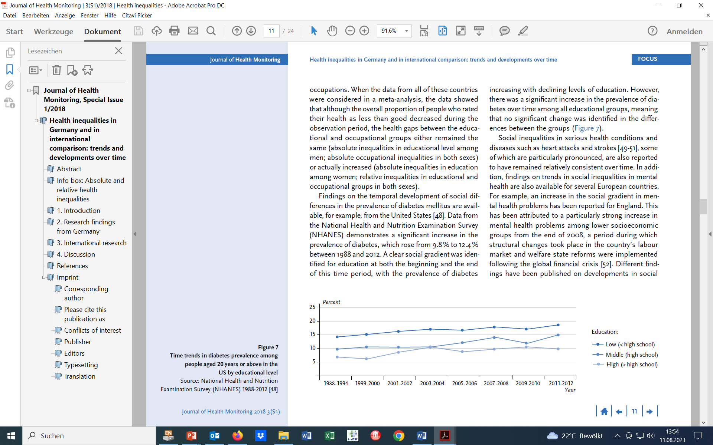
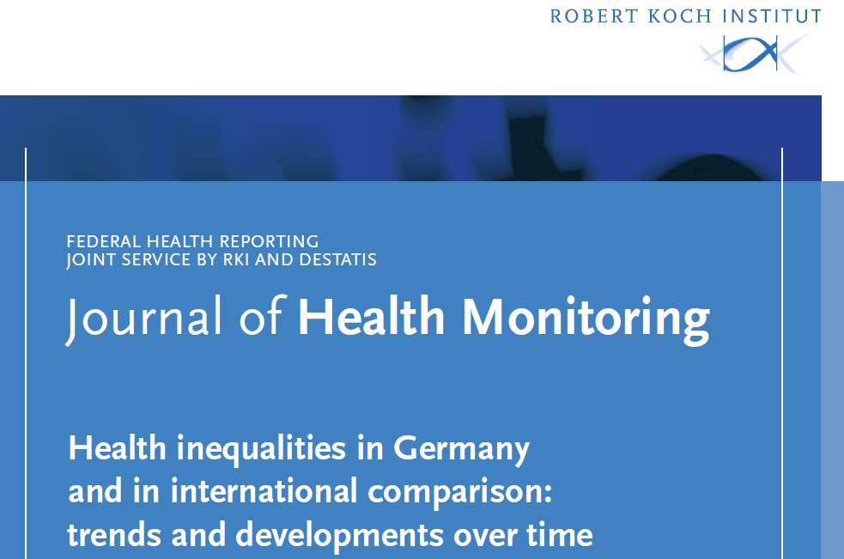
Diabetes Prevalence (20+) USA

Slide 28

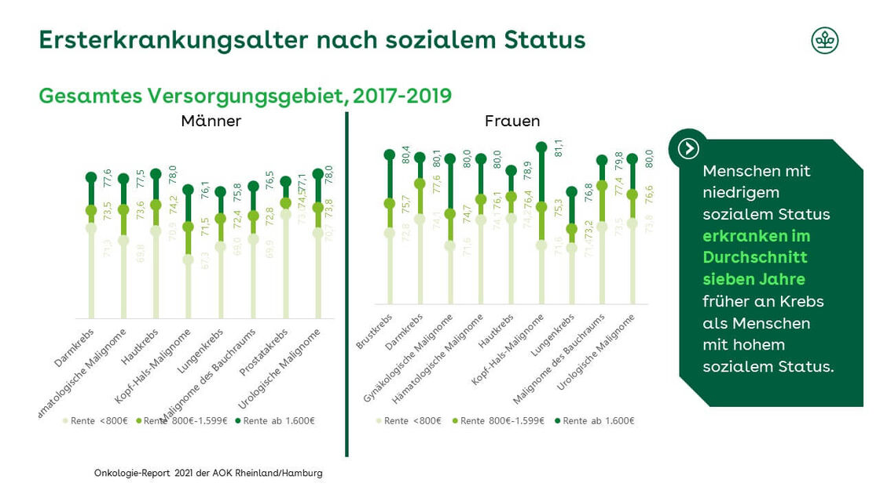
Oncology and Poverty
Pension > 1599 €
Age of oneset acc. to social status
Male Female
Population with lower income suffer from cancer seven years earlier than populatoin with higher income
Pension < 800 €

Slide 29
Disease as Cause and Result of Poverty

Slide 32
1.2 Health and Development
1 International Public Health
1.1 Background
1.2 Health and Development
  1.2.1 Context
  1.2.2 Static Concept of Development
  1.2.3 Dynamic Concept of Development
  1.2.4 Health Care in Developing Countries
  1.3 Conceptions

