Slide 1
International Health Care Management Part 1.2.2
Steffen Fleßa
Institute of Health Care Management
University of Greifswald

Slide 2
1.2 Health and Development
1 International Public Health
1.1 Background
1.2 Health and Development
1.2.1 Context
1.2.2 Static Concept of Development
1.2.3 Dynamic Concept of Development
1.2.4 Health Care in Developing Countries
1.3 Conceptions

Slide 3
1.2.2 Static Concept of Development
Static Concept of Development
→ Level of development based on specific indicators
Dynamic Concept of Development
→ Process of development

Slide 4
Indicators of the Static Concept of Development
Per Capita Income
Gini Coefficient for Income Distribution
Illiteracy
Epidemiological Indicators (child mortality, infant mortality, maternal mortality, life expectancy)
…

Slide 5
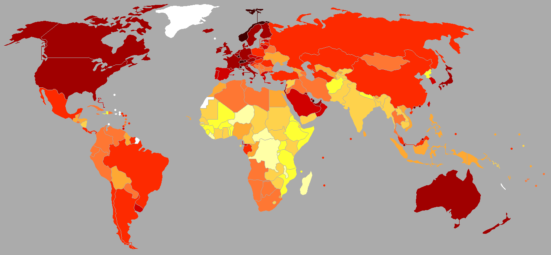
Gross National Product per capita [US$]
https://commons.wikimedia.org/w/index.php?curid=47590281

Slide 6
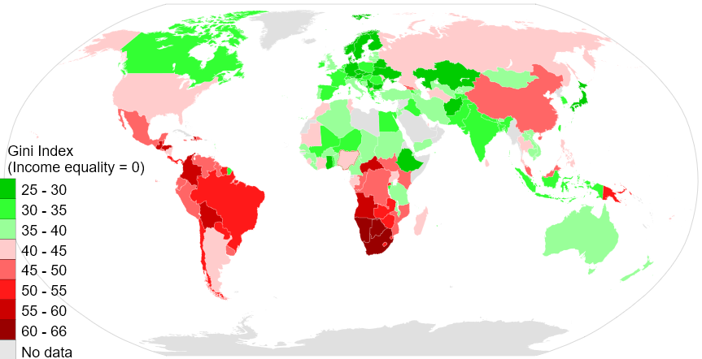
Gini-Index (2014)
https://commons.wikimedia.org/w/index.php?curid=33962866

Slide 7
Country Categories
Traditional Classification
Developed Countries
Underdeveloped Countries
Classification according to GNP per capita
Developed Countries
Less Developed Countries (LDC)
Least Developed Countries (LLDC)

Slide 8
Least Developed Country: Definition
Income: the annual per capita income does not exceed $905 in a three-year rolling average
Economic Vulnerability Index (EVI): describes „the vulnerability of a society“ primarily originating from the dependency on one source of income, i.e. proceeds from export, share of agricultural production, processing industry and services in the gross domestic product
Human Assets Index (HAI): the HAI provides information on the human capital, i.e. food security, malnutrition, child mortality, school enrollment rate, ability to read in adults

Slide 9
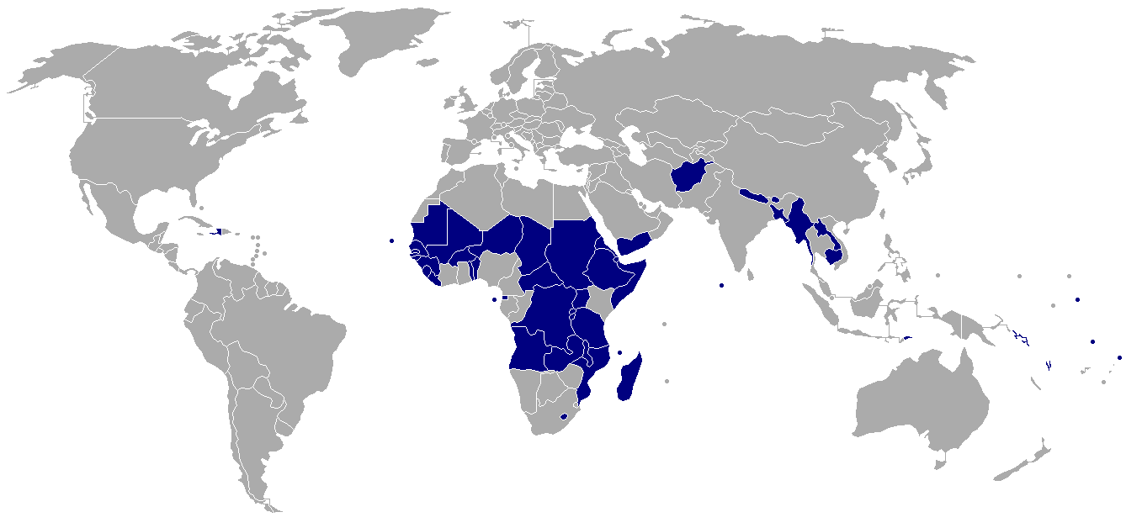
Least Developed Countries 2016
Source: https://commons.wikimedia.org/wiki/File:Least_Developed_Countries_map.svg

Slide 10
Other Classifications
Classification according to proportion of market relations: first, second and third world
Classification according to the Human Development Index
Low-Income Countries
Middle-Income Countries
Severely Indebted Low-Income Countries
Severely Indebted Middle-Income Countries
Most seriously affected countries (MSAC)

Slide 11
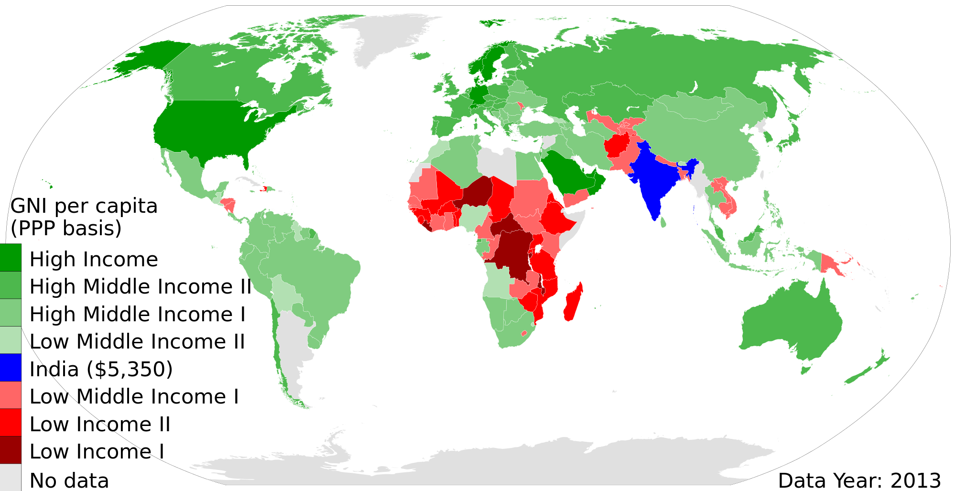
High, low and middle income countries
Source: The World Bank 2014

Slide 12
Annual Loss of Quality of Life per 1000 Inhabitants
600
developed market economies (DME)
former socialist countries (FS)
South America (SA)
Middle East (ME),
Rest of Asia (AR), excluding India
500
Loss of DALYs per 1000 inhabitants
400
300
200
100
0
Africa
India
AR
ME
SA
China
FS
DME
Source: Worldbank 1993, S. 3

Slide 13
Burden of Disease 2007 (WHO 2008)

Slide 14
1.2 Health and Development
1 International Public Health
1.1 Background
1.2 Health and Development
1.2.1 Context
1.2.2 Static Concept of Development
1.2.3 Dynamic Concept of Development
1.2.4 Health Care in Developing Countries
1.3 Conceptions

