Slide 1
International Health Care Management Part 1.3.4
Steffen Fleßa
Institute of Health Care Management
University of Greifswald

Slide 2
1.3 Concepts
1 International Public Health
1.1 Background
1.2 Health and Development
1.3 Concepts
1.3.1 Prevention
1.3.2 Primary Health Care
1.3.3 Health Promotion
1.3.4 Recent Developments

Slide 3
1.3.4 Recent Developments
World Development Report 1993
Annual World Development Reports of World Bank on changing topics
Predecessor: „Financing Health Care Services in Developing Countries – An Agenda for Reform“ (World Bank 1987)
1993: „Investing in Health”
Content:
defined orientation on efficient measures of intervention
Measuring efficiency using DALYs
12 US$ for the provision of basic supply in LLDCs (33 % on prevention, 67 % on curation)
Follow-up document: Better health for Africa (1994)

Slide 4
Millennium Development Goals
Eradicate extreme poverty and hunger until 2015
Achieve universal primary education
Promote gender equality and empower women
Reduce child mortality
Improve maternal health
Combat HIV/Aids, Malaria and other diseases
Ensure environmental sustainability
Global partnership for development

Slide 5
Commission on Macroeconomics and Health
Commission on Macroeconomics and Health
Gro Harlem Brundtland in January 2000
Report: December 2001
Members: Jeffrey Sachs, Robert Feachem et al.
Goal: Identify ways on how to reach the Millennium Development Goals

Slide 6
Results I
Health as the central factor of production
Investments in health are rational
Better health does not lead to an increase in birth rates
Better health has a higher rate of return than numerous other investments
➔ Investments in health allow overcoming development traps!

Slide 7
Results II
The expenditure on health per capita and year have to be increased to 30-40 US$
Donor organizations have to cover the difference to the current expenditure equaling 30 US$ per capita and year or 27 billion US$ respectively
Donor organizations have to quintuple their current investments in health (from 5 to 27 billion p.a.)

Slide 8
Realistic?
Investment (annual):
27 billion, thereof
22 billion additionally???
➔ absolutely unrealistic!
But: even small investments pay off
Example: fight against Malaria, AIDS, TB

Slide 9
Global Fund
Global Fund to Fight AIDS, Tuberculosis and Malaria
GF founded in June 2001 by the UN General Assembly (Kofi Annan)
GF represents an instrument of financing not an agency for implementation
Goal: 10 billion US$ p.a.
Reality: ???

Slide 10
Declaration of Paris
28/2-2/3/2005: conference of donor and partner countries
Goal: Increasing the efficacy in development cooperation, inter alia by means of a binding agreement on indicators for progress
https://www.oecd.org/dac/effectiveness/parisdeclarationandaccraagendaforaction.htm

Slide 11
Principles of Paris for sustainable development
Reinforcing the Ownership of partnering countries,
Alignment of developmental cooperation on national developmental strategies, institutions and procedures,
Harmonization of donor activities,
Introduction of Managing for Results and
Mutual Accountability.

Slide 12
Managing for Results: Examples
Examples for Indicators
Increase the number of partnering countries that can prove developmental strategies
Increase the percentage of financial benefits being paid according to an agreed schedule
Increase the percentage of financial benefits being paid within program based approaches

Slide 13
Declaration of Paris
Implementation (Examples)
Sector Wide Approach (SWAp)
Basket Funding
Output Based Aid
Elite-Training (ILT)
Problem: Return to elites
The problem being the legitimation of elites by the civil society
http://www.betteraid.org/

Slide 14
Consequence of Paris
Providing for Health (P4H) (2007)
„P4H is aiming in particular to address the incapacity of poor people living in low- and middle-income countries to access quality health services.”
Initiative von development EZ- and UN-Organisations (e.g. WHO, WB, DiFID, GIZ, KfW)
Focus: Social Security
http://www.who.int/providingforhealth/about/en/

Slide 15
Consequence of Paris
International Health Partnership (2012)
Broadly distributed (WHO, European Commission, WB, UNAIDS, UNFPA, GAVI Alliance, UNICEF, Bill and Melinda Gates Foundation, African Development Bank, GFATM, UN Development Group) goals (not only social security):
More inclusive national health planning and joint assessment (JANS) processes
More unified support to national plans through country compacts
One monitoring and evaluation platform to track strategy implementation
Greater mutual accountability
Improved civil society engagement
Harmonized financial management
http://www.internationalhealthpartnership.net/en/

Slide 16
Accra Agenda for Action (AAA, 2008)
Target: Strengthen and deepen implementation of the Paris Declaration, AAA takes stock of progress and sets the agenda for accelerated advancement towards the Paris targets
Improvement fields:
Ownership: Countries have more say over their development processes through wider participation in development policy formulation, stronger leadership on aid co-ordination and more use of country systems for aid delivery
Inclusive partnerships: All partners (Governments, donors, foundations and civil society) participate fully
Delivering results: Aid is focused on real and measurable impact on development.
Capacity development: ability of countries to manage their own future

Slide 17
DAC Criteria
Term: “DAC Criteria for Evaluating Development Assistance”
OECD: Organisation for Economic Co-operation and Development
DAC: Development Assistance Committee
Criteria to assess development assistance:
Relevance: Are we doing the right thing?
Effectiveness: Will we achieve the project's objective?
Impact: Are we contributing to the achievement of overarching development results?
Efficiency: Are the objectives being achieved cost-effectively?
Sustainability: Are the positive results durable?

Slide 18
Business of Health
International Finance Corporation, The World Bank Group (2008): „The business of health in Africa“
Content:
Investments in the African health care demand for the private sector
Public-Private-Partnership
Private not for the rich only!

Slide 19
Universal Health Coverage
WHO (homepage 2013)
Universal coverage (UC), or universal health coverage (UHC), is defined as ensuring that all people can use the promotive, preventive, curative, rehabilitative and palliative health services they need, of sufficient quality to be effective, while also ensuring that the use of these services does not expose the user to financial hardship.
…

Slide 20
UHC
…
Evans, Hsu & Boerma (2013)
Universal health coverage is the obtainment of good health services de facto without fear of financial hardship.
Kutzin (2013)
UHC is system-wide effective coverage combined with universal financial protection.

Slide 21
Elements of UHC
Health
WHO Constitution 1948
“Health is a state of complete physical, mental and social well-being and not merely the absence of disease or infirmity”.
Alma Ata 1978: Health for All by the Year 2000
“Health For All means that health is to be brought within reach of everyone in a given country. And by "health" is meant a personal state of well being, not just the availability of health services”. (H. Mahler 1981)
UHC is not a reprint of “Health for All”
Strong emphasis on health care delivery and social security
Clearly more realistic

Slide 22
Elements of UHC
Coverage
Accessibility
Physical accessibility
Financial accessibility
Acceptance
Willingness of the population to accept the provided services
Problem: social and cultural barriers
Effective Health Services
Quantity of health services
Quality of health services
Broadness and depth of provided health services

Slide 23
Elements of UHC
Universal
Who is covered?
Poverty groups? Almost-poor in the informal sector? Almost-poor in formal sector? Middle class? Rich?
Urbane and rural population?
Employees, unemployed, informal sector, families?

Slide 24
Elements of UHC
Universal
…
What services are covered?
Health promotion, prevention, out-patient, in-patient, rehabilitation, palliative care?
Communicable diseases, chronic degenerative diseases, …?
Interventions low in cost or resource intensive (i.e. ART and HAART? Dialysis?)
Which proportion of costs is covered?
Public health expenditures, health insurance, Out-of-Pocket?

Slide 25
Dimensions of UHC
Quelle: WHO 2011

Slide 26
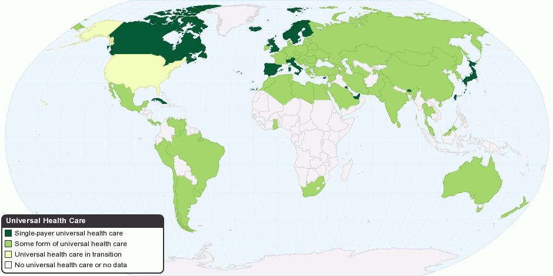
Universal Health Coverage Worldwide
http://what-is-is.blogspot.de/2012/09/lancet-how-to-achieve-universal-health.html

Slide 27
UHC and Economic Framework

Slide 28
Current Discussion
WHO-resolution 58.33 by 2005
“Universal protection and social health insurance”
World Health Report 2010
“Health systems financing: the path to universal coverage”
Mexico City Political Declaration on Universal Health Coverage (4/2012)
Bangkok Statement on Universal Health Coverage (I/2012)
Tunis Declaration on Value for Money, Sustainability and Accountability in the Health Sector (I/2012)
UN-resolution “Transition of National Health Care Systems towards Universal Coverage” (12.12.2012)

Slide 29
Current Discussion
Post-MDGs and Sustainable Development Goals (SDG´s)
Problems of MDGs
Lack of “participation of the South” in target selection
Lack of important elements
Only small number of ambitious objectives, no differentiation of countries
One dimensional definition of poverty
Non measurable objectives for the North
Narrow understanding of development: VERTICAL APPROACH in health care

Slide 30
Current Discussion
Post-MDGs and Sustainable Development Goals (SDG´s)
…
Post 2015
UN-Summit on MDG´s 2010: „Recognition“ of the changing global situation
Ban Ki-moon appoints UN Task Team for Post-2015 agenda
„Realizing the Future We Want for All” (2012)

Slide 31
Sustainable Development Goals (SDGs)
UN-initative: “Transforming our world: the 2030 Agenda for Sustainable Development” (2015)
17 "Global Goals"
169 targets

Slide 32
Sustainable Development Goals (SDGs)

Slide 33
SDGs 3: Good Health and Well-being
3.1 By 2030, reduce the global maternal mortality ratio to less than 70 per 100,000 live births
3.2 By 2030, end preventable deaths of newborns and children under 5 years of age, with all countries aiming to reduce neonatal mortality to at least as low as 12 per 1,000 live births and under-5 mortality to at least as low as 25 per 1,000 live births
3.3 By 2030, end the epidemics of AIDS, tuberculosis, malaria and neglected tropical diseases and combat hepatitis, water-borne diseases and other communicable diseases
3.4 By 2030, reduce by one third premature mortality from non-communicable diseases through prevention and treatment and promote mental health and well-being
3.5 Strengthen the prevention and treatment of substance abuse, including narcotic drug abuse and harmful use of alcohol
3.6 By 2020, halve the number of global deaths and injuries from road traffic accidents
3.7 By 2030, ensure universal access to sexual and reproductive health-care services, including for family planning, information and education, and the integration of reproductive health into national strategies and programmes
3.8 Achieve universal health coverage, including financial risk protection, access to quality essential health-care services and access to safe, effective, quality and affordable essential medicines and vaccines for all
3.9 By 2030, substantially reduce the number of deaths and illnesses from hazardous chemicals and air, water and soil pollution and contamination

Slide 34
Lancet-Commission
„Global Health 2035: a world converging within a generation“
Background:
20 years „Investing in Health“ (World Bank)
Are investments in health care profitable?
Commission: Lancet assigns international scientists with finding an answer to this question
Final report: December 2013
Jamison, Dean T., et al. "Global health 2035: a world converging within a generation." The lancet 382.9908 (2013): 1898-1955.

Slide 35
Lancet-Commission
Investments in health care are profitable!
GNP: Reduction in mortality is the reason for 11% of expected economic growth in Low- and Middle-Income Countries
„Full income“:
GNP + VLYs
VLY: Value of additional life-year (expressed in willingness to pay for an additional year of life)
Reduction in mortality is the reason for 11% of expected increase in „full income“

Slide 36
Lancet-Commission
…
„Grand convergence“
Middle- und Low-income countries reach the level of upper-middle income countries in 2013 by the year 2035.
In particular concerning infectious diseases, infant and maternal mortality
Profitability: 9-10fold amortization
Conditions
High total financing: 38 Billion US$ p.a.
Rising state funds
No external shocks (i.e. resistance to antibiotics)
International financing

Slide 37
Lancet-Commission
…
…
NCDs and fiscal policy
The fight of NCDs is possible
Conditions
National policy
Financial needs: minimum of 2 billion US$ p.a.
Requires fiscal policy
Taxation of risk factors, i.e. tobacco
Reducing subsidies for risk factors, i.e. gasoline

Slide 38
Lancet-Commission
…
…
…
Universal Health Coverage
„progressive universalism“: reaching the goal step by step
Basic social security (essential care): insurance + state subsidies
Supplemental insurance (larger benefit package): partially public subsidies for the poor
High profitability

Slide 39
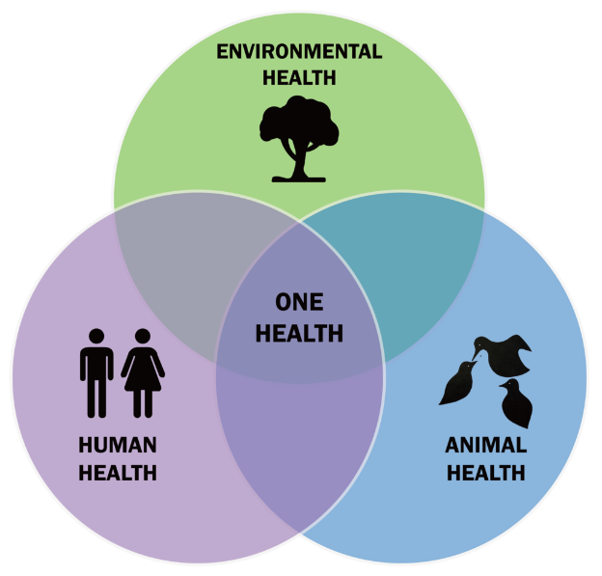
One Health
One Health is an approach calling for "the collaborative efforts of multiple disciplines working locally, nationally, and globally, to attain optimal health for people, animals and our environment", as One Health Initiative Task Force

Slide 40
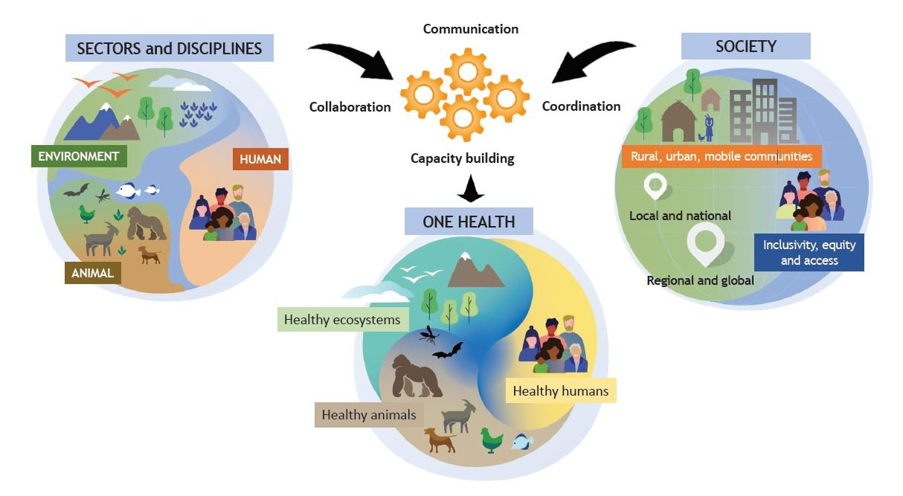
One Health
https://doi.org/10.1371/journal.ppat.1010537

Slide 41
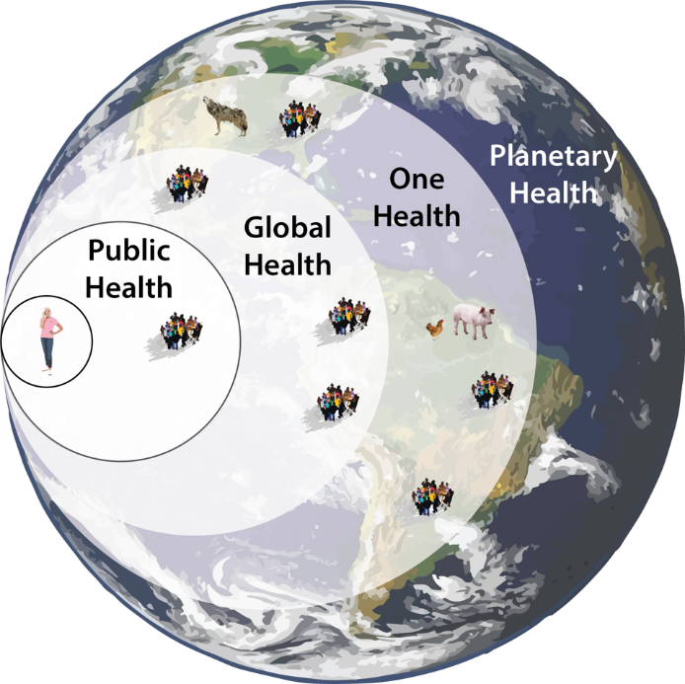
Planetary Health
Planetary health refers to "the health of human civilization and the state of the natural systems on which it depends“ (https://www.thelancet.com/journals/lancet/article/PIIS0140-6736(15)61038-8/fulltext)
https://www.forbes.com/sites/johndrake/2021/04/22/what-is-planetary-health/?sh=7aba63d02998

Slide 42
„Health in All Policies“
“Helsinki Statement”:
8th Global Conference on Health Promotion
10-14 June 2013
„… health and equity [are] a core responsibility of governments to its peoples, affirm the compelling and urgent need for effective policy coherence for health and well-being and recognize that this will require political will, courage and strategic foresight”

Slide 43
Health in All Policies
https://www.accesskent.com/Health/HiAP/

Slide 44
Health in All Policies
https://www.cph.co.nz/your-health/health-in-all-policies/

Slide 45
1.3 Concepts
1 International Public Health
1.1 Background
1.2 Health and Development
1.3 Concepts
1.3.1 Prevention
1.3.2 Primary Health Care
1.3.3 Health Promotion
1.3.4 Recent Developments

