Slide 1
International Health Care Management Part 2.1
Steffen Fleßa
Institute of Health Care Management
University of Greifswald

Slide 2
Structure
International Public Health
2 Demand for Health Services
3 Supply of Health Services
4 Health Systems and Reforms

Slide 3
2 Demand for Health Services
2.1 Determinants of Demand: Overview
2.1.1 Health Economic Framework
2.1.2 History of Epidemiologic Concepts
2.1.3 Excursus: Measuring Quality of Life
2.2 Demographic and Epidemiologic Transition
2.3 Epidemiology of Infectious Diseases

Slide 4
2.1.1 Health Economic Framework

Slide 12
2.1.2 History of Epidemiologic Concepts
Age | Causal Model | Concepts of Health | Health Indicators
1900 | Single-Cause-Model (Infectious Diseases) | Ecological-Model (Agent-Host-Environment) | Mortality Morbidity (Prevalence, Incidence)
1920 | Multiple-Cause-Model (Infectious Diseases, Transition to Chronic Diseases) | Social-Ecology-Model (Host-Environment-Behavior) | Work-Related Dimensions of Invalidity (Inability to Work, Disability)

Slide 13
Age | Causal Model | Concepts of Health | Health Indicators
1940 |  | WHO-Model: Complete Physical, Mental, Social Wellbeing
1970 | Multiple-Cause-Model Multiple-Effect-Model (Chronic Diseases) | Risk-Factor-Model Holistic Model (Environment, Biology, Lifestyle, Health Care System) WHO-Model: „Health for all by 2000“ | Dimensions of Risk Factors (Smoking, Alcohol, Cancer Registry,...)

Slide 14
Age | Causal Model | Concepts of Health | Health Indicators
1980 |  | Wellness-Model (Increasing Conditions of Wellness) | Dimensions of Wellness, Quality of Life (QALY)
1990 | Multiple-Cause-Multiple-Effect Model (Social Transformation Disease Cycle) | WHO: Health Promotion Developing Healthy Policies | Dimensions of Equity Dimensions for Social Index
(cf. Dever 1991)

Slide 15
Example: Attention Deficit – Hyperactivity Syndrome (ADHS)
Cardinal Symptoms:
Low attention span
Impulsiveness
Hyperactivity
NB: Attention Deficit Syndrome (ADS) without Hyperactivity („Dreamer“)
Starts before the age of 6
Occurrence:
3-5% of the population; 1:3 female:male

Slide 16
ADHS
Causes (Risk Factors)
Genetic: Abnormality of the cerebral ability to process signals (fragile X-Syndrome)
Complications during pregnancy and birth
Low birth weight
Infection
Pollutants
Illness or injury of the central nervous system
Bad parenting, negligence
No direct correlation between cause and effect

Slide 17
2.1.3 Excursus: Measuring Quality of Life
Measuring Individual Quality of Life
Analogue model
Questionnaires
i.e. SF-12, SF-36
Standardized Measures of Quality of Life
Rosser-Matrix
Quality Adjusted Life Years
Disability Adjusted Life Years

Slide 18
Analogue Model
100
0

Slide 19
SF-36 (https://www.rand.org/health-care/surveys_tools/mos/36-item-short-form.html)

Slide 20
Rosser Matrix
Pain
A: Painless
B: Slight Pain
C: Moderate Pain
D : Severe Pain
Impairment
I. No impairment
1.000
0.995
0.990
0.967
II. Slight Social Impairment
0.990
0.986
0.973
0.932
III. More Severe Social Impairment
0.980
0.972
0.956
0.912
IV. More Severe I. of the Ability to Work
0.964
0.956
0.942
0.870
V. Inability to Work
0.946
0.935
0.900
0.700
VI. Inability to Move without Assistance
0.875
0.845
0.680
0
VII. Bedrest
0.677
0.564
0
-1.486
VIII. Coma
-1.028
-
-
-

Slide 21
Disability Adjusted Life Years (DALY)
Von Original: Planemad Vektor: Radio89 - Diese Datei wurde von diesem Werk abgeleitet: DALY disability affected life year infographic.png:, CC BY-SA 3.0, https://commons.wikimedia.org/w/index.php?curid=20278903

Slide 22
States of Health According to DALYs
State of Health | Rating of State of Health
Limited capability of performing at least one activity in one of the following areas: relaxation, education, procreation, profession | 0.096
Limited capability of performing most activities in one of the following areas: relaxation, education, procreation, profession | 0.220
Limited capability of performing activities in two or three of the following areas: relaxation, education, procreation, profession | 0.400
Limited capability of performing most activities in all four areas | 0.600
Need for assistance in instrumental activities of daily life, i.e. preparing meals, grocery shopping, household chores | 0.810
Need for assistance in activities of daily life, i.e. eating, personal hygiene, toilette | 0.920
Death | 1.000

Slide 23
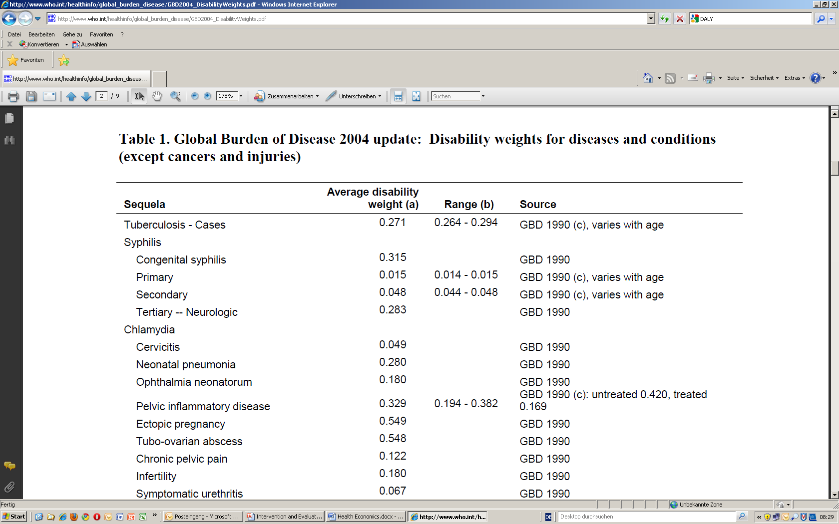
DALYs (http://www.who.int/healthinfo/global_burden_disease/GBD2004_DisabilityWeights.pdf)

Slide 24
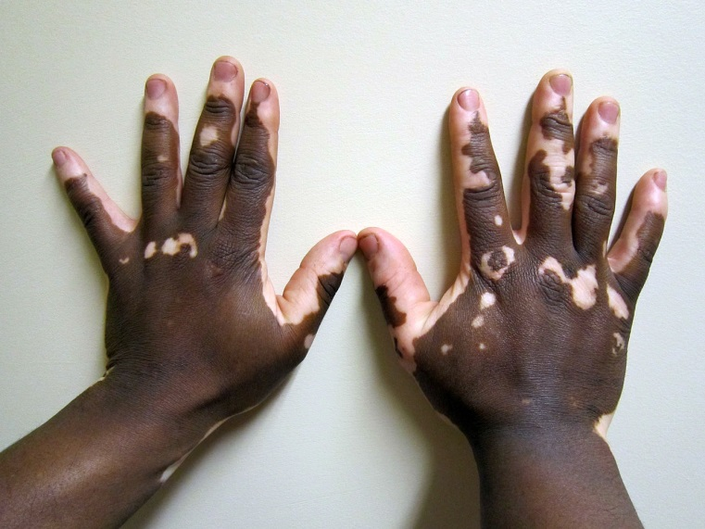
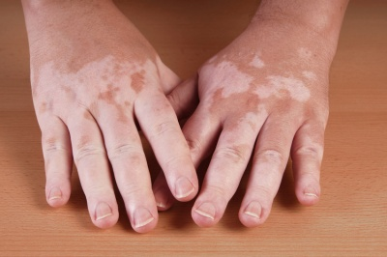
Disability Weight and Culture
Example: Vitiligo
chronic skin disease
Loss of pigment
European: low disability
African/Asian: strong disability
Frequently confused with leprosy
International disability weight is wrong!

Slide 25
Remaining Life Expectancy according to DALYs
Age | Male | Female
0 | 80.00 | 82.50
1 | 79.36 | 81.84
5 | 75.38 | 77.95
10 | 70.40 | 72.99
15 | 65.41 | 68.02
20 | 60.44 | 63.08
25 | 55.47 | 58.17
30 | 50.51 | 53.27
35 | 45.57 | 48.38

Slide 26
Age | Male | Female
40 | 40.64 | 43.53
45 | 35.77 | 38.72
50 | 30.99 | 33.99
55 | 26.32 | 29.37
60 | 21.81 | 24.83
65 | 17.50 | 20.44
70 | 13.58 | 16.20
75 | 10.17 | 12.28
80 | 7.45 | 8.90
85 | 5.24 | 6.22
90 | 3.54 | 4.25
95 | 2.31 | 2.89

Slide 27
Value of One Year of Life in the Calculation of DALYs
2
1.5
1
Relative Value of One
Year of Life
0.5
0
0
20
40
60
80
100
Age

Slide 28
At a discounting rate of 3 % and the described age adjustment the loss of DALYs due to illness or disability can be described accordingly:
D Value of state of health according to the table
L Period of physical disability; respectively loss of years lived due to premature death
a Age of starting physical impairment; respectively year of death
x Age

Slide 29
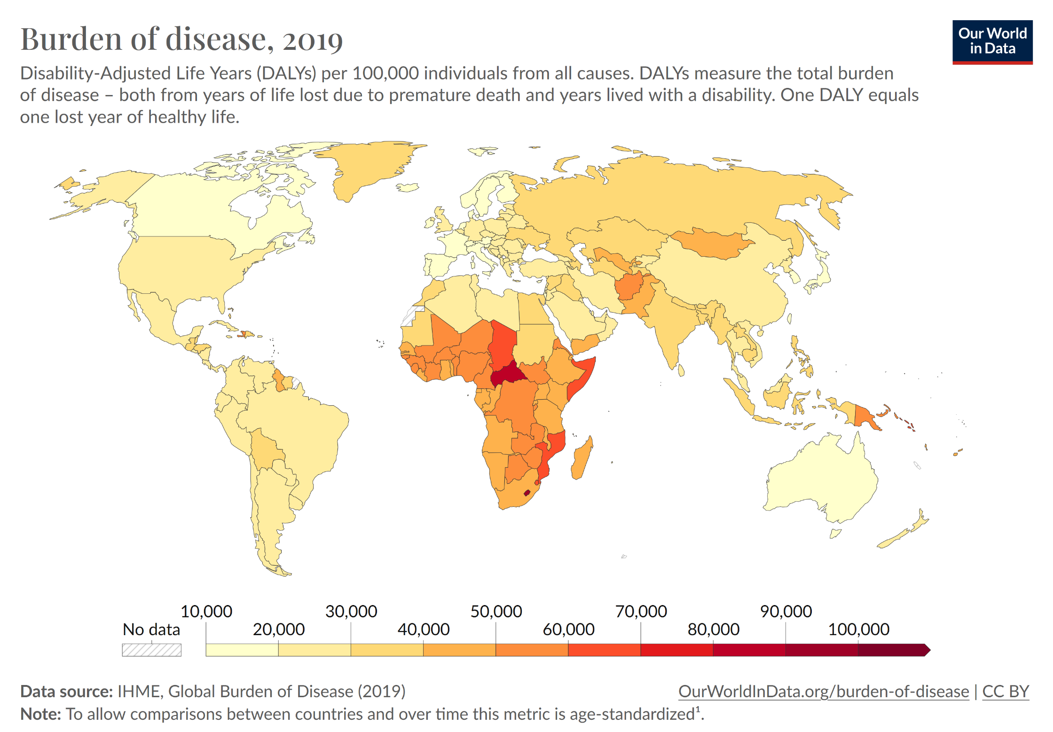
No data

Slide 30
2 Demand for Health Services
2.1 Determinants of Demand
2.1.1 Health Economic Framework
2.1.2 History of Epidemiologic Concepts
2.1.3 Excursus: Measuring Quality of Life
2.2 Demographic and Epidemiologic Transition
2.3 Epidemiology of Infectious Diseases

