Slide 1
International Health Care Management Part 2.3.1
Steffen Fleßa
Institute of Health Care Management
University of Greifswald

Slide 2
2 Demand for Health Services
2.1 Determinants of Demand: Overview
2.2 Demographic and Epidemiologic Transition
2.3 Epidemiology of Infectious Diseases
2.3.1 Background
2.3.2 Example: Malaria
2.3.3 Example: Covid-19

Slide 3
2.3 Epidemiology of Infectious Diseases 2.3.1 Background
Paths of Transmission
Symbols:
Human
Animal
Vector

Slide 4
Paths of Transmission
Direct Transmission from Human to Human, i.e. Influenza, AIDS
Directly Transmitted Zoonoses, Human as aberrant host, i.e. Brucellosis
Vector-borne Human Diseases, i.e. Malaria
Vector-borne Zoonoses, i.e. Eichonoccus (Cestoda of Fox, Buchsbandwurm)

Slide 5
Paths of Transmission
5. Vector-borne Anthropoid-Zoonoses, i.e. Plague, Yellow Fever
6. Transmission via Intermediate Host, i.e. Bilharzia
1
2

Slide 6
Epidemiologic Course: Constant Virus
Measles
Time

Slide 7
Mutating Virus: Kilbourne Model

Slide 8
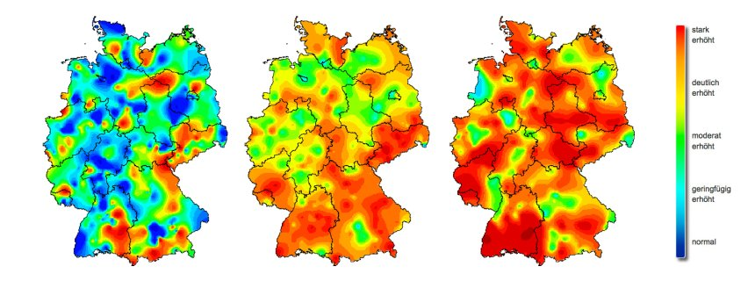
Influenza (2015)
5., 7. 9. Woche 2015

Slide 9
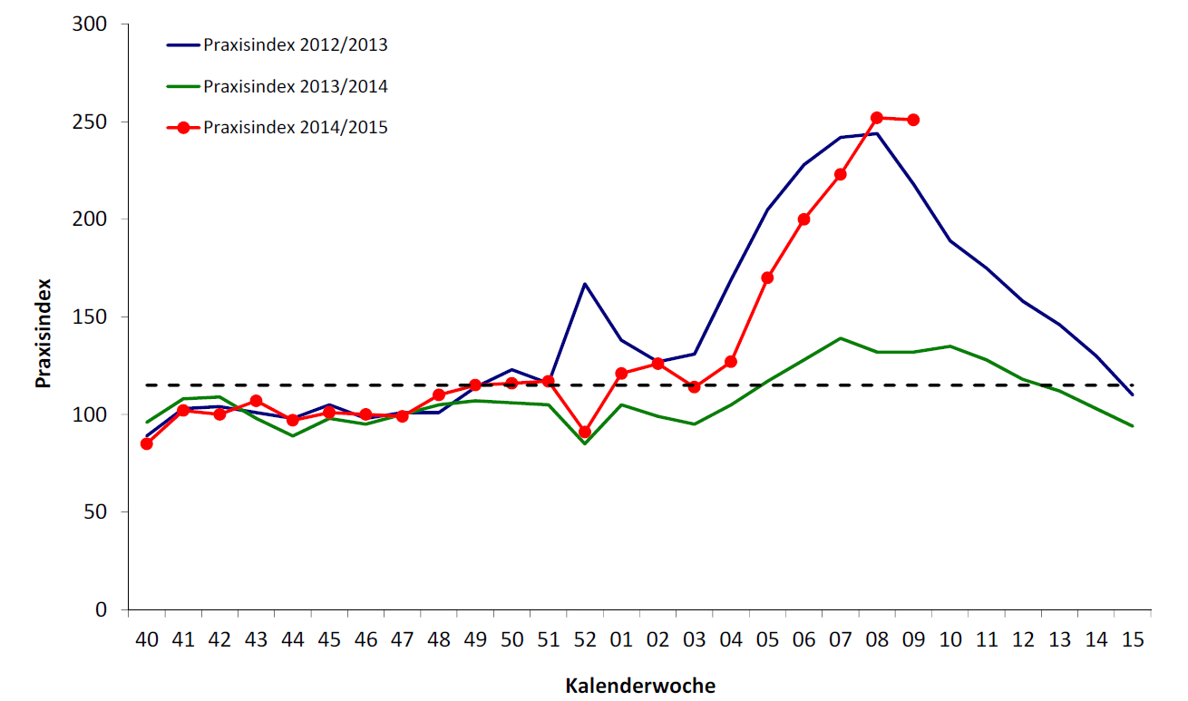
Influenza 2015 (RKI) Praxisindex = number of consultations for acute respiratory infects compared to annual average
Week of year

Slide 10
Conditions for Pandemics
„New“ agent within a population that shows low immunity
Infiltration, i.e. Plague
New Agent, i.e. Influenza
Rapid Diffusion
Low Lethality
Mortality of a disease referring to the proportion of fatalities to total number of sick people
High lethality results in the extinction of a disease before it is able to spread

Slide 11
Diffusion in space (here: Covid-19)
for t=34

Slide 12
Diffusion in space (here: Covid-19)
for t=52

Slide 13
Diffusion in space (here: Covid-19)
for t=65

Slide 14
Diffusion in space (here: Covid-19)
for t=73

Slide 15
Diffusion in space (here: Covid-19)
for t= 78

Slide 16
Diffusion in space (here: Covid-19)
for t=87

Slide 17
Diffusion of Diseases, i.e. Plague
Plague (1347-1352)
Possibly originating in Central Asia
Diffusion to Europe via salesmen and ships
Diffusion in whole of Europe
Estimated 25 million fatalities (1/3 of the European population)
Theory: various diseases at the same time: Ruhr, TBC, Typhus, Influenza, Pocks
http://www.scilogs.de/blogs/gallery/25/Pestilence_spreading_1347-1351_europe.png

Slide 18
Loss in Population in Central Europe Caused by Plague (14th+15th century)
Source: http://www.yersiniapestis.info/geschichte.html

Slide 19
Plague
Thirty Years War (1618-48)
Recurring plague
Reduction of the population by 1/3 due to plague and war
Pattern: weakened population (i.e. famine, war) is especially prone to disease
Today:
Worldwide Diffusion almost completely preventable thanks to antibiotics
Extinction impossible due to reservoirs in animals

Slide 20
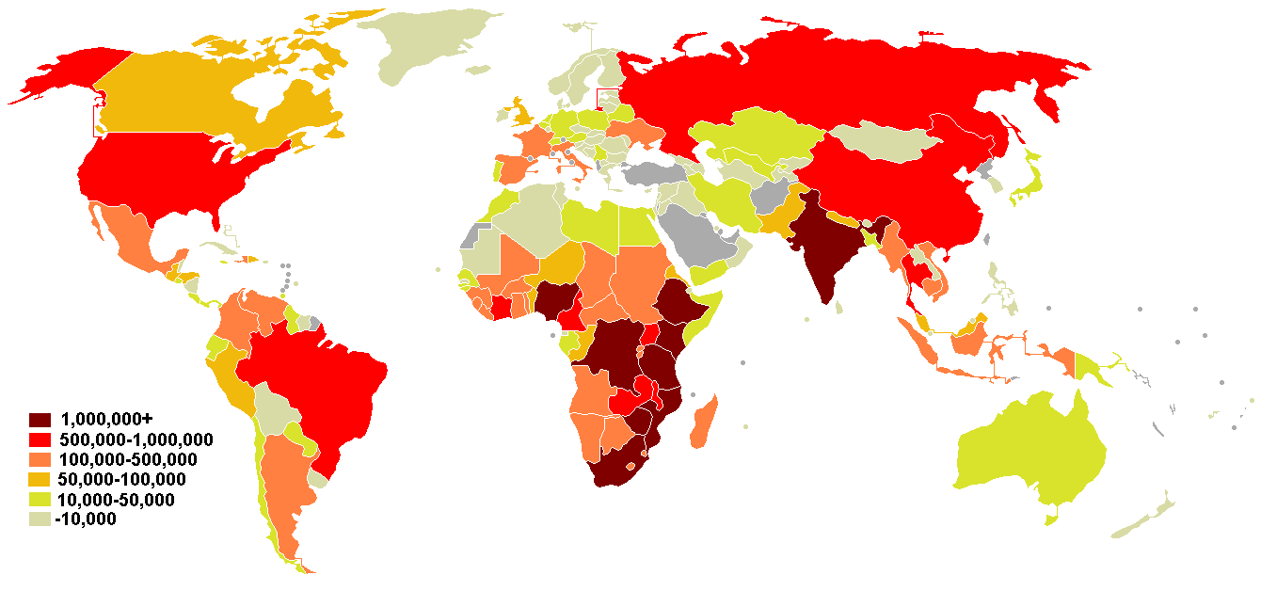
Diffusion of Diseaes
AIDS (since 1980)
Possibly originating in Africa
Diffusion through migration, tourism etc. (under debate!)
Worldwide Diffusion, >20 million fatalities
At present no cure
http://www.mapsharing.org/MS-maps/map-pages-worldmap/7-world-map-aids.html

Slide 21
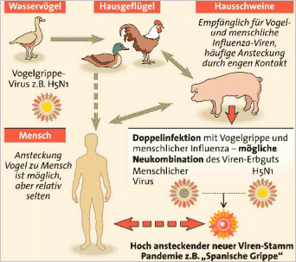
Emergence of New Viruses
Simultaneous Infection of a Host With Two Virus Strains
Danger of recombination through exchange of genetic material
Emergence of new, highly pathogen virus

Slide 22
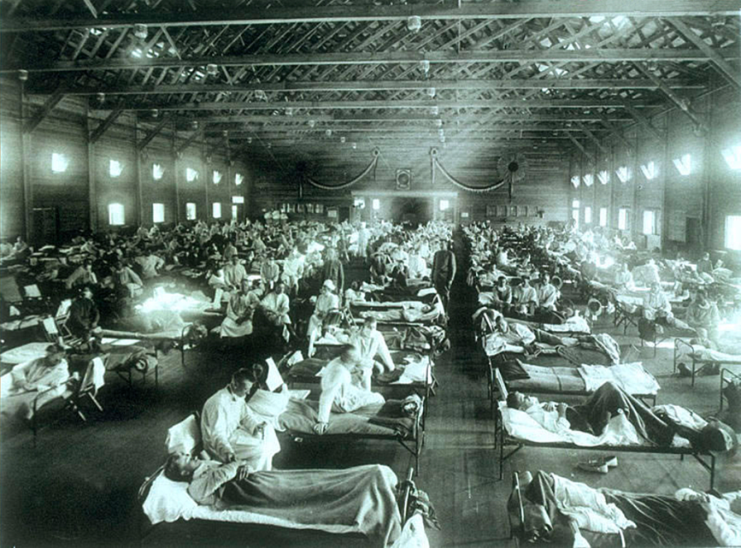
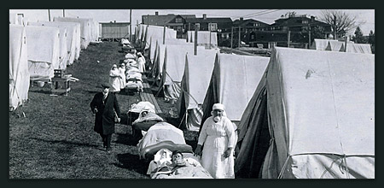
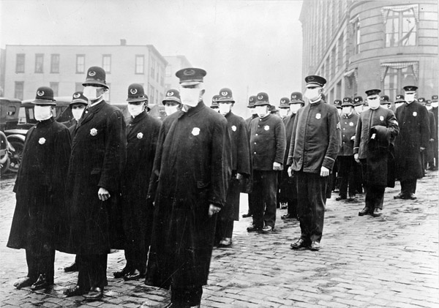
Spanish Influenza (1918-1920)
Influenza A H1N1
25-50 Mio. Fatalities
National Museum of Health and Medicine, Armed Forces Institute of Pathology, Washington, D.C.,
http://www.planet-schule.de/sf/multimedia/animationen/schweinegrippe/html/media/bild_spanischegrippe.jpg
165-WW-269B-25-police-

Slide 23
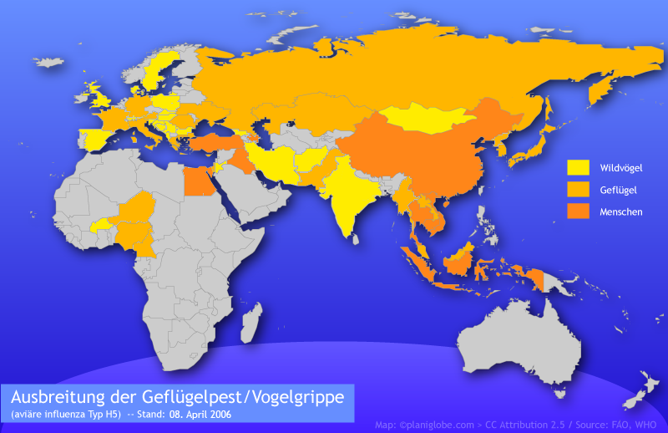
Avian Flu Worldwide
Wild Birds
Poultry
Humans
Diffusion of Avian Influenza / Bird Flu
(as of April 8th, 2006)

Slide 24
Main Routes of Bird Migration
Wild Birds
Poultry
Humans
Diffusion of Avian Influenza / Bird Flu
(as of April 8th, 2006)
http://going-to-korea.blogspot.com/

Slide 25
Swine Flu Worldwide
http://gamapserver.who.int/h1n1/cases-deaths/h1n1_casesdeaths.html

Slide 26
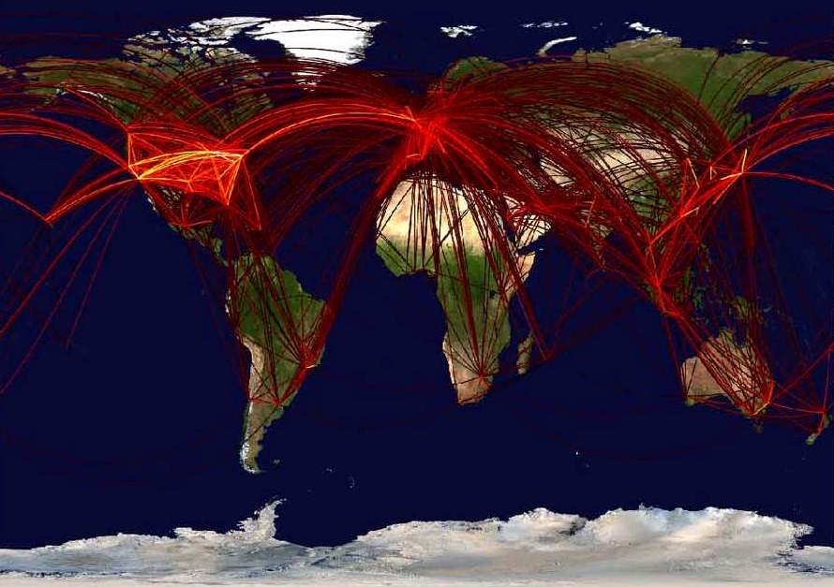
Flight Routes: faster than ever…
http://www.innovations-report.de/html/berichte/medizin_gesundheit/bericht-34912.html

Slide 27
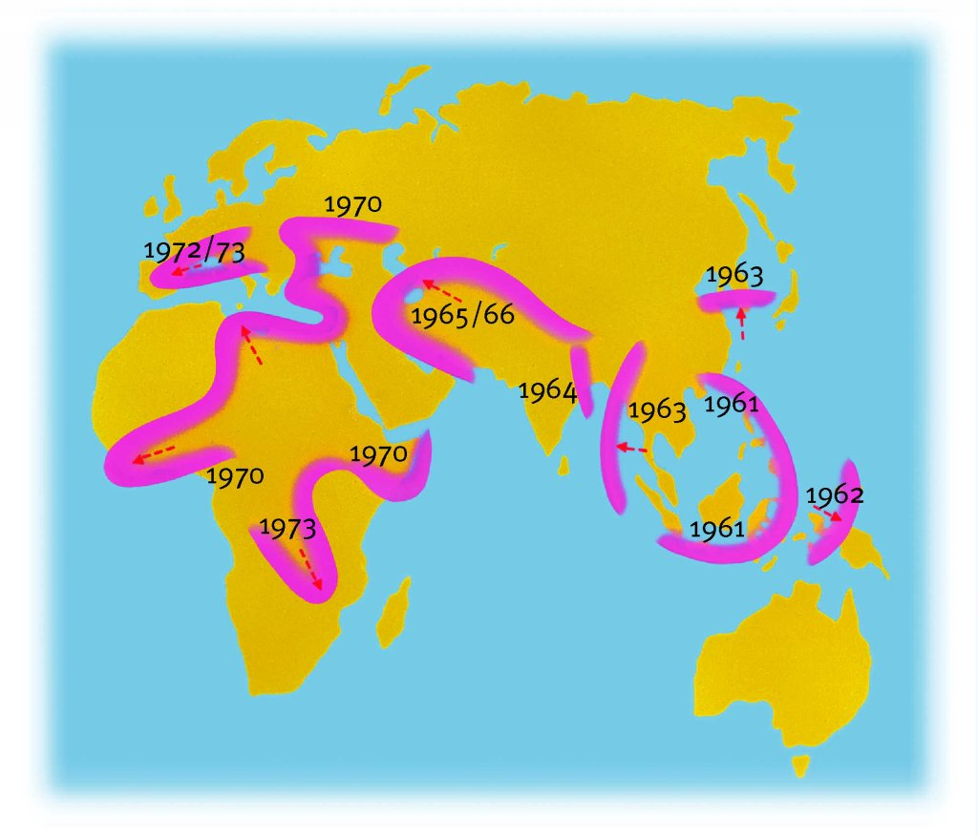
In Comparison: Diffusion of the 7th Cholera Epidemic
http://www.bertelsmann-bkk.de/fileadmin/Redakteure/Bilder/gesundheitslexikon/506693.jpg

Slide 28
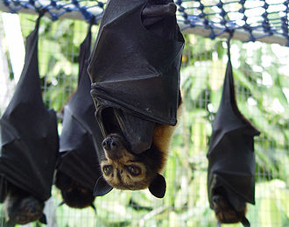
Ebola
officially: Ebola virus disease (EVD); Ebola hemorrhagic fever (EHF)
Victims: humans and primates
Cause: Ebola virus
Infection: body fluids (blood!)
Natural reservoir: fruit bats
Incubation period: 2-21 days
Symptoms: fever, sore throat, pain, vomiting, diarrhea, liver and kidney failure, internal and external bleeding

Slide 29
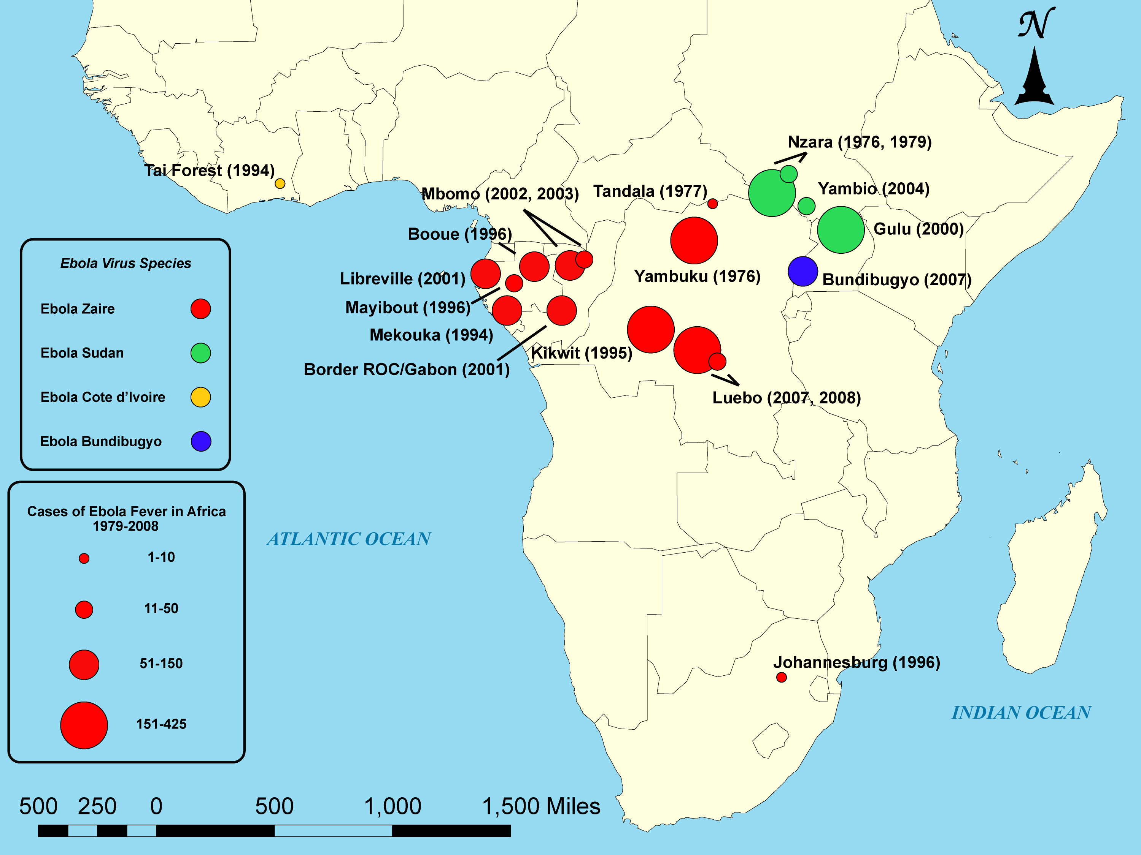
Cases of Ebola fever in Africa from 1979 to 2008.
www.cdc.org

Slide 30
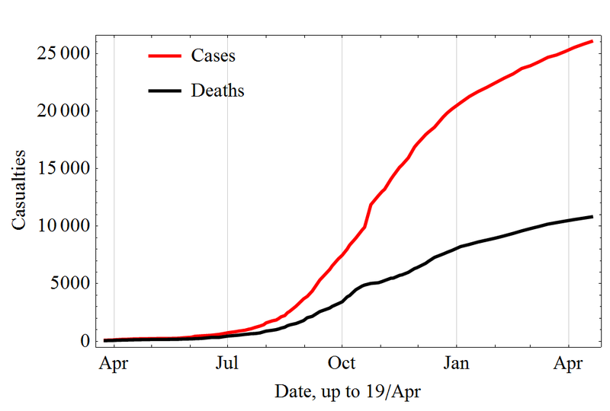
West-Africa Outbreak 2014

Slide 31
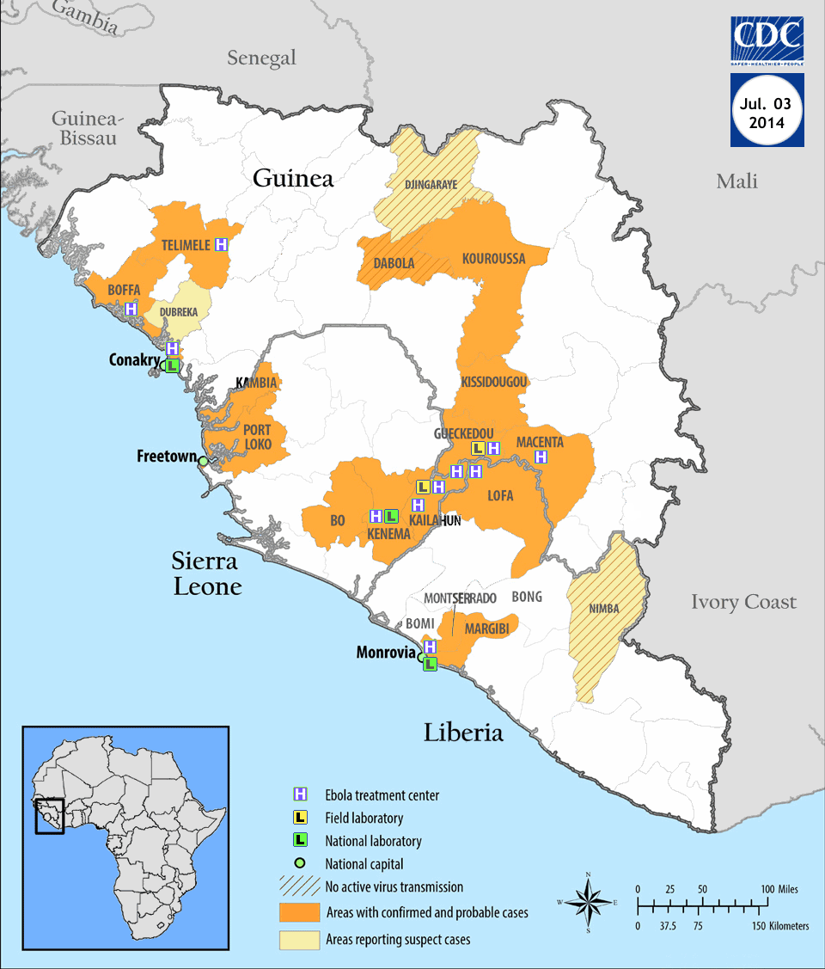
Ebola 2014

Slide 32
Major problems
Dysfunctional health care system
Culture (e.g. burial rite)
Fear and rejection of population
…
⇨Primarily Ebola is not a medical problem!

Slide 33
Cholera
Cholera is an acute diarrhoeal disease that can kill within hours if left untreated
1.3 to 4.0 million cases of cholera o,a,
21 000 to 143 000 deaths worldwide p.a.
https://www.zdf.de/nachrichten/panorama/cholera-kreuzfahrt-schiff-norwegian-dawn-mauritius-100.html
https://www.who.int/news-room/fact-sheets/detail/cholera

Slide 34
Cholera (Annual cases and case fatility rate)
http://dpaq.de/CmEWI

Slide 35
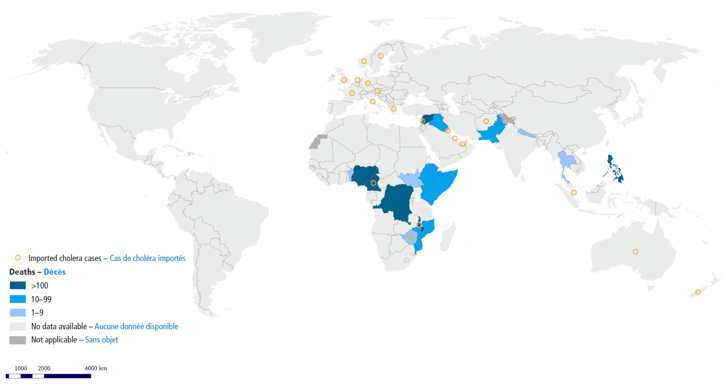
Countries Reporting Cholera Cases 2022
http://dpaq.de/CmEWI

Slide 36
Cholera Epidemic Jemen 2017/18
April-December 2017: 1,000,000 cases;
2500 fatalities

Slide 37
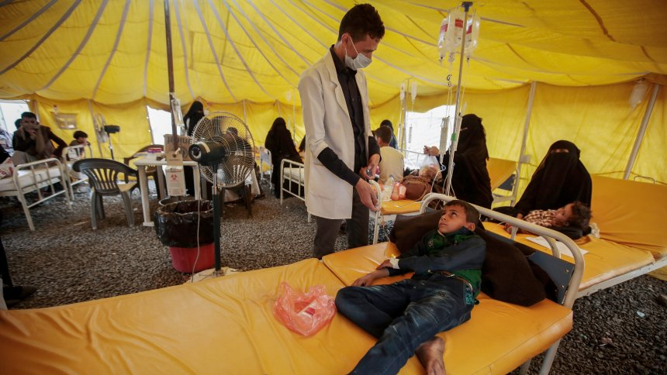
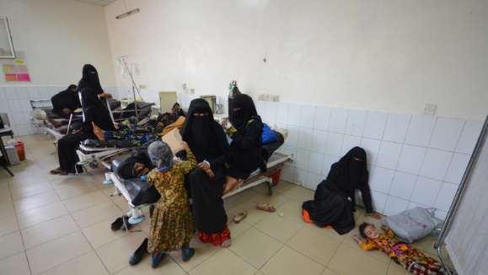
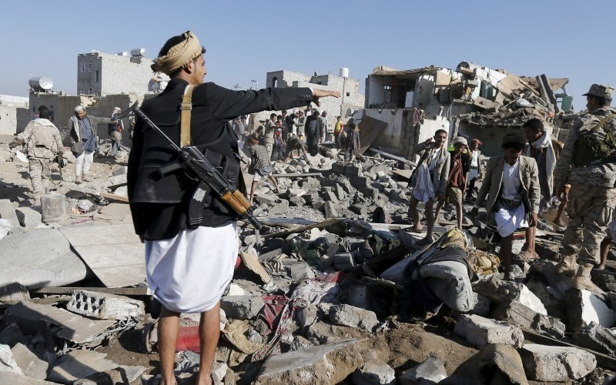
„not a medical problem"

Slide 38
Determinants of Epidemiology
Natural determinants
Temperature
Altitude
Precipitation
Waterways
Migration (Animals)
Relief

Slide 39
Determinants of Epidemiology
Natural determinants
Temperature
Altitude
Precipitation
Waterways
Migration (Animals)
Relief
Cultural determinants
Division of Labor Men/Women
Geographical Mobility
Clothing
Buildings
Settlements
Marriage
Belief in Predestination

Slide 40
Course of Disease: Latency, Incubation, Convalescence

Slide 41
Vector

Slide 42
Vaccination
Most efficient intervention known!
Example: Measles
Before vacciation (< 1960):
90 % of children had measles < 15 yrs.
2 mio. death cases p.a.
15,000 cases of blindness p.a.
Year 2000 developing countries:
535 000 death cases in developing countries
case-fatality rates for measles: 5–6%
Year 2000 industrialized countries:
10–30% of measles cases require hospitalization
Case fatality rate: 1/1000

Slide 43
Measles vaccinaton
Target 2020
Achieve at least 95% coverage with both the first and second routine doses of measles vaccine

Slide 44
Basic Reproductive Rate (of an infection)
Synonyms: basic reproduction number, reproductive ratio
Abbreviations: R₀
Expected number of cases directly generated by one case in a population where all individuals are susceptible to infection.

Slide 45
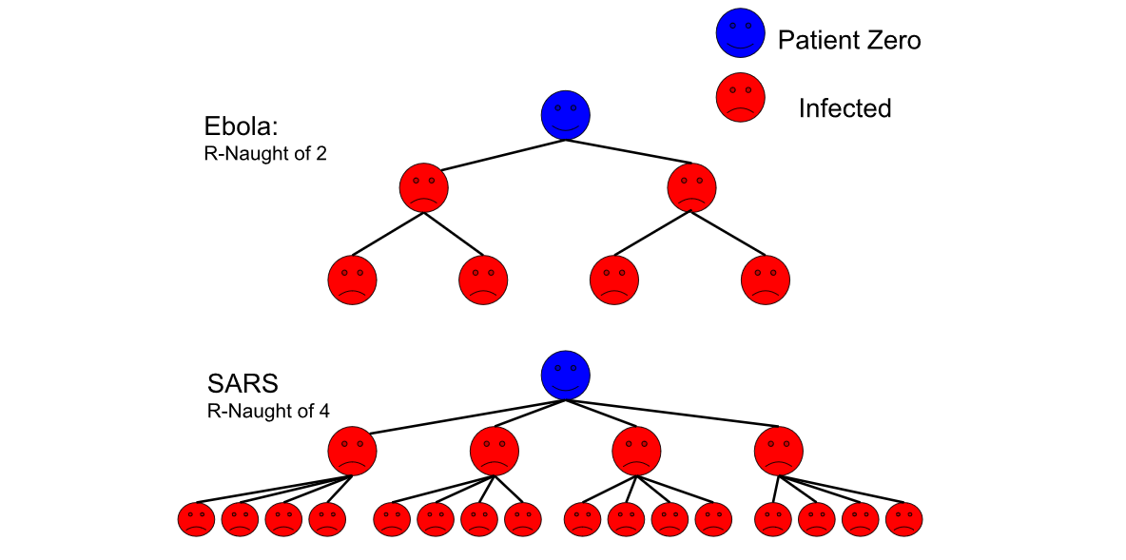
Basic Reproductive Rate (of an infection)
By KieraCampbell - Own work, CC BY-SA 4.0, https://commons.wikimedia.org/w/index.php?curid=79523883

Slide 46
Basic Reproductive Rate (of an infection)
https://www.cebm.net/wp-content/uploads/2020/04/KM-4.png

Slide 47
Net Reproductive Rate (of an infection)
Net Reproductive Rate
Reproductive rate if a part of the population is immune (because it survived the disease or was successfully immunized)
$N_{0}=\frac{R_{0}(100−n)}{100}$; $n=100−100\frac{N_{0}}{R_{0}}$ with
n: share of immune population (e.g. vaccination rate)
Herd Immunity: Resistance to the spread of a contagious disease within a population if a sufficiently high proportion of individuals are immune to the disease (N₀<1)
Covid-19
R₀=3
for N₀<1: n>67 %
Measles:
R₀=15
For N₀<1: n>93 %

Slide 48
Measles, vaccination barriers and religion

Slide 49
Resilience
https://academic.oup.com/cjres/article/3/1/27/339274?login=false

Slide 50
Resilience
https://academic.oup.com/cjres/article/3/1/27/339274?login=false

Slide 51
Resilience
https://academic.oup.com/cjres/article/3/1/27/339274?login=false

Slide 52
Resilience
https://academic.oup.com/cjres/article/3/1/27/339274?login=false

Slide 53
2 Demand for Health Services
2.1 Determinants of Demand: Overview
2.2 Demographic and Epidemiologic Transition
2.3 Epidemiology of Infectious Diseases
2.3.1 Background
2.3.2 Example: Malaria
2.3.3 Example: Covid-19

